Slide 1
SBS Quality Database Version 6.0 Overview
New features
Benefits

Slide 2
What’s new in 6.0
New features include:
Improved menu system
Improved dashboard
Improved CAR Process
configurable workflow controls
electronic signature approvals
Document the context of the organization
Risks and opportunities of interested parties
Fishbone diagram / cause and effect analysis
Environmental Health and Safety (EHS)
safety incident reports
job hazard assessments
hazardous waste tracking
Lessons Learned Register
New and improved reports
Minor bug fixes

Slide 3
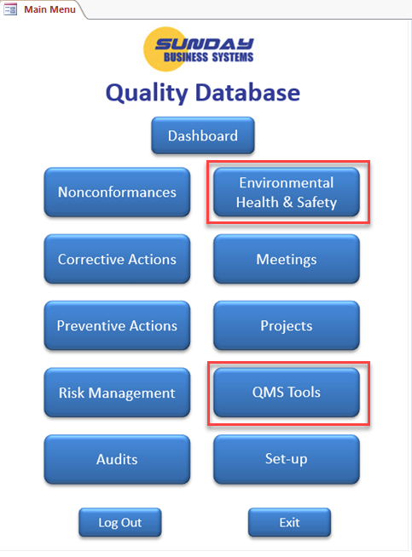
SBS Quality Database Version 6.0
2 new features added:
An Environmental Health & Safety (EHS) module
Safety Incident records and management
Job Hazard assessment
Hazardous material Transactions
EMS interested parties and organizational context
A QMS Tools module
Lessons Learned (register)
Context of the Organization
Fishbone or cause and effect diagram for problem-solving
Simple surveys
Additional bug fixes and enhancements are included

Slide 4
Environmental Health & Safety Module

Slide 5
Safety incident records and management

Slide 6
Job Hazard Assessment

Slide 7
Hazardous Material Transactions

Slide 8
EMS Context of the Organization

Slide 9
QMS Tools

Slide 10
Lessons Learned Register

Slide 11
ISO 9001 Section 4 Context of the Organization
Section 4.0 Context of the Organization
can be difficult to interpret, document, and demonstrate in an audit
We have made it very easy to comply with all the requirements of section 4
Requirement | Quality DB Feature
The organization shall determine external and internal issues that are relevant to its purpose | 
Determine the interested parties that are relevant to the quality management system | 
Define interested party requirements | 
Monitor and review each requirement | 
Document the scope of the quality management system | 
Apply risk-based approach to prioritize impacts | 

Slide 12
Context of the Organization, Interested Parties, Issues & Risk

Slide 13
Cause and Effect Diagram (Fishbone)

Slide 14
Simple Surveys

