Slide 1

SBS FMEA Database
FMEA Background
SBS Database Features and Benefits
SBS Database Set-up and Use

Slide 2

History
FMEA: Failure Mode and Effects Analysis
Was one of the first systematic techniques for failure analysis
Developed by reliability engineers in the 1950s to study problems that may arise from military system malfunctions
Further developed and adopted by the aerospace and automotive industries
Today, it is a standard technique for risk analysis and continual improvement

Slide 3

FMEA
An FMEA is often the first step of a system reliability study.
It involves reviewing as many components, assemblies, and subsystems as possible to identify failure modes, and their causes and effects.
FMEA begins during the earliest stages of design and continues throughout the life of the product or service.
You can use the FMEA Tool in two separate, but related ways:
Analyze the current process and evaluate the potential impact of changes under consideration
Track improvement over time

Slide 4

Reduce Risk and Improve Performance
The FMEA is a simple business process:
Anticipate: what can go wrong?
Prioritize actions to
Reduce the severity or impact of an adverse event
Decrease the frequency of an adverse event
Increase the delectability of an adverse event
Complete the actions in a timely fashion
Re-evaluate the process / product / service in light of
New data
Improved processes
New processes

Slide 5
FMEA Process Flow
Assemble the Team
Inputs
Process Experience
Map the process
Customer Feedback
Field Failure Data
Identify the
failure modes
Yield / Rework Data
Inspection Results
Determine the
Effects and Severity Rating
Gauge R&R
Complete Actions and
Re-compute RPN
Identify the Cause
and Occurrence Rating
Management review
and approval
Analyze the current
controls and determine
Detection Rating
Determine actions to
Reduce each RPN

Slide 6
The FMEA Process
Assemble a cross-functional team of people with diverse knowledge about the process, product or service and customer needs.
Identify the scope of the FMEA.
for Safety, concept, system, design, process, or service?
Identify the items: process steps, components, subsystems, parts, assemblies
For each item, identify the possible failure modes
What could go wrong?
Identify all the consequences or effects of each failure mode
Determine the Severity of each failure mode
rate it on a scale of 1-10 where 1 is not severe and 10 is extremely severe
Determine all the potential root causes

Slide 7
The FMEA Process
For each cause, determine the Occurrence rating
occurrence estimates the probability of the failure occurring
rate it on a scale of 1-10 where 1 is infrequent and 10 is commonplace
Identify current process controls for each cause
Determine the Detection rating based on the effectiveness of the current process controls
rate it on a scale of 1-10 where 1 is highly detectable and 10 is not detectable
Calculate the risk priority number, or RPN
RPN = [Severity] × [Occurrence] × [Detection]
Rank Failure modes according to the estimated risk factor (RPN)
Identify actions to lower the severity and occurrence, and / or add controls to improve detection.
Actions are assigned to owners, completed, validated and closed
Risk factors (Severity, Occurrence, and Detection) are then re-evaluated after remedial action has been completed

Slide 8

Traditional Methods
Paper forms
Excel Spreadsheets
Problems
Difficult to work collaboratively
Difficult to audit
No user based restrictions to protect data integrity
Difficult to manage
No concise reports for actions due
Poor visibility to FMEA effectiveness

Slide 9


SBS FMEA Database Advantages
Easy to use
Collaborative platform
Simple, menu driven user interface
Easy to train users
Convenient, intuitive forms
Can restrict users to control data integrity
Rich set of reports
Easy to identify delinquencies, stalled actions
Reports may be emailed with a single click
Export data to Excel for further analysis
Built using Microsoft Access
Common, convenient software platform
Runtime version of Access is available as a free download

Slide 10
SBS FMEA Database
Using the SBS FMEA Database

Slide 11
Key Features
List items, process steps, or functions
Identify Failure Modes for each
Identify effects and severity
Identify causes and frequency
Identify current controls and detection level
Develop multiple actions associated with this failure mode
Assign owners and due dates
Establish verification and validation criteria
Electronic signature for management approval
Rich set of reports
Track open actions and delinquent due dates

Slide 12
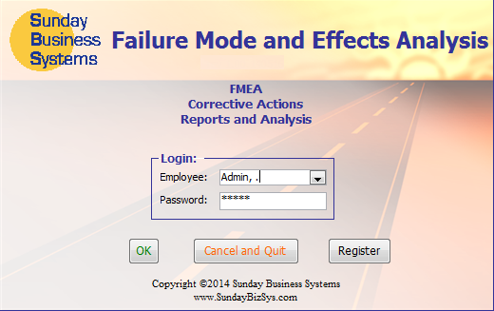
Login Screen
The login process limits access to the database features
Password is required
Privileges may be restricted to protect data
The Demo version includes dummy data and employees
Admin is the default login for demo versions
Admin has full Database privileges
Employee: Admin
Password: admin
All other employees: password = pw

Slide 13
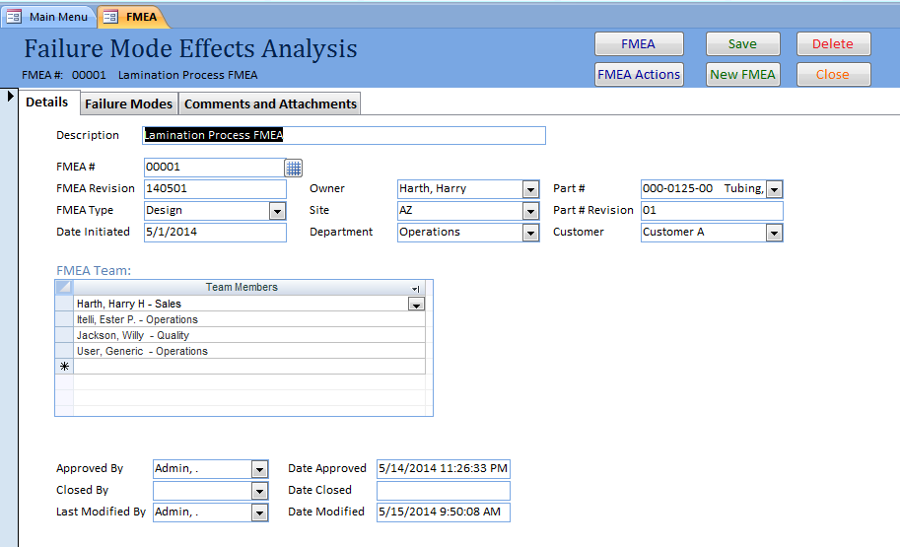
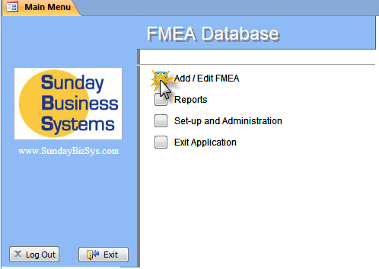
FMEA form - Details
Data Organized into 3 tabs
FMEA details determine
the type and scope
Define the Team
Approvals and edits

Slide 14
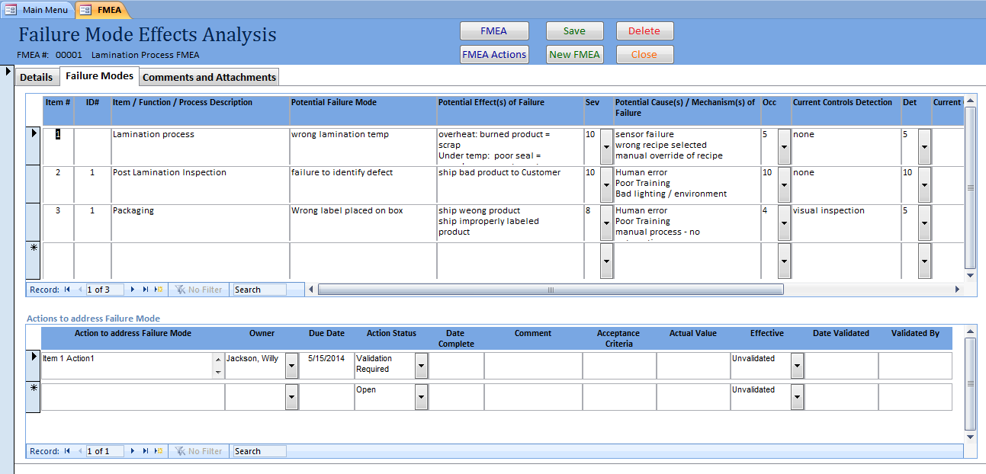
FMEA Form – Failure Modes and Actions
Actions include acceptance criteria and validation
For each Failure mode, you may create any number of actions to reduce the RPN

Slide 15
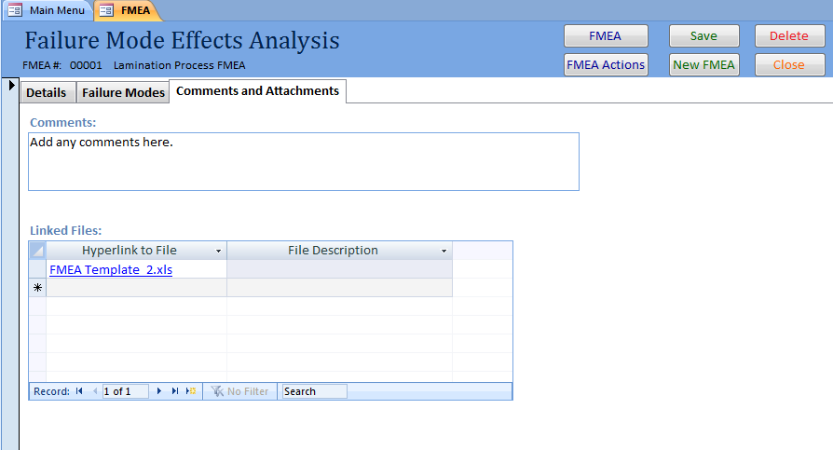
FMEA Form – Comments and Attachments
Supporting documentation may be linked to the FMEA

Slide 16
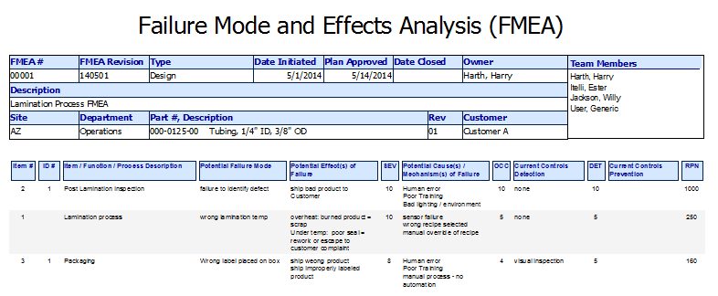

FMEA Form - Reports

Slide 17
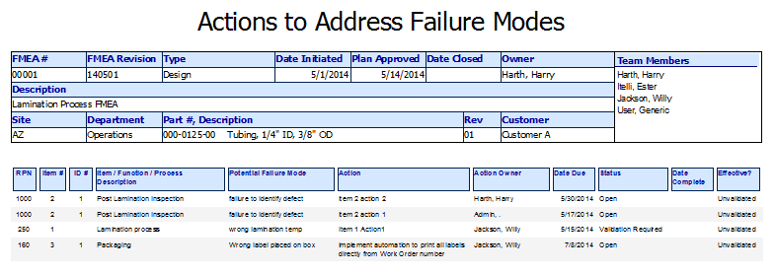
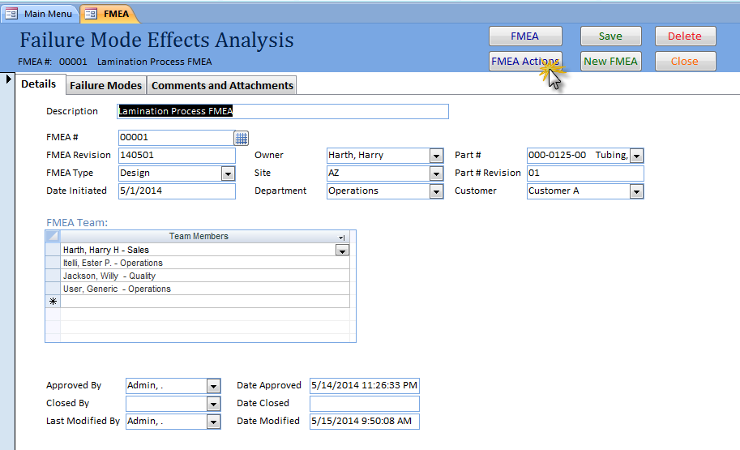
FMEA Form – Reports (FMEA Actions)

Slide 18
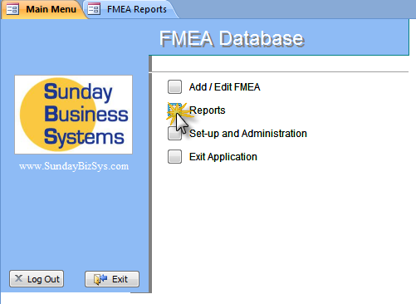
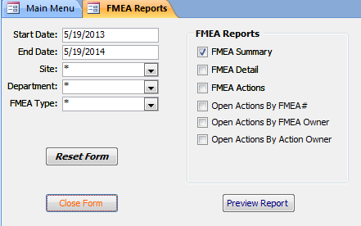
Reports and Analysis
Reports and analysis
Report filters

Slide 19
Set-up and Configuration
FMEA Database Set-up and Configuration

Slide 20
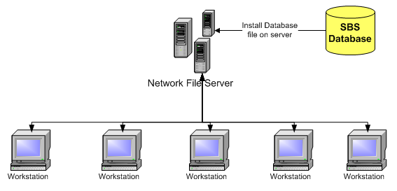
Easy Installation
Download the demo database
Save or copy the FMEA.accde file to a designated folder on your Network File Server
Once purchased, register the demo database (enter the Product Key)
Ensure all Workstations have
Microsoft Access or the free Runtime version of Microsoft Access
Read and write privileges to the designated folder on the Network File Server
Note: The above graphic is for stand alone Access databases - SQL configurations are different

Slide 21

Database Set-up
Enter Employees
Enter password if employee login is required
Detail employee login privileges
Enter Company information
Company name, address, etc.
Sites
Departments
Customers
Parts
Edit FMEA Types and RPN Ratings
FMEA Types
Severity
Occurrence
Detection

Slide 22
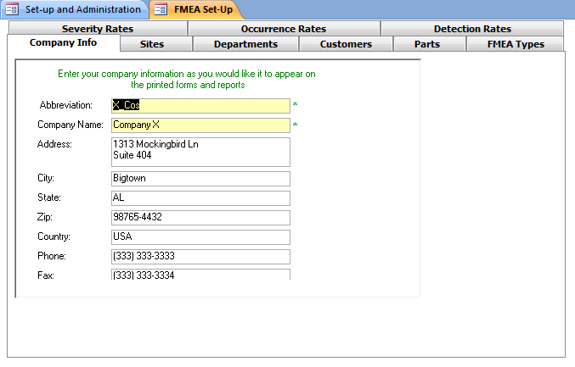
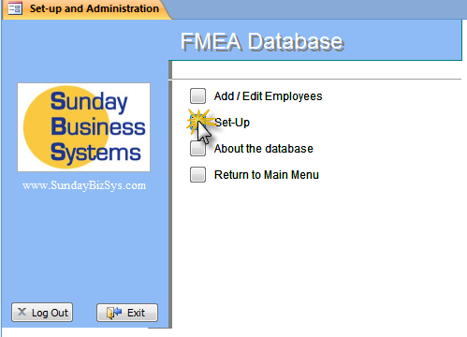
Set-up Parameters
Set-up parameters are organized into multiple tabs

Slide 23
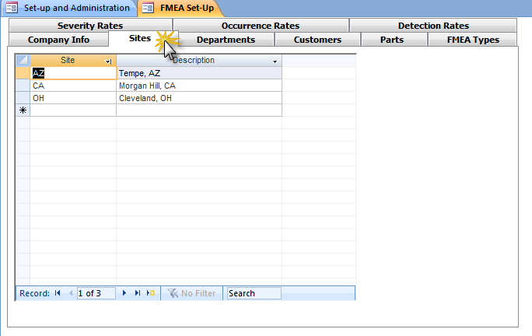
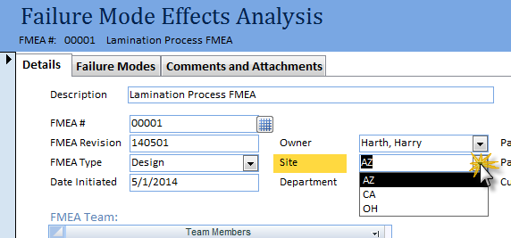
Set-up Parameters - Sites
Used in Site list

Slide 24
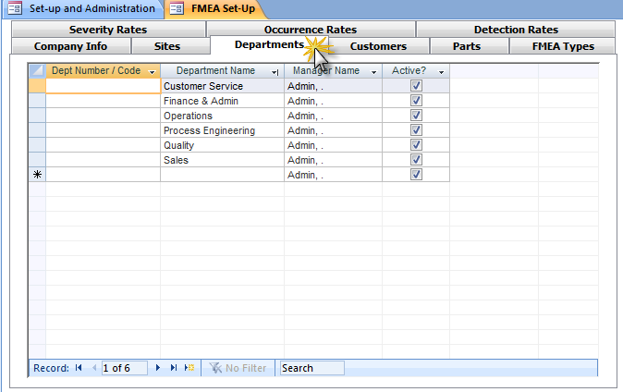
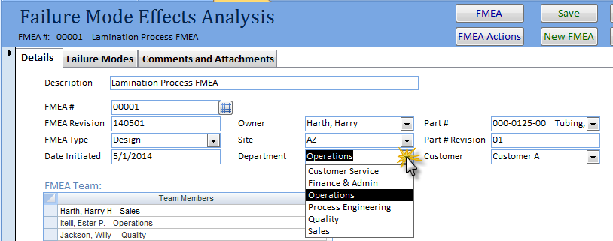
Set-up Parameters - Departments
Used in Department list

Slide 25
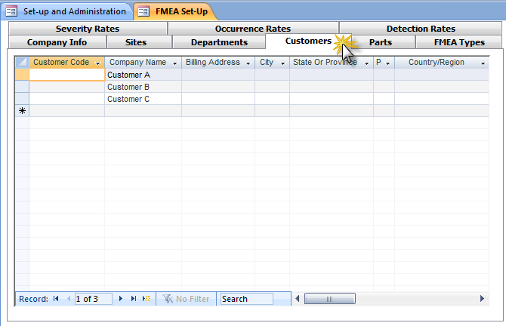
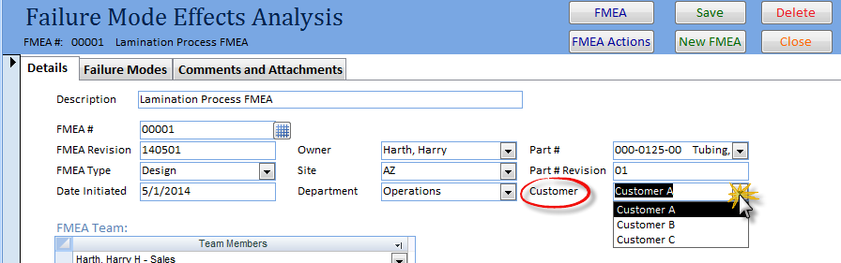
Set-up Parameters - Customers
Used in Customer list

Slide 26
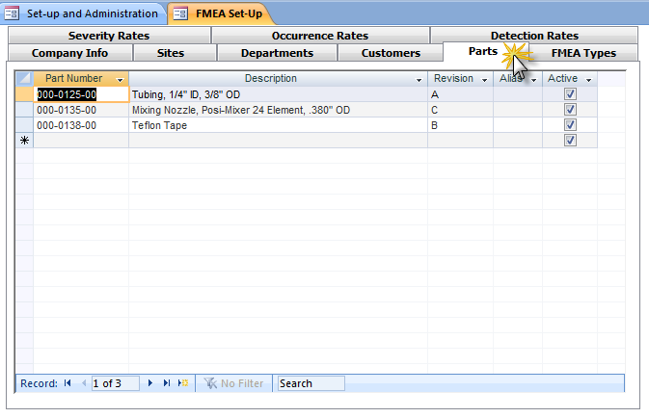
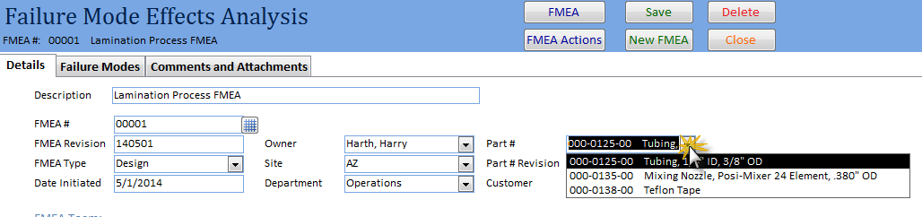
Set-up Parameters - Parts
Used in Parts list

Slide 27
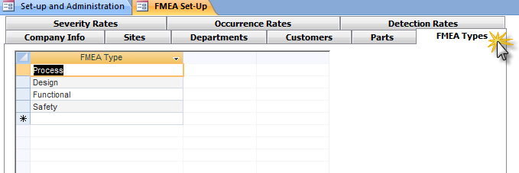
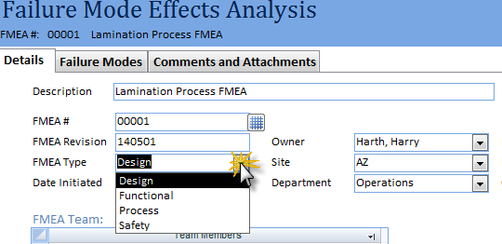
Set-up Parameters – FMEA Types
Used in FMEA Type list

Slide 28
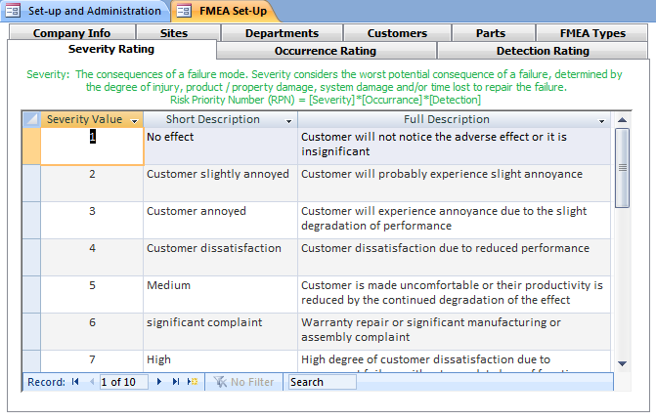
Set-up Parameters – Severity Rating
Customizable
For example: change scale from 1-10 to 1-3
Short description shows in Severity List

Slide 29
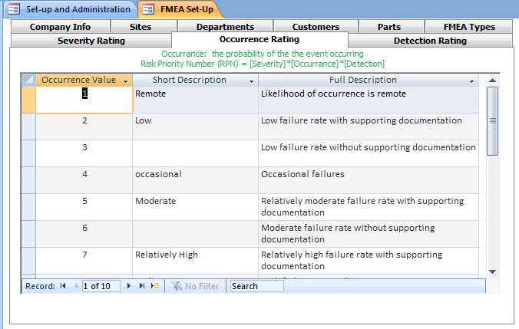
Set-up Parameters – Occurrence Rating

Slide 30
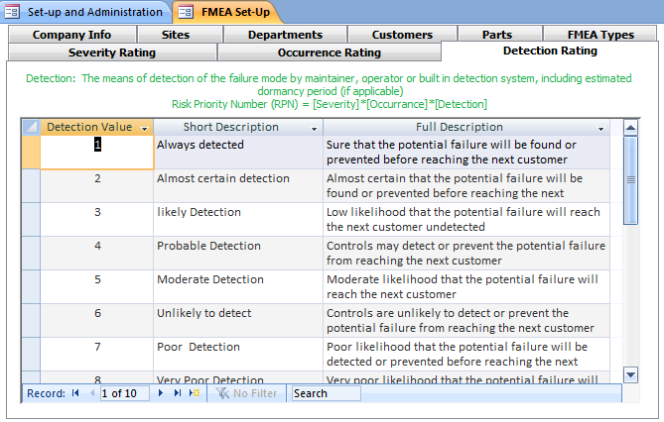
Set-up Parameters – Detection Rating

Slide 31
Overall Risk Management Strategy
SWOT Analysis
FMEA
Corporate Vision
Product Design
Sales / Marketing
Strategy
Project
Planning
Manufacturing
Process Design
Competitive Analysis
Manufacturing
Process

Slide 32
Summary
The SBS FMEA Database is a cost effective tool to
Ensure effective compliance with OSHA and Quality Standards
ISO 9001:2008
AS 9100
TS 16949
ISO 14001
ISO 13485
Develop and execute Risk Reduction plans
Maintain paperless quality records
Analyze performance and develop improvement strategies
Save time and effort
Customization is available
Talk to us about customizing the software to meet your needs!

Slide 33
Additional Services
Data Import Service
Import legacy data from excel spreadsheets into your Database
Training Services
SBS offers instructor led, Webex based, interactive training sessions
We cover the following subjects:
Vendor Management Database features and benefits
General set-up and configuration
Creating Qual plans / requirements
Creating Qualifying Vendors
Using reports to manage the qualification process
Microsoft Access tips and tricks
Customization
Talk to us about customizing the software to meet your needs!
Contact Sales@sundaybizsys.com for more information

Slide 34
About SBS
Sunday Business Systems provides cost effective software for your Quality Management System
Corrective and Preventive Actions (CAPA)
Audit management
Employee Training
Document Control
Control of calibrated equipment
Vendor management
Customer Satisfaction Surveys
Communication / Continual improvement
Shop Floor Control
SBS will customize the software for your particular needs
Offers instructor led training services

Slide 35
Sunday Business Systems
Fueling Small Business Efficiency
Visit www.SundayBizSys.com for:
Free product demos
Additional information
Pricing
Links to purchase software
© 2014 Sunday Business Systems. All rights reserved. This presentation is for informational purposes only. Sunday Business Systems MAKES NO WARRANTIES, EXPRESS OR IMPLIED, IN THIS SUMMARY. Microsoft is a registered trademark of Microsoft Corporation in the United States and/or other countries.

