Slide 1

The SBS Quality Database
Features and Benefits
Introduction and Tutorial
www.SundayBizSys.com
Fueling Small Business Efficiency
Notes:
Windows Small Business Server
11/26/25 21:45
© 2006 Microsoft Corporation. All rights reserved.
This presentation is for informational purposes only. Microsoft makes no warranties, express or implied, in this summary.
<number>

Slide 2

Background
Quality management standards require many things, including
  Defining Context of the Organization
  Corrective Actions
  Nonconformance management
  Internal Audits
  Management reviews
  Risk based thinking
  ISO 9001:2015 “The Organization shall continually improve the effectiveness of the quality management system through the use of…audit results, analysis of data, corrective and preventive actions, and management review.”

Slide 3






Background
The SBS Quality Database was created to make it easy to comply with quality management standards
And for OSHA compliance

Slide 4
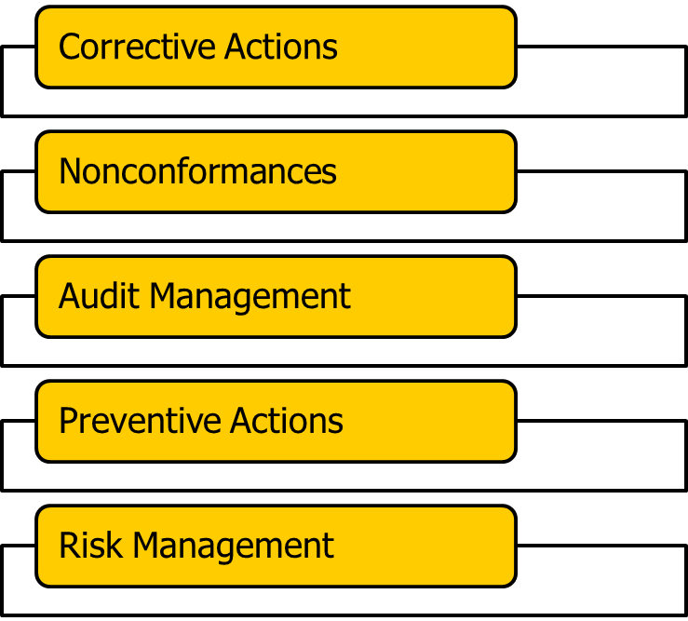
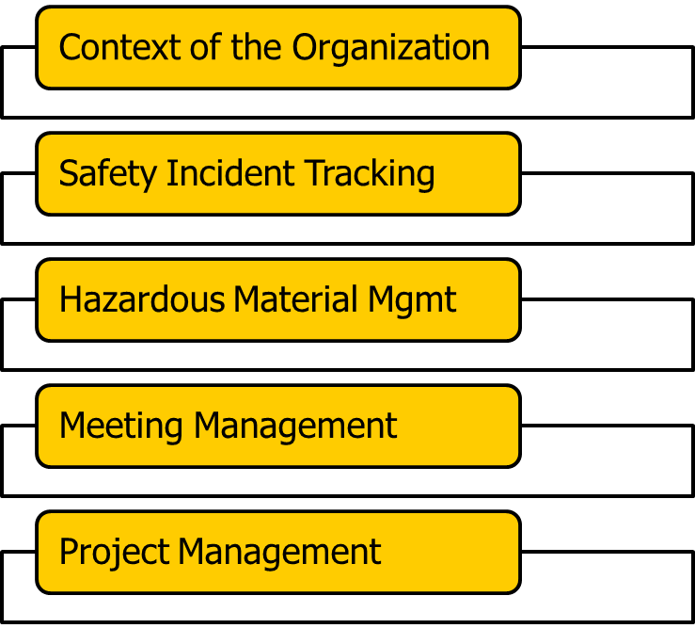
Quality Database Features
The Quality Database is a multipurpose application covering many different QMS / EMS requirements
Notes:
Windows Small Business Server
11/26/25 21:45
© 2006 Microsoft Corporation. All rights reserved.
This presentation is for informational purposes only. Microsoft makes no warranties, express or implied, in this summary.
<number>

Slide 5

Quality Database Features
Nonconformance Tracking
Corrective Actions (CA)
  Safety Corrective Actions
  Supplier Corrective Actions
  Internal Audit Corrective Actions
Preventive Actions (PA)
Risk Management (FMEA & SWOT)
Audit Management
  Record and track audit findings
  Manage Audit Schedules
Meeting Manager (communication and Management Review)
Project Management
QMS tools
  Lessons Learned
  Context of the Organization (with Risk analysis)

Slide 6
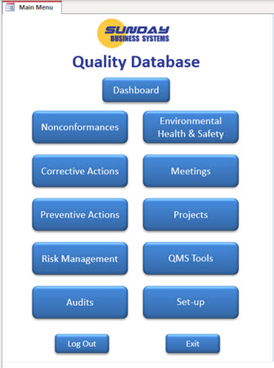
Simple, Efficient User Interface
Dashboard
  Overall performance at a glance
All modules clearly displayed
Data entry in simple forms
Reports for further analysis
  Configurable reports
  Email reports with a single click
  Export data to excel, word, or PDF
Notes:
Windows Small Business Server
11/26/25 21:45
© 2006 Microsoft Corporation. All rights reserved.
This presentation is for informational purposes only. Microsoft makes no warranties, express or implied, in this summary.
<number>

Slide 7
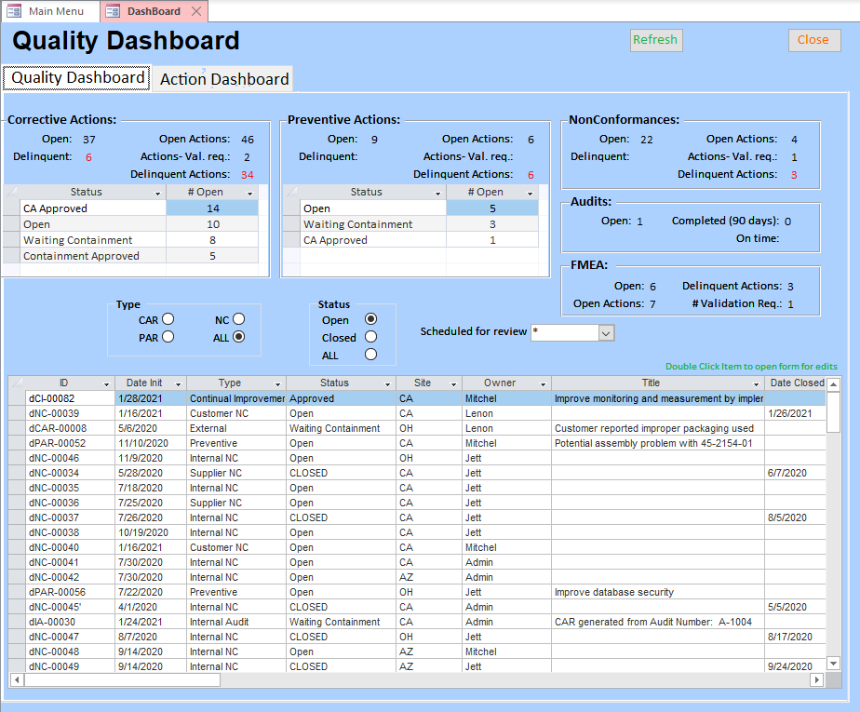
Dashboard Summary of Key Performance Indicators

Slide 8
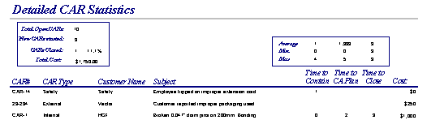
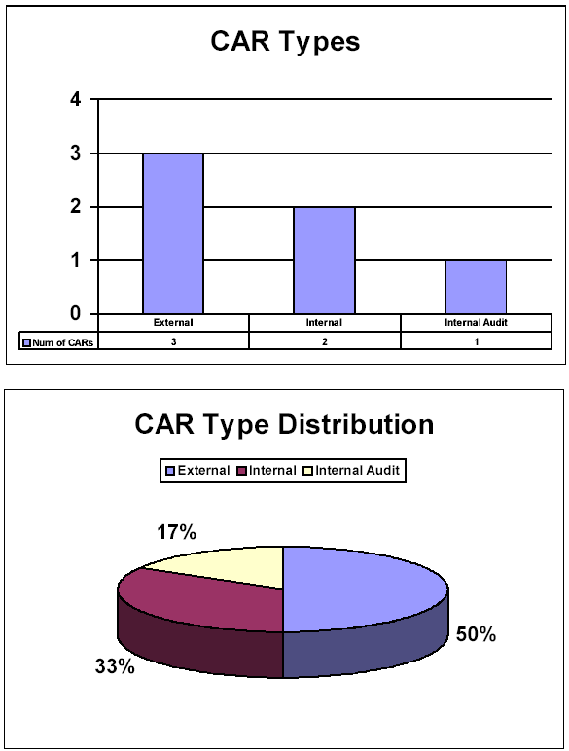
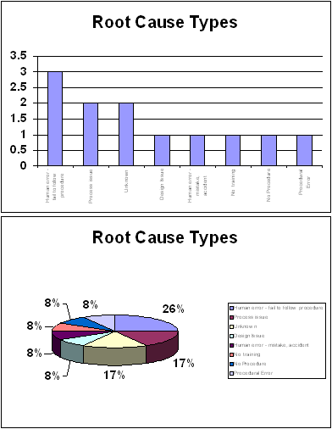
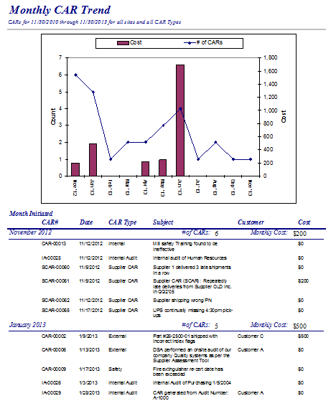
Analysis Tools
Wide variety of detailed reports
Charts, graphs, Pareto analysis
Quality Performance metrics
Notes:
Windows Small Business Server
11/26/25 21:45
© 2006 Microsoft Corporation. All rights reserved.
This presentation is for informational purposes only. Microsoft makes no warranties, express or implied, in this summary.
<number>

Slide 9

Features - continued
Locally installed or cloud-based solutions
User privileges allow access only to designated modules
Link electronic documents, pictures, pdf files, Customer email
Simple set-up
  Enter employee names, passwords, and access levels
  Enter Company information
  Enter Company locations or sites and departments
  Enter CAPA categories (i.e. functional groups within your organization)
  Enter Nonconformance defect categories
  Enter list of root cause categories
  Start using the program!!!
Notes:
Windows Small Business Server
11/26/25 21:45
© 2006 Microsoft Corporation. All rights reserved.
This presentation is for informational purposes only. Microsoft makes no warranties, express or implied, in this summary.
<number>

Slide 10



3 platforms available
Access Stand-Alone Version
  Single database file saved on your network file server
  Based on Microsoft Access
    Access license not required
    free runtime version of Microsoft Access is available
SQL version
  Access front-end / SQL back-end
  Affords better data security and reliability
In the Cloud
  SBS Quality Database accessible from any internet enabled device
Notes:
Windows Small Business Server
11/26/25 21:45
© 2006 Microsoft Corporation. All rights reserved.
This presentation is for informational purposes only. Microsoft makes no warranties, express or implied, in this summary.
<number>

Slide 11

Benefits
Complies with requirements of
  ISO 9001:2015
  AS9100
  ISO/TS 16949
  ISO 13485
  API Q1
  ISO 14001
Provides a concise electronic record of historical events, actions, and improvements
  No paper to get lost - No paper files to search
Efficiently maintains quality records
    Management reviews
    Internal audits
    Corrective Action results
    Risk Analysis results
    Context of the Organization and Interested Parties
    Health
Improves Customer Satisfaction
  Rapidly report results or CARs / Nonconformances to Customers
    Email report directly from the database
  Stay on top of key Customer issues
  Rebuild customer confidence when things go wrong
  Analyze Customer perceptions and how they change over time
Notes:
Windows Small Business Server
11/26/25 21:45
© 2006 Microsoft Corporation. All rights reserved.
This presentation is for informational purposes only. Microsoft makes no warranties, express or implied, in this summary.
<number>

Slide 12
Benefits
The best value in QMS software
  Simple, low cost solution
    One-time license fees
    Concurrent user licensing – not CPU based
    Free runtime version of Access is available
    Optional support subscription
  Minimal training is required
  Saves time and improves efficiency
Reports and analysis
  Managers get immediate answers
    How many CARs are open and why?
    Who has open actions?
  Email reminders for open actions
Develop agendas for meetings
Utilizes a proven method of Corrective Action
Organize and track results of management review meetings

Slide 13
Introducing the Quality Database

Slide 14

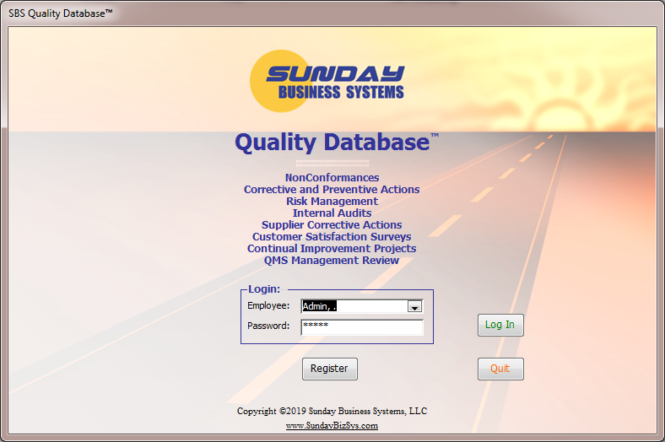
Login Screen
The login process limits access to the database modules
The Demo version includes example data that may be modified
  Admin is the default login for demo versions (unregistered)
  Admin has full Database privileges
    For the demo database,
      Employee: Admin
      Password: admin
      All other employees password = pw

Slide 15
Form Basics
Yellow fields indicate that data is required prior to saving a record
Buttons are color-coded
  Blue is for reports
  Green is for saving or adding a new record
  Black is a special function which varies from button to button
  Orange is to close a form or menu
The Datasheet button displays the form data like a spreadsheet
  Double-click any record in datasheet view to return to form view and display that particular record
“*” Indicates that a double-click performs a special function
  such as opening a supporting form or inserting today's date
Use Ctrl-F To search for a particular string
  The search field at the bottom of the form May also be used
Record navigation is at the lower left-hand corner of each form

Slide 16
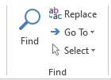
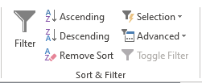

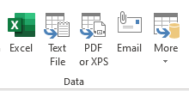
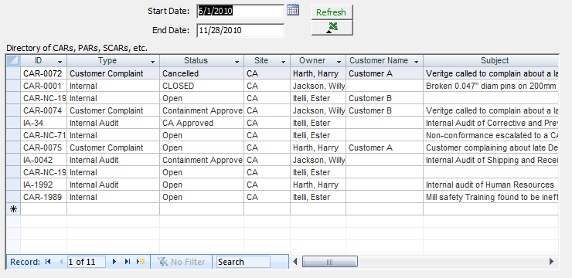
Handy Features
Forms may be
  Searched
  Sorted
  Filtered
  Export data
  Spell check
Directory
  Lists a summary

Slide 17
Corrective Action Requests
Background: The 8D problem solving process
Create a CAR
Review reports
Measure effectiveness

Slide 18
Types of Corrective Action Requests
Internal
  Originated from within the company
External
  Originated from outside source like a regulatory body or potential Customer
Customer complaint
  Defective product shipped to Customer
  Late delivery
Audit
  Internal / 3rd party / Customer audit findings
Safety
  Safety incident resolution
  OSHA compliance
Supplier
  Vendor or supplier failing to perform to specification
  Late deliveries, defective parts

Slide 19
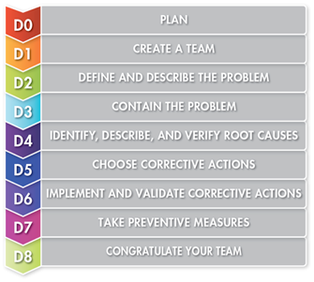
The 8D Problem Solving Process
QDB Workflow
Open / Waiting Containment
D0 – D3
Containment Approved
D3
Corrective Action Plan Approved
D4 – D5
Closed
D8

Slide 21
CAR Workflow & Status
Process
CAR / PAR Status
Exceptions
Status
Notes:
Windows Small Business Server
11/26/25 21:45
© 2006 Microsoft Corporation. All rights reserved.
This presentation is for informational purposes only. Microsoft makes no warranties, express or implied, in this summary.
<number>

Slide 22
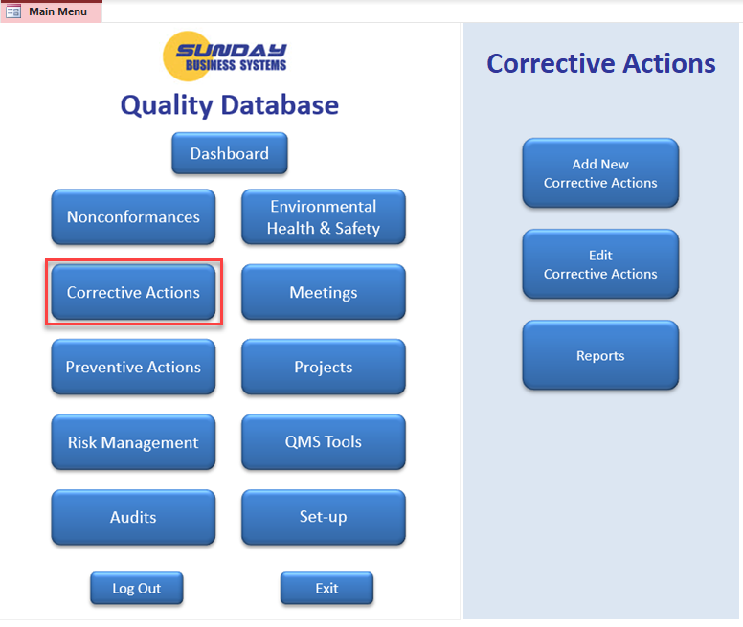
Corrective Actions Menu

Slide 23
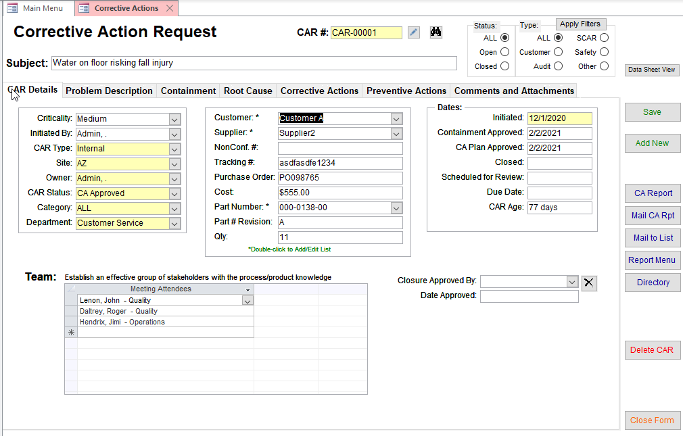
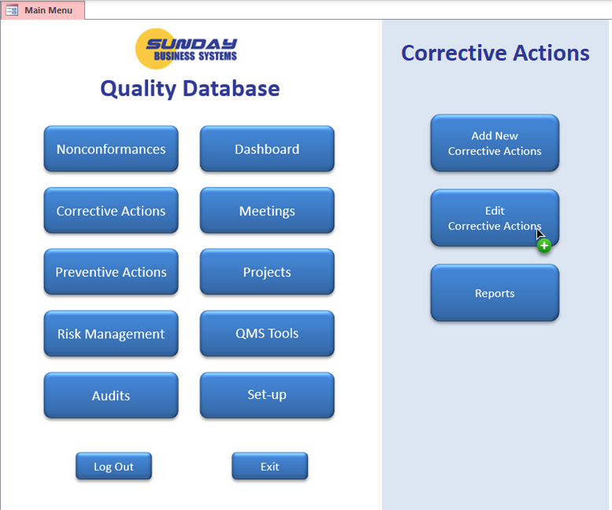
Corrective Actions Form
Filter the form to display specific data
Information organized into 7 tabs
Yellow fields are required
Control buttons

Slide 24
CAR Form – CAR Details
Click to Automatically number the CAR

Slide 25
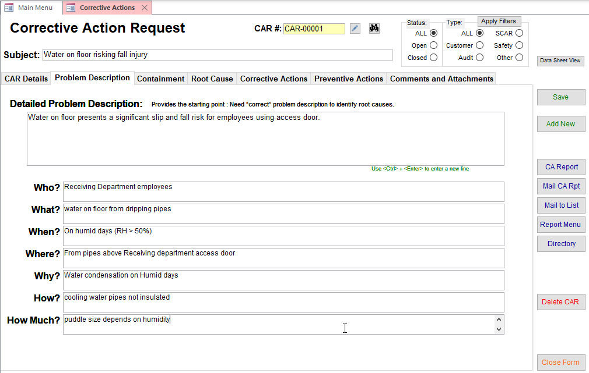
CAR Form– Problem Description
Supports 5w2H problem description

Slide 26
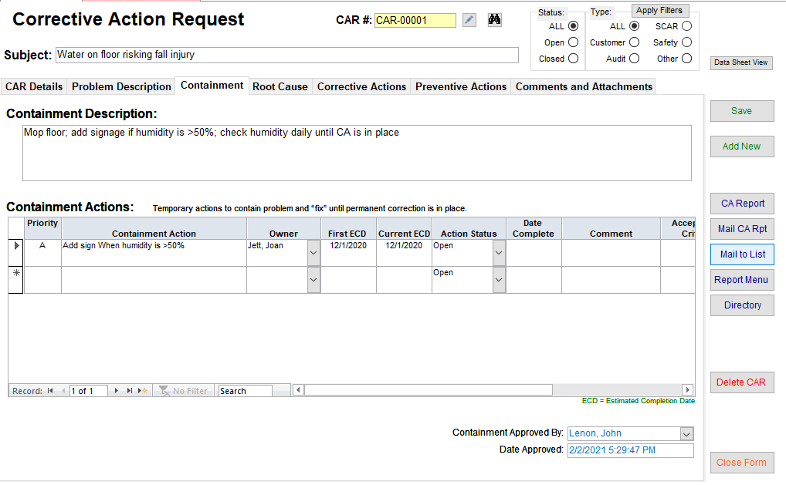
CAR Form – Containment
General containment description
Specific containment actions with verification and validation
Electronic Signature to approve Containment

Slide 27
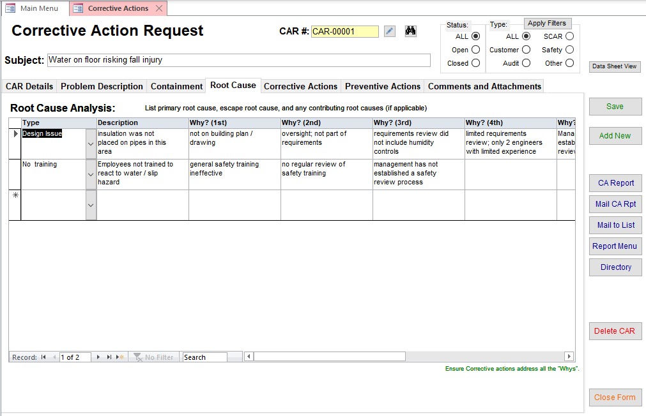
CAR Form – Root Cause Analysis
Ask why?, why?, why?, why?, why? to determine the real cause
Supports multiple root causes: Primary, contributing, and escape
Type allows pareto chart analysis

Slide 28
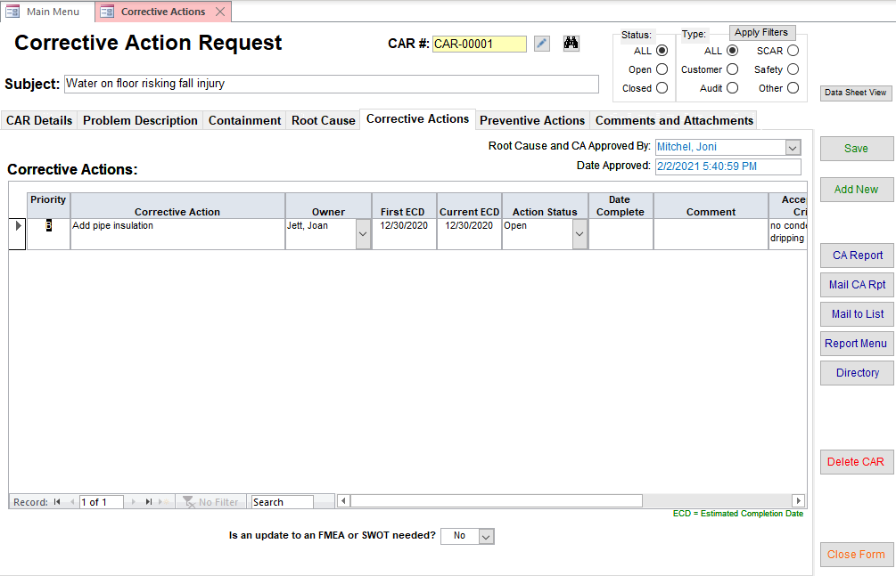

CAR Form - Corrective Actions
Detailed actions with verification and validation
Corrective Action Plan approval (e-sig)

Slide 29
Corrective Actions
Record multiple Corrective Actions for each CAR
Assign owners and due dates
Verify and validate
  Was the action implemented
  Was the intended outcome effective in addressing the root cause
  Ensure the problem will not re-occur
Each Action has an
  Owner
  ECD – Estimated Completion date
    First ECD – original ECD (does not change)
    Current ECD – may be changed to reflect work load
  Status – see corrective Action Life Cycle
  Date complete
  Comment – used to explain current status
  Acceptance criteria
  Actual value (did value meet or exceed acceptance criteria?)
  Was the action effective (Effective or Ineffective?)
  Validated By: name and date

Slide 30
Verification and Validation
Verification
  Documented by approving the corrective action plan
  Should require management review and approval
Upon completion, each action must be validated
  Validation / Acceptance Criteria
    Defines pass / fail criteria
    For example:
      99% of all parts measure < 15mm
      Document XX version 02 released on 4-May-2006
      Training records updated and reviewed
  Actual Value
    the observed or actual value
  Record who validated the action, when, and definitively state that the action was effective (or not)

Slide 31
Examples of Actions with Validation

Slide 32
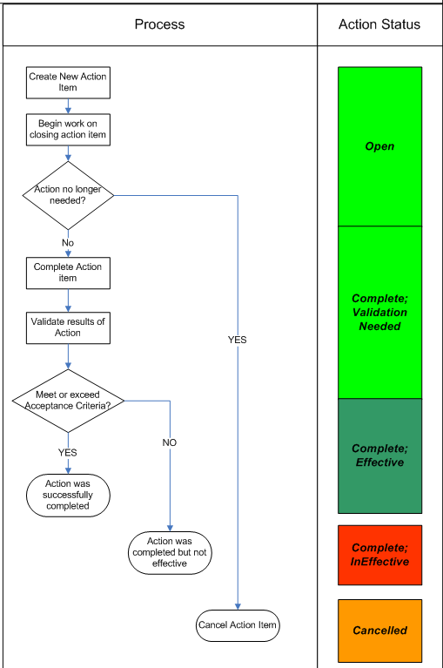
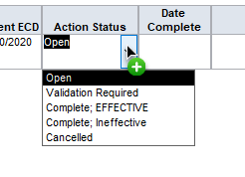
Action Work Flow
The Action Status drives accountability
Make use of reports for Open Actions by Owners
Keep CARs on track
Notes:
Windows Small Business Server
11/26/25 21:45
© 2006 Microsoft Corporation. All rights reserved.
This presentation is for informational purposes only. Microsoft makes no warranties, express or implied, in this summary.
<number>

Slide 33
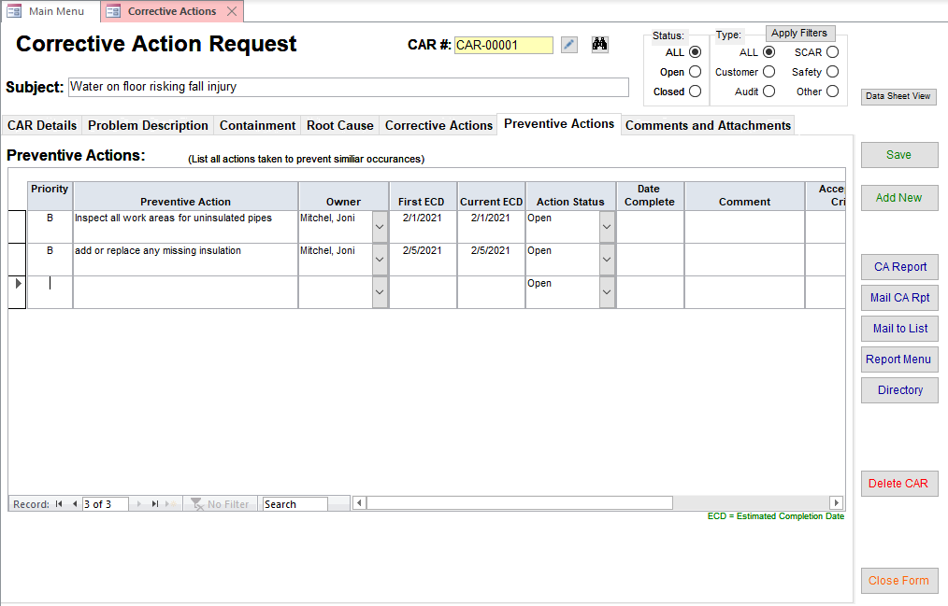
CAR Form – Preventive Actions
Preventive actions with verification and validation

Slide 34
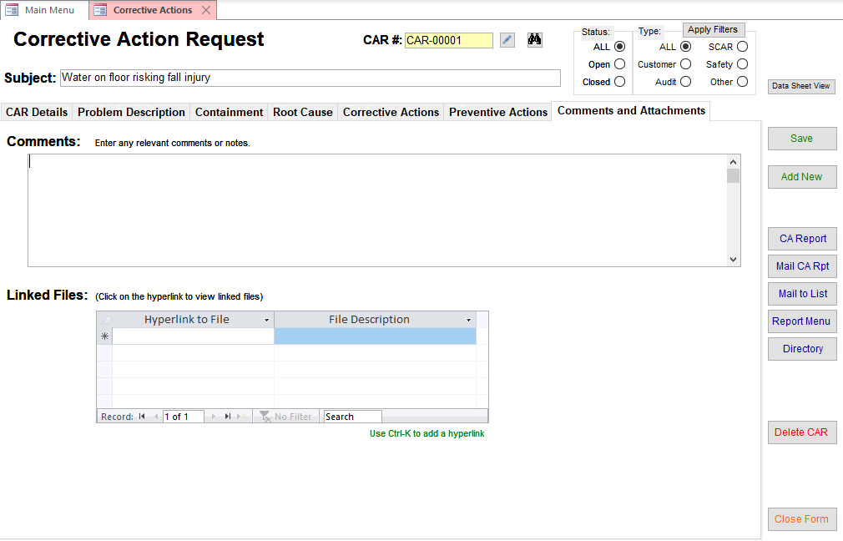
CAR Form – Comments and Attachments
Add comments including customer feedback
Link any number of electronic files such as pictures, customer emails, etc.

Slide 35
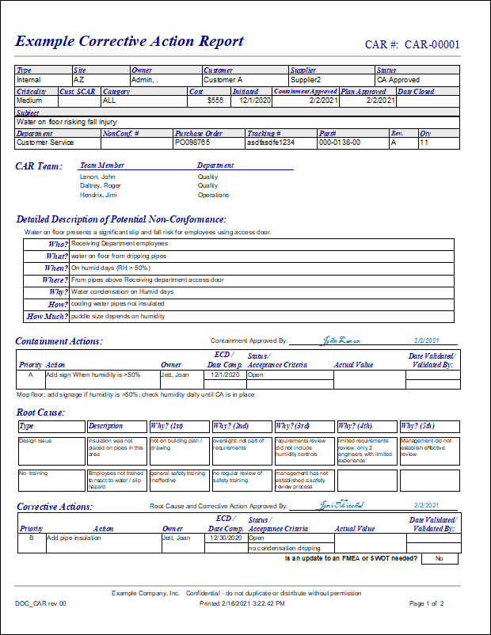
Professional Reports
Print or email the CAR report directly to the Customer

Slide 36
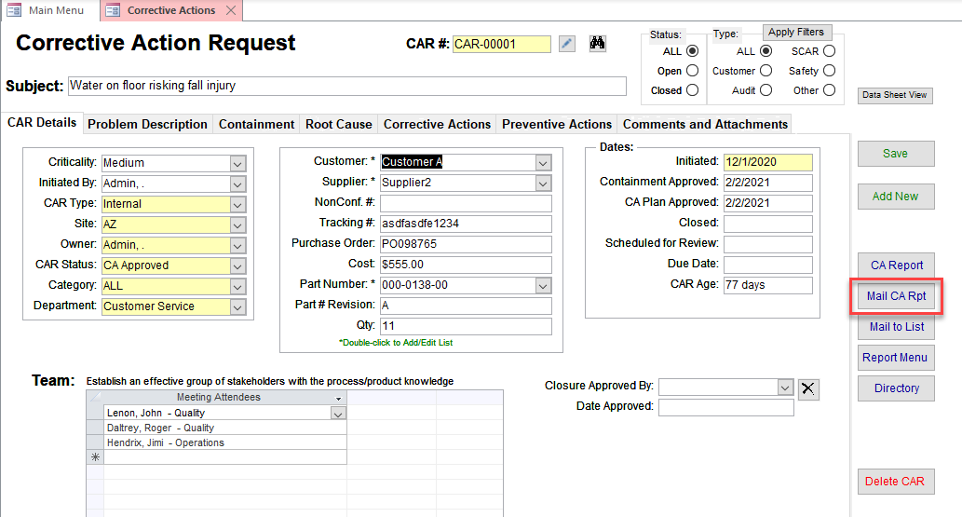
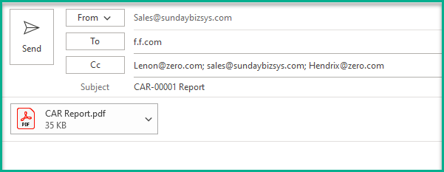
Email CA Report – Mail CA Rpt
“CAR approvals” email List
(see set-up)
CAR Owner’s email address

Slide 37
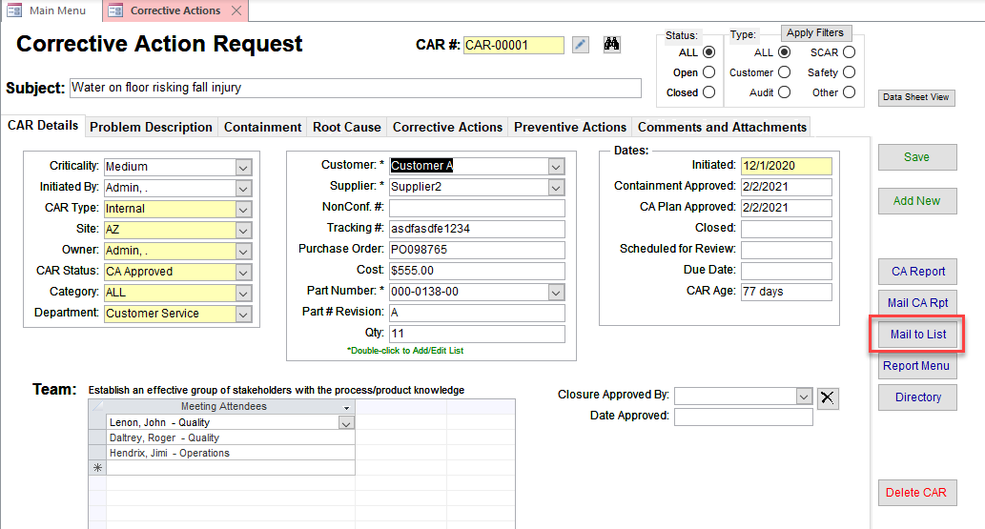
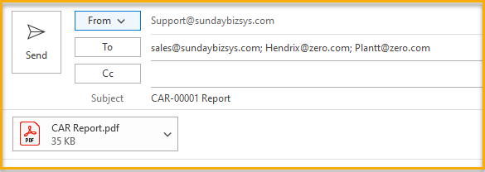
Email CA Report – Mail to List
From “CAR approvals” email List
(see set-up)

Slide 38
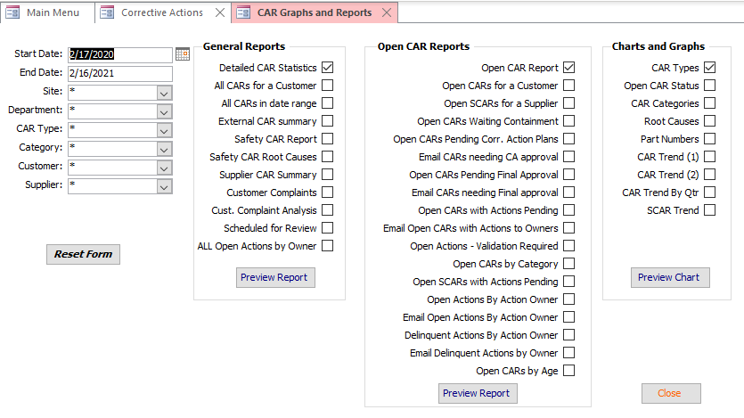
CAR Reports
More than 35 reports, charts, and graphs for analysis
Apply filters to reports
Note: Not all filters apply to all reports

Slide 39
Preventive Actions
For want of a nail, the shoe was lost,
For want of the shoe, the horse was lost,
For want of the horse, the rider was lost,
For want of the rider, the battle was lost,
For want of the battle, the kingdom was lost,
And all for the want of a horseshoe nail!
PARs use the same process and similar forms as CARs

Slide 40
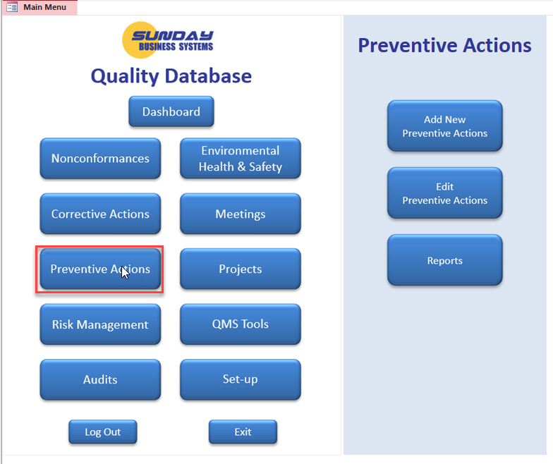
Preventive Actions
PARs are very similar to CARs
  Used for purely potential nonconformances
  Ideal for Safety improvements, mistake-proofing activities

Slide 41
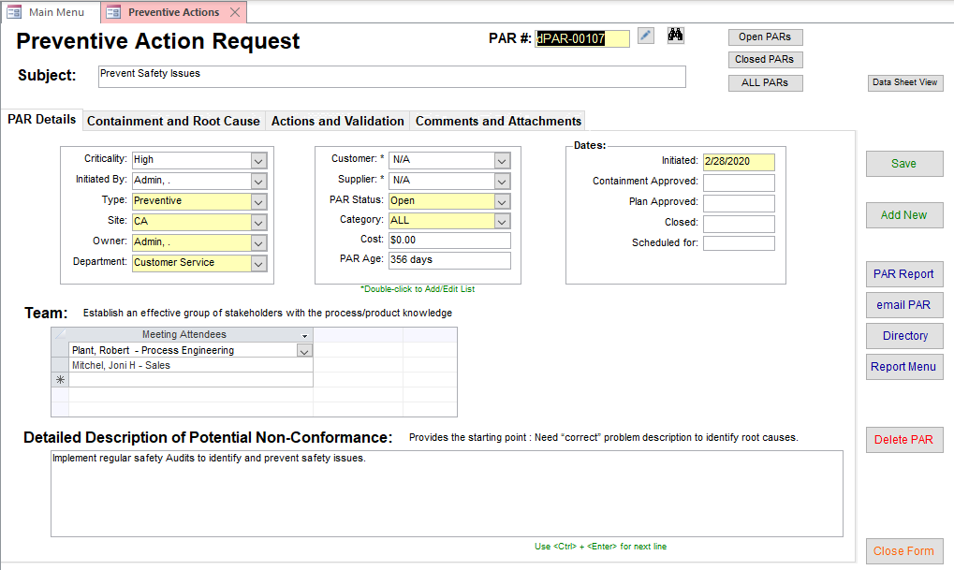
Preventive Action Form – PAR Details
Filter the form to display specific data
Information organized into 4 tabs
Yellow fields are required
Control buttons

Slide 42
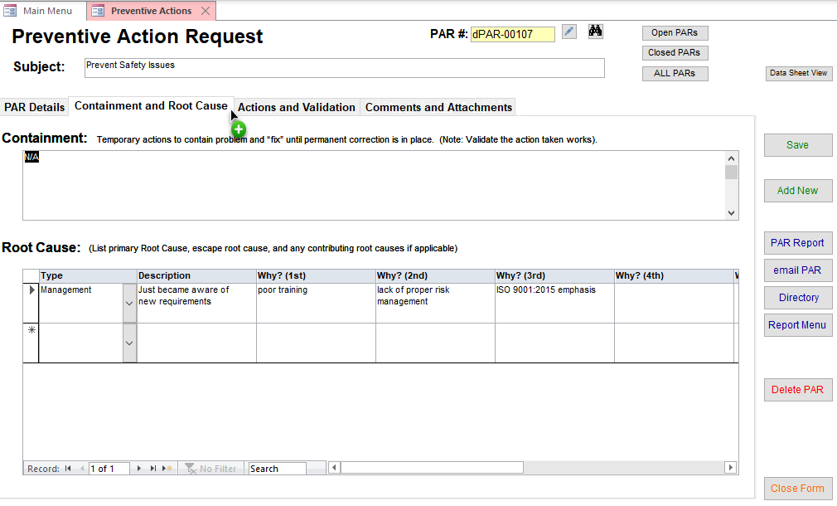
Preventive Action Form – Containment and Root Cause

Slide 43
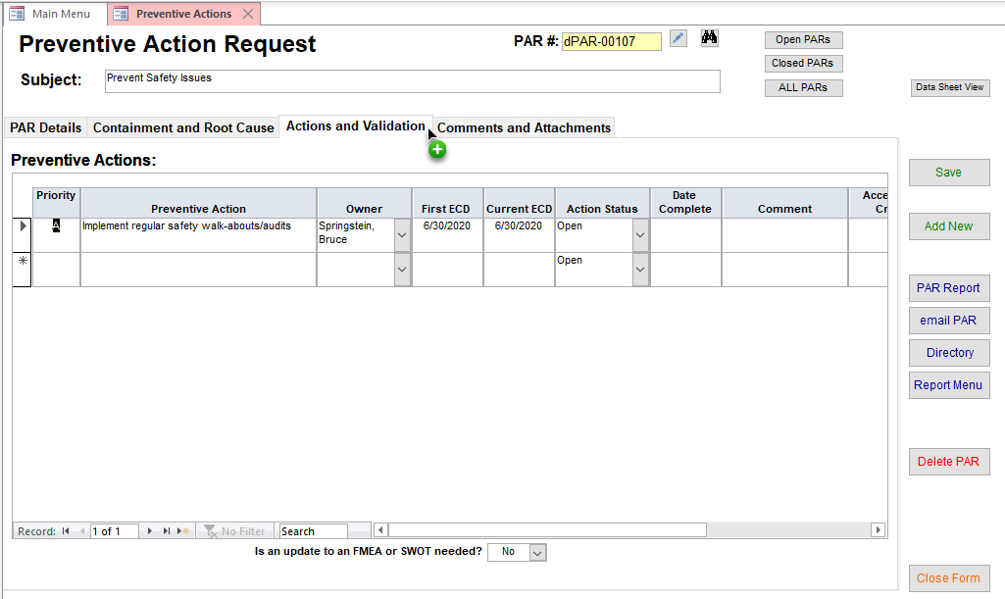
Preventive Action Form – Actions and Validation
Preventive actions with verification and validation

Slide 44
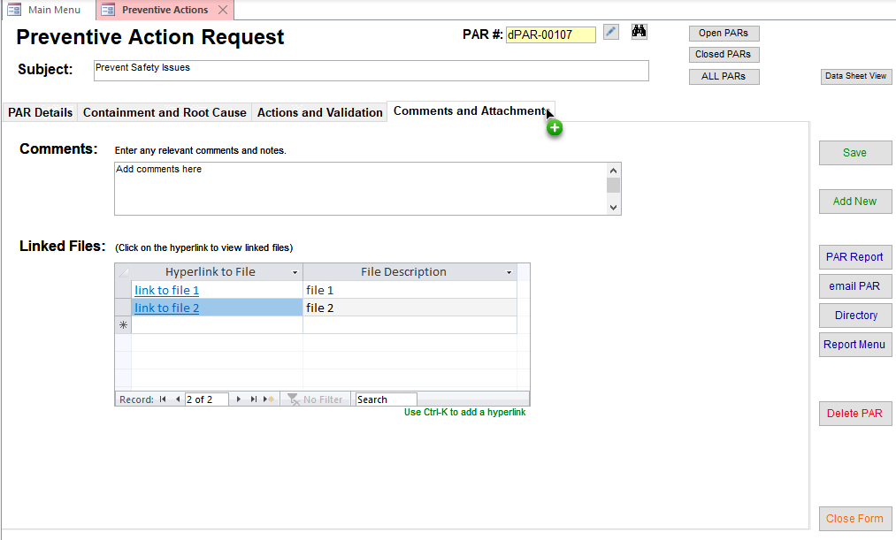
Preventive Action Form – Comments and Attachments
Add comments including customer feedback
Link any number of electronic files such as pictures, audit reports, emails, etc.

Slide 45
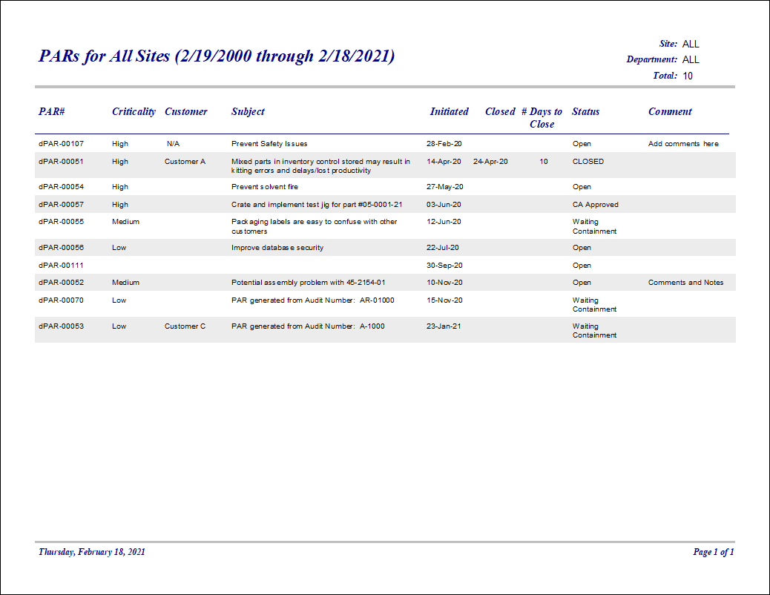

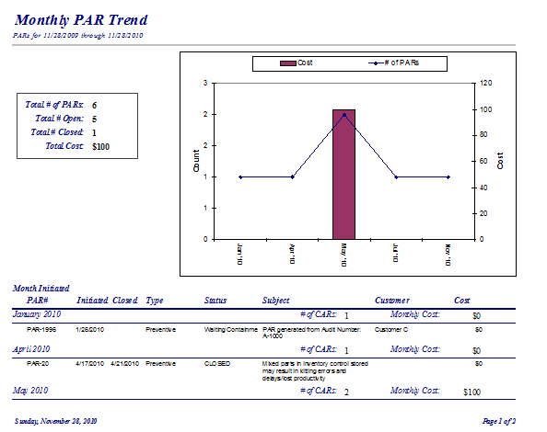
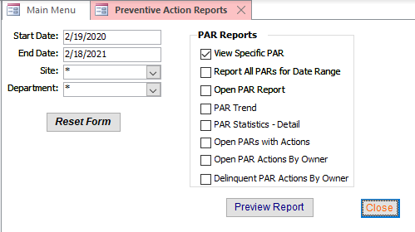
PAR Reports

Slide 46
Nonconformance Management
Track non-conformances
Document product disposition
Perform Failure Analysis
Analyze defects for continual improvement

Slide 47
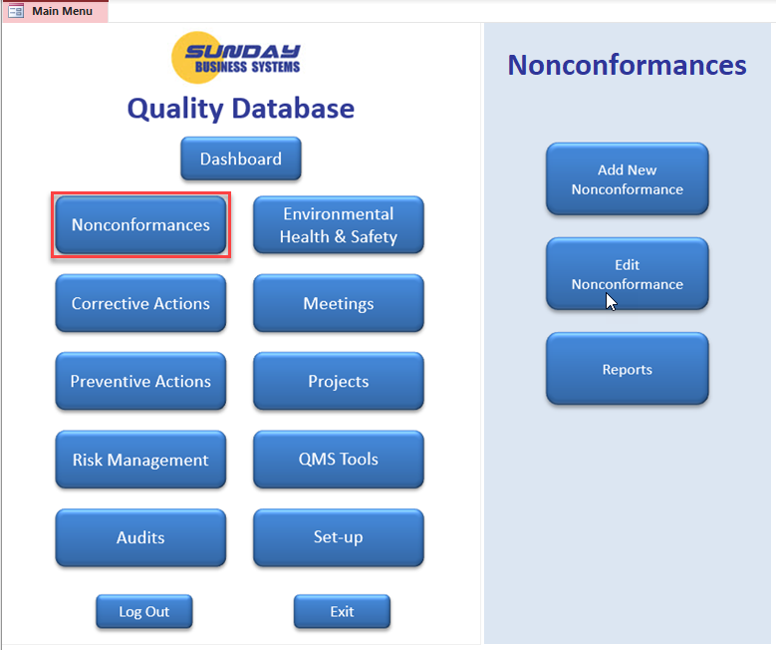
Nonconformance Main Menu

Slide 48
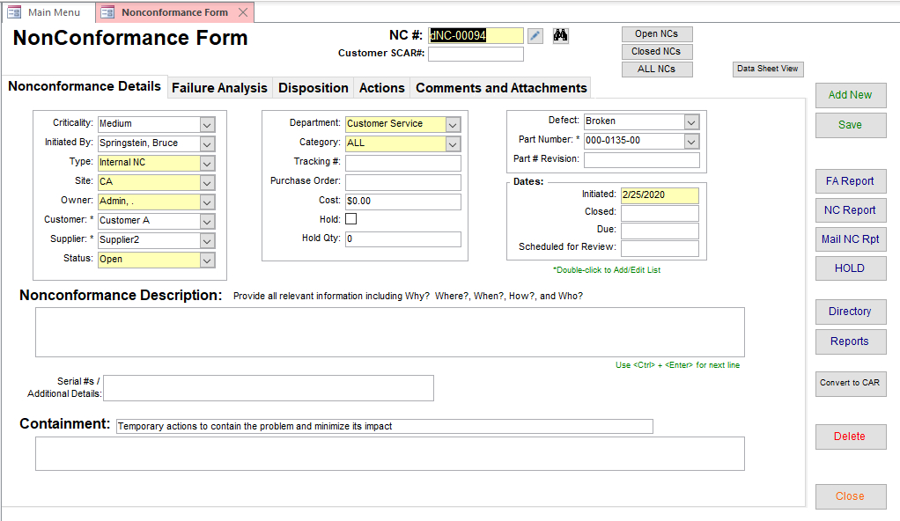

Nonconformance Management
Filter the form to display specific data
Information organized into 5 tabs
Yellow fields are required
Control buttons

Slide 49
Nonconformance Form – Nonconformance Details

Slide 50
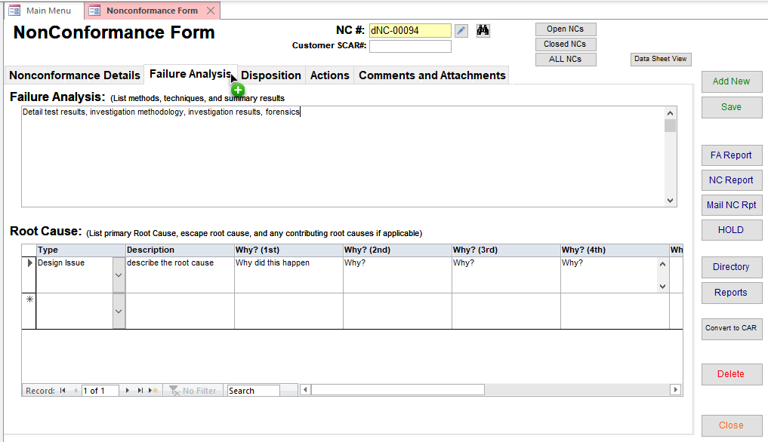
Nonconformance Form – Failure Analysis

Slide 51
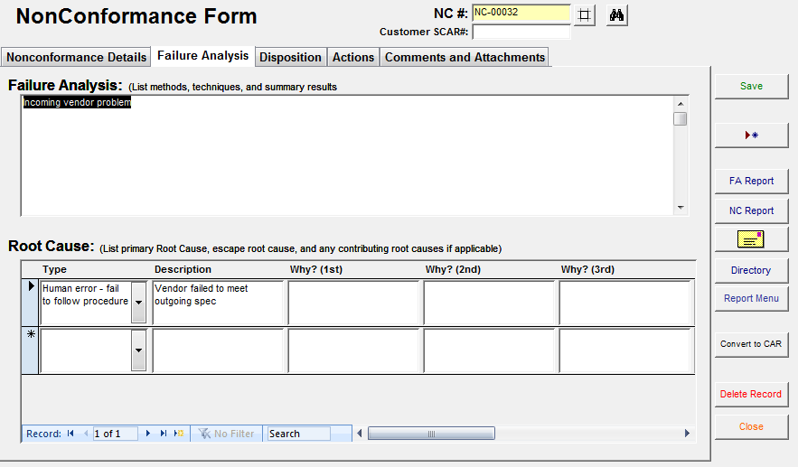
Failure Analysis
Perform Failure Analysis
Assign multiple root causes – later, analyze by root cause
Produce professional Failure Analysis reports

Slide 52
Nonconformance Form – Disposition
Record Dates, material quantities, and Dispositions
Disposition as:
  Use as Is
  Re-grade
  Repair or Rework
    Add rework instructions (if applicable)
  Scrap
  Return to sender (Customer or Supplier)
  Electronic Signature approval / date stamp

Slide 53
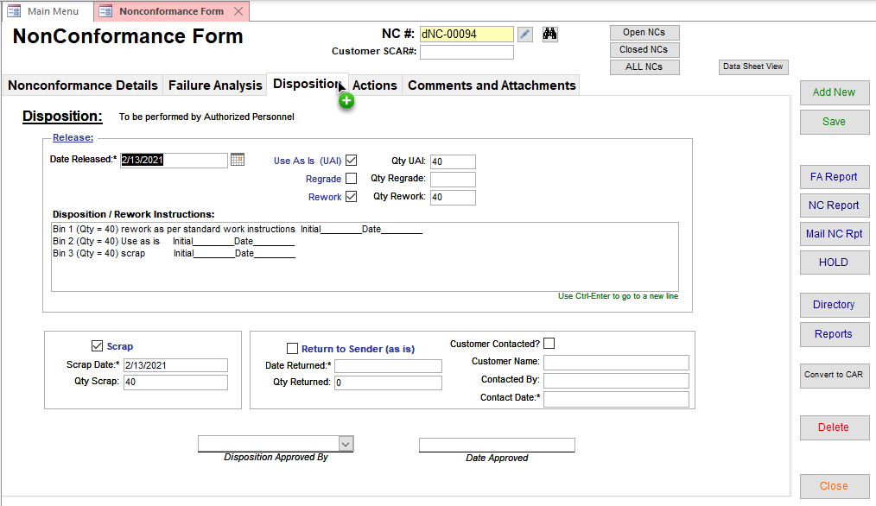
Nonconformance Form – Disposition
  Electronic Signature approval

Slide 54
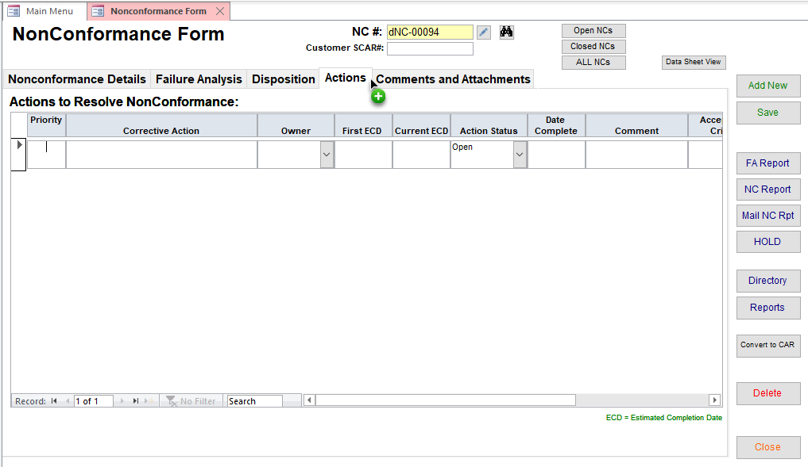
Nonconformance Form –Record Actions to remedy the NC

Slide 55
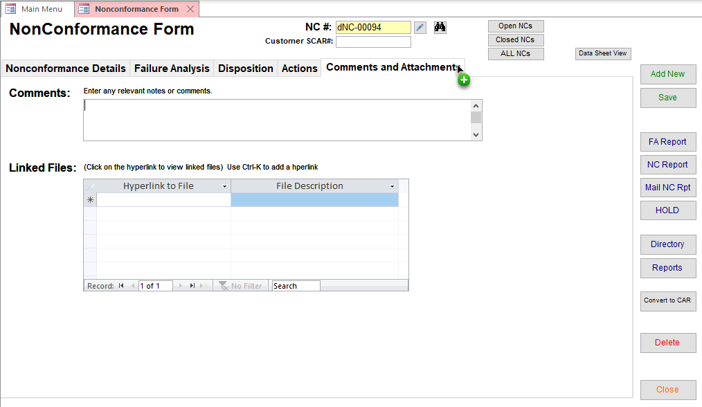
Nonconformance Form – Comments and Attachments

Slide 56
Failure Analysis
Perform Failure Analysis
Assign multiple root causes – later, analyze by root cause
Produce professional Failure Analysis reports

Slide 57
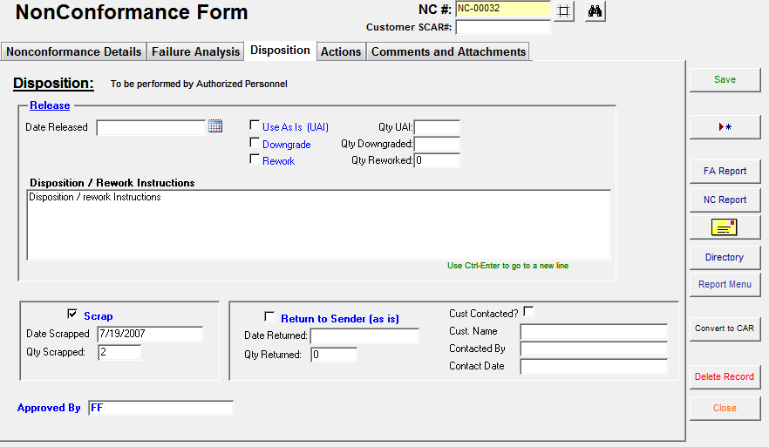
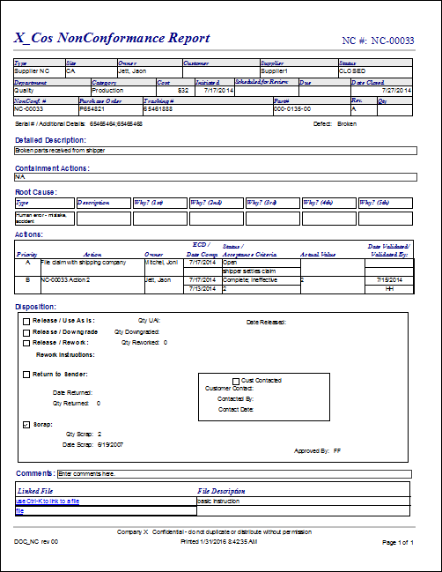
NC Reports & Escalation
Produce a concise nonconformance report
Escalate any Non-conformance to a CAR with a click of a button

Slide 58
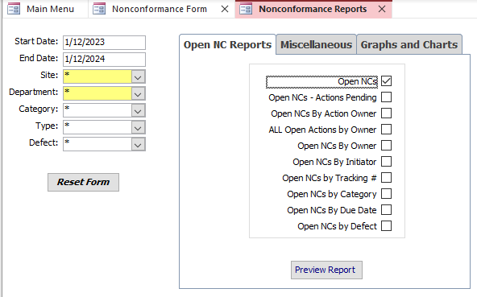
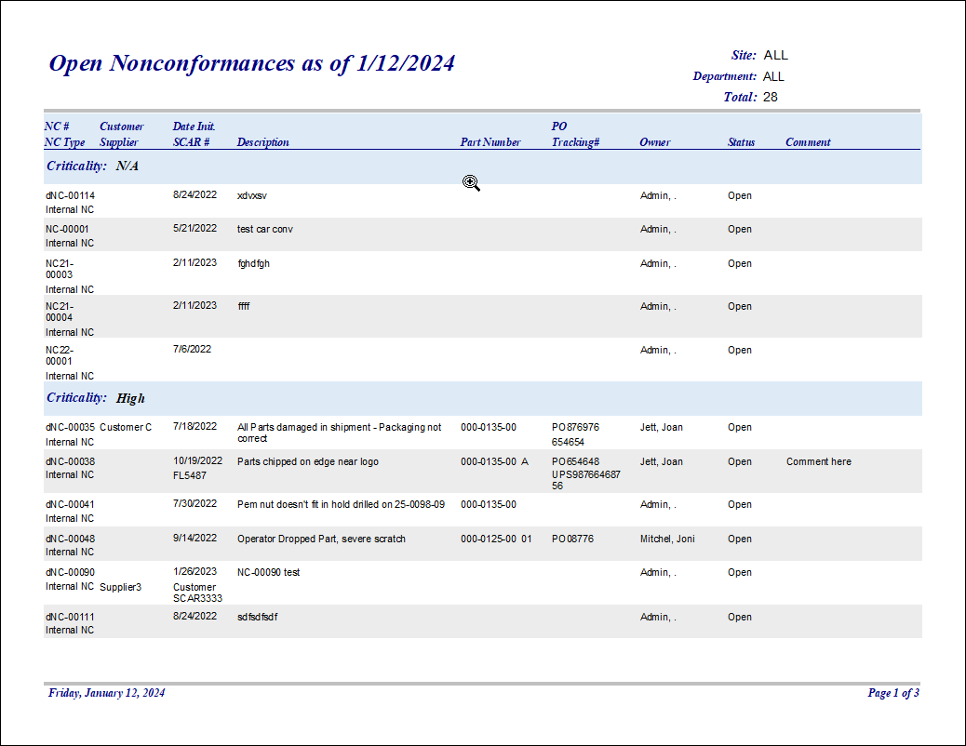
Nonconformance Reports and Analysis
30 different configurable reports and charts
  Configurable Filters

Slide 59


Nonconformance Reports and Analysis
30 different configurable reports and charts

Slide 60



Nonconformance Reports and Analysis
30 different configurable reports and charts

Slide 61

Audits
Schedule audits
Document audit findings
Convert findings into a CAR or CARs
Report and analyze results

Slide 62
Audit Management
Great for recording findings in:
  Internal audits
  Supplier audits
  Customer audit results
  QMS surveillance and registration audits
Create linked CARs for each finding
Use electronic signatures to document
  Audit approval (approve findings and corrective actions)
  Audit closure (verify the corrective actions were effective)

Slide 63

Internal Audits – Audit Details
Enter dates; an audit is “Open” if there is no completion date
Electronic signature approvals for audit completion and audit closure
Document general audit details
Specific audit report
Configurable audit reports

Slide 64

Audit Findings
Document detailed audit findings
Double-click to open CAR
Create a CAR Linked to the Audit with a click of a button

Slide 65

Audit Conclusions

Slide 66

Audit Data links
Hyper-Link to any number of files
  audit checklists
  Supporting data
  Pictures
  Objective evidence

Slide 67


Manage Audit Schedule
To schedule a future audit :
1) enter the audit details
2) Click button to schedule audit
Review the entire audit schedule

Slide 68



Audit Reports and Analysis

Slide 69

Risk Management
FMEA (Failure Modes & Effects Analysis)
SWOT Analysis

Slide 70
Risk Management Overview
The Quality Database incorporates 2 risk management techniques
  SWOT analysis (Strengths Weaknesses Opportunities and Threats)
  FMEA (Failure Modes and Effects Analysis)
For compliance, we recommend
  Using SWOT analysis for upper level business risk analysis
    Competitive advantages
    Threats to overall business
    Market analysis
  Using FMEA analysis for detailed product and process risk management
    Product Design FMEA
    Manufacturing operations (process) FMEA
These two risk management techniques can be optimally applied to different levels of organizational risk management

Slide 71
Overall Risk Management Strategy
SWOT Analysis
FMEA
Corporate Vision
Product Design
Sales / Marketing
Strategy
Project
Planning
Manufacturing
Process Design
Competitive Analysis
Manufacturing
Process

Slide 72
FMEA
FMEA Background
Features and Benefits
Set-up and Use

Slide 73

History
FMEA: Failure Mode and Effects Analysis
Was one of the first systematic techniques for failure analysis
Developed by reliability engineers in the 1950s to study problems that may arise from military system malfunctions
Further developed and adopted by the aerospace and automotive industries
Today, it is a standard technique for risk analysis and continual improvement

Slide 74

FMEA
An FMEA is often the first step of a system reliability study.
It involves reviewing as many components, assemblies, and subsystems as possible to identify failure modes, and their causes and effects.
FMEA begins during the earliest stages of design and continues throughout the life of the product or service.
You can use the FMEA Tool in two separate, but related ways:
  Analyze the current process and evaluate the potential impact of changes under consideration
  Track improvement over time

Slide 75
Reduce Risk and Improve Performance
The FMEA is a simple business process:
  Anticipate: what can go wrong?
  Prioritize actions to
    Reduce the severity or impact of an adverse event
    Decrease the frequency of an adverse event
    Increase the delectability of an adverse event
  Complete the actions in a timely fashion
  Re-evaluate the process / product / service in light of
    New data
    Improved processes
    New processes

Slide 76





FMEA Process Flow
Assemble the Team
Inputs
Process Experience
Map the process
Customer Feedback
Field Failure Data
Identify the
failure modes
Yield / Rework Data
Inspection Results
Determine the
Effects and Severity Rating
Gauge R&R
Complete Actions and
Re-compute RPN
Identify the Cause
and Occurrence Rating
Management review
and approval
Analyze the current
controls and determine
Detection Rating
Determine actions to
Reduce each RPN

Slide 77
The FMEA Process
Assemble a cross-functional team of people with diverse knowledge about the process, product or service and customer needs.
Identify the scope of the FMEA.
  for Safety, concept, system, design, process, or service?
Identify the items: process steps, components, subsystems, parts, assemblies
For each item, identify the possible failure modes
  What could go wrong?
Identify all the consequences or effects of each failure mode
Determine the Severity of each failure mode
  rate it on a scale of 1-10 where 1 is not severe and 10 is extremely severe
Determine all the potential root causes

Slide 78
The FMEA Process
For each cause, determine the Occurrence rating
  occurrence estimates the probability of the failure occurring
  rate it on a scale of 1-10 where 1 is infrequent and 10 is commonplace
Identify current process controls for each cause
Determine the Detection rating based on the effectiveness of the current process controls
  rate it on a scale of 1-10 where 1 is highly detectable and 10 is not detectable
Calculate the risk priority number, or RPN
  RPN = [Severity] × [Occurrence] × [Detection]
  Rank Failure modes according to the estimated risk factor (RPN)
Identify actions to lower the severity and occurrence, and / or add controls to improve detection.
Actions are assigned to owners, completed, validated and closed
Risk factors (Severity, Occurrence, and Detection) are then re-evaluated after remedial action has been completed

Slide 79

Traditional Methods
Paper forms
Excel Spreadsheets
Problems
  Difficult to work collaboratively
  Difficult to audit
  No user based restrictions to protect data integrity
  Difficult to manage
    No concise reports for actions due
    Poor visibility to FMEA effectiveness

Slide 80


SBS FMEA Database Advantages
Easy to use
  Collaborative platform
  Simple, menu driven user interface
  Easy to train users
Convenient, intuitive forms
  Can restrict users to control data integrity
Rich set of reports
  Easy to identify delinquencies, stalled actions
  Reports may be emailed with a single click
  Export data to Excel for further analysis
Built using Microsoft Access
  Common, convenient software platform
  Runtime version of Access is available as a free download

Slide 81
USING THE FMEA MODULE
Using the SBS FMEA Module in the SBS Quality Database

Slide 82
Key Features
List items, process steps, or functions
  Identify Failure Modes for each
    Identify effects and severity
    Identify causes and frequency
    Identify current controls and detection level
  Develop multiple actions associated with this failure mode
    Assign owners and due dates
    Establish verification and validation criteria
Electronic signature for management approval
Rich set of reports
  Track open actions and delinquent due dates

Slide 83

FMEA form - Details
Data Organized into 3 tabs
FMEA details determine
the type and scope
Define the Team
Approvals and edits

Slide 84
FMEA form - Details
Data Organized into 3 tabs
FMEA details determine
the type and scope
Define the Team
Electronic signatures to
document approval and closure
Approvals and edits

Slide 85

FMEA Form – Failure Modes and Actions
Actions include acceptance criteria and validation
For each Failure mode, you may create any number of actions to reduce the RPN

Slide 86

FMEA Form – Comments and Attachments
Supporting documentation may be linked to the FMEA

Slide 87



FMEA Form - Reports

Slide 88


FMEA Form – Reports (FMEA Actions)

Slide 89

FMEA Reports and Analysis
Reports and analysis
Report filters

Slide 90
FMEA SET-UP
FMEA Set-up and Configuration

Slide 91

FMEA Set-up
Edit FMEA Types and RPN Ratings
  FMEA Types
  Classification
  Severity
  Occurrence
  Detection
Customize your RPN rating to meet your requirements

Slide 92

Set-up Parameters
Set-up parameters are organized into multiple tabs

Slide 93


Set-up Parameters – FMEA Types
Used in FMEA Type list

Slide 94

Set-up Parameters – Classification

Slide 95

Set-up Parameters – Severity Rating
Customizable
  For example: change scale from 1-10 to 1-3
Short description shows in Severity List

Slide 96

Set-up Parameters – Occurrence Rating

Slide 97

Set-up Parameters – Detection Rating

Slide 98
USING THE SWOT MODULE
Using the SWOT Module in the SBS Quality Database

Slide 99

SWOT Form
Form organized into 3 tabs

Slide 100

SWOT Matrix

Slide 101

SWOT Actions
Manage Actions to reduce risk

Slide 102


SWOT Report

Slide 103
Environmental Health & Safety (EHS)
Safety Incident Tracking
Job Hazard Assessments
Hazardous Material Transactions
EMS Context of the Organization

Slide 104

Environmental Health & Safety Module

Slide 105

Safety incident records and management

Slide 106

Job Hazard Assessment

Slide 107

Hazardous Material Transactions

Slide 108
EMS Context of the Organization
State your EMS Policy
Define the scope of your quality management system (QMS)
Define any exclusions to the QMS requirements standard
Define Interested Parties
  Stakeholders;
  person or organization that can affect, be affected by, or proceed itself to be affected by a decision or activity
Register risks and opportunities associated with interested parties

Slide 109

EMS Context of the Organization

Slide 110




EHS Set-Up
Configure various drop-down lists through the Set-Up form

Slide 111
Meeting Manager
Document meeting minutes
Track and manage meeting actions
Drive Continual Improvement at the management level
Use for mission critical meetings

Slide 112

Meeting Manager
Track Mission Critical meetings:
  Quality Management System Reviews
  Safety Meetings
  MRB meetings
  Design reviews
  Daily operations meetings
Document meeting decisions and actions
Maintain an auditable record of compliance
Demonstrate evidence of risk based thinking
Meeting Manager is organized in 4 tabs
  QMS Details
  Data Review
  Actions and Validation
  Comments and files

Slide 113

Meetings Menu

Slide 114

Meeting Details
Specific Meeting Report
Configurable Meeting Reports

Slide 115

Meeting Minutes

Slide 116

Meeting Actions and Validation

Slide 117

Comments and Attachments

Slide 118




Meeting Manager - Reports

Slide 119
Project Management
Manage simple projects
Document continuous improvement projects

Slide 120


Slide 121

Project Details

Slide 122

Project description and benefits

Slide 123

Project actions and validation

Slide 124

Comments and attachments

Slide 125
QMS Tools
Tools to make your Quality Management System more effective.

Slide 126

QMS Tools

Slide 127

Lessons Learned Log
Simple log to archive key learning
Documents elements of Organizational Knowledge
Archives continual improvement milestones

Slide 128
Context of the Organization
State your Quality Policy
Define the scope of your quality management system (QMS)
Define any exclusions to the QMS requirements standard
Define Interested Parties
  Stakeholders;
  person or organization that can affect, be affected by, or proceed itself to be affected by a decision or activity
Register risks and opportunities associated with interested parties

Slide 129


Context of the Organization, Interested Parties, Issues & Risk

Slide 130

Cause and Effect Diagram (Fishbone)

Slide 131
Simple Surveys
Create Customer Satisfaction surveys
Create Vendor Qualification surveys
Manage & analyze survey results

Slide 132

Simple Survey Features
Easily create custom surveys
  Simple, intuitive interface
  Print out or e-mail a professional looking survey directly from the program
  Ask different types of questions
    True or False / Yes or No
    Rating (on a scale of one to ten)
    Text response (let the customer provide feedback in his own words)
Create an efficient quality record

Slide 133

Simple Survey Features
Customer Satisfaction
  Directly quantify customer satisfaction
  Monitor Customer perceptions
  Analyze trends with grafts and reports
Vendor qualification surveys
  Measure vendor suitability
  Monitor vendor improvement
Employee opinion polls
  Measure job satisfaction
  Solicit continual improvement ideas
  Measure and track long term results print

Slide 134


User Interface
Enter General Information
Simple, efficient interface
Menu Driven
Data entry in simple forms
Organize the survey into topics
List all Survey questions & define types
Notes:
Windows Small Business Server
11/26/25 21:45
© 2006 Microsoft Corporation. All rights reserved.
This presentation is for informational purposes only. Microsoft makes no warranties, express or implied, in this summary.
<number>

Slide 135
Creating Surveys
Enter general survey information
Create a survey Category (i.e. Customer Service, General, Engineering Support, etc.)
Create a question and establish the order in which it will appear on the survey
Select the question type.
  Yes/no and true/false questions are rated as either 0 or 10
  Text response questions have no score
  Rating types receive a number rating from 1 to 10 with 1 being the lowest or worst level.
If the question was yes/no or true/false, you must determine if a positive answer (yes or true ) carries the maximum score.
  Check the check box labeled "PositiveIsTen" if a positive answer receives the maximum score.
  Leave the "PositiveIsTen" check box unchecked if a positive answer should receive the minimum score.
Each question may be weighted differently (not all questions were created equal).
  The "Weight" field is used to score each question where Score = Rating * weight.
  The user must determine appropriate waiting factors.

Slide 136

Produce Professional Looking Surveys

Slide 137



Survey Analysis Tools
Variety of customizable reports
Charts, graphs
Notes:
Windows Small Business Server
11/26/25 21:45
© 2006 Microsoft Corporation. All rights reserved.
This presentation is for informational purposes only. Microsoft makes no warranties, express or implied, in this summary.
<number>

Slide 138
SBS Quality Database
Best in class software solution

Slide 139

Summary
The SBS Quality Database is a cost effective tool to
  Ensure effective training compliance with Quality standards
    ISO 9001:2015
    AS 9100
    TS 16949
    ISO 13485
    ISO 14001
  Manage Corrective and Preventive Actions
  Document Risk management
  Manage meetings
  Monitor Customer perceptions
  Maintain paperless quality records
  Analyze performance and develop improvement strategies
  Save time and effort

Slide 140
Additional Services
Data Import Service
  Import legacy data from excel spreadsheets into your Database
Training Services
  SBS offers instructor led, WebEx based, interactive training sessions
  We cover the following subjects:
    Vendor Management Database features and benefits
    General set-up and configuration
    Creating Qual plans / requirements
    Creating Qualifying Vendors
    Using reports to manage the qualification process
    Microsoft Access tips and tricks
Customization
  Talk to us about customizing the software to meet your needs!

Slide 141

About SBS
Sunday Business Systems is engaged in software sales and consulting services.
Applies Lean Manufacturing principles to Quality Management Systems
Sells affordable and efficient software solutions to help implement ISO9001:2015 compliant systems
  Document Control
  Corrective and Preventive Actions
  Risk Management
  Audit Management
  Employee Training
  Control of calibrated equipment
  Vendor Management
  SPC
  Communication / Continual improvement

Slide 142
Sunday Business Systems
Fueling Small Business Efficiency
Visit www.SundayBizSys.com for:
      Additional information
      Free product demos
      Pricing
      Links to purchase software
© 2024 Sunday Business Systems. All rights reserved. This presentation is for informational purposes only. Sunday Business Systems MAKES NO WARRANTIES, EXPRESS OR IMPLIED, IN THIS SUMMARY. Microsoft is a registered trademark of Microsoft Corporation in the United States and/or other countries.
Notes:
Windows Small Business Server
11/26/25 21:45
© 2006 Microsoft Corporation. All rights reserved.
This presentation is for informational purposes only. Microsoft makes no warranties, express or implied, in this summary.
<number>

