Slide 1
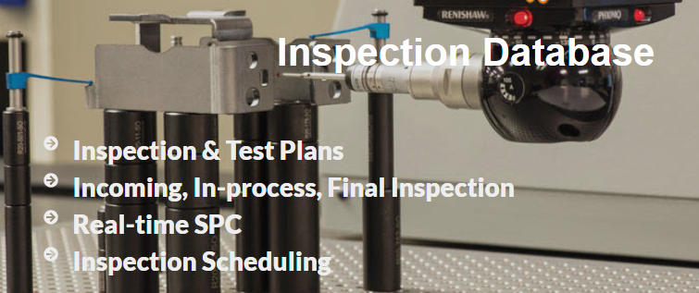
SBS Inspection Database
Features, Benefits, Set-up and Use

Slide 2

SBS Inspection Database
Simple program to manage part / process inspections
  Incoming or Receiving Inspections
    purchased material
    third party processes (Plating, anodizing, welding, etc.)
  In-process inspections
  Final product inspections
Real-time SPC charts (Statistical Process Control)
  Accept / Reject notices in real time
Create a detailed inspection data repository
Generate First Article Inspection Reports (FAIR)
Create Inspection or Test Plans
  Define part specific parameters to be measured
  Define Acceptance criteria
Manage Control Plans linked to Inspection Plans
Request and Schedule Inspections
  Great for inspection labs or inspection tools with critical capacity
Collect and analyze data
  Rich set of reports for statistical analysis

Slide 3
Features
Test plans ensure
  Provide clear Acceptance criteria for each part or assembly
  Inspections are performed uniformly and consistently
Control plans
Data Collection options
  Simple data collection
    Automated Accept / Reject messages
  Data Collection with SPC limits applied
    Automated Accept / Reject messages for Spec or Control limit violations
  Data Collection with SPC Charts displayed
    Automated Accept / Reject messages for Spec or Control limit violations
    SPC Charts displayed after each entry
Secure
  password entry
  Grant privileges to limit access

Slide 4
Benefits
Real time control of inspection results
Analyze inspection data to drive process / process improvement
Ensure compliance to customer requirements
Improve inspection efficiency
Improve product traceability
Eliminate mistakes
Secure data repository

Slide 5
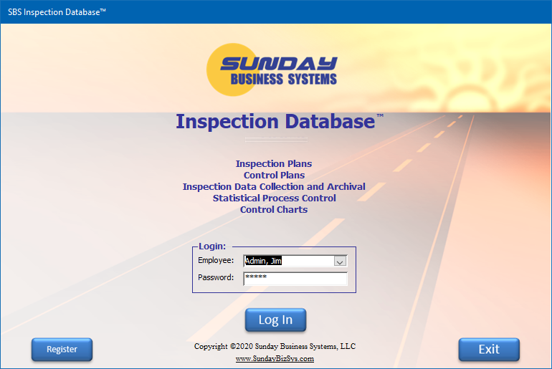
Privilege based employee login

Slide 6
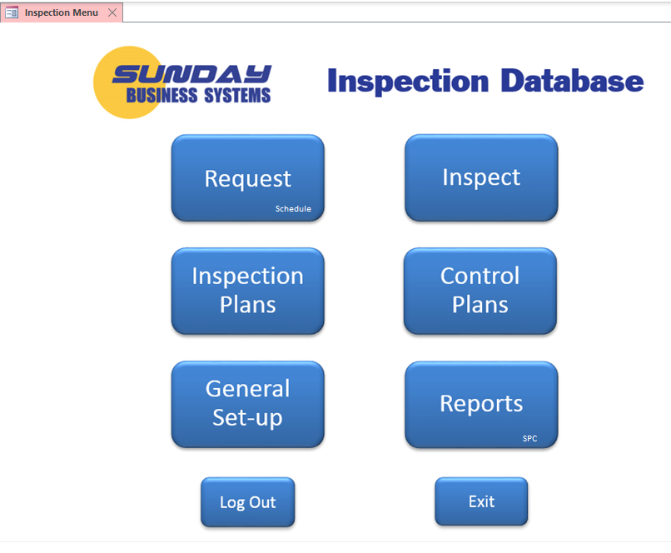
Main Menu
Simple, easy to use menu system

Slide 7
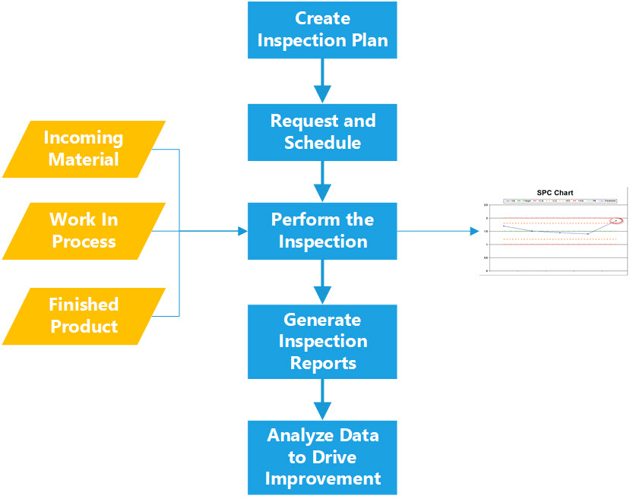
Inspection DB Process Flow
Real-Time SPC Chart

Slide 8
Create an Inspection Plan

Slide 9
The Inspection Plan
Inspection Plan
  A list of Parameters to be measured or tested
    Contains Specification limits
    Contains Control limits (if applicable)
    Contains flags to apply SPC limits and display simple control charts
  May be associated to a Part Number that is inspected
    The same plan gets executed each time a part is inspected
  Note that Yellow fields are required (mandatory entry)
  May be linked to your Control Plan (from the Control Plan form)

Slide 10
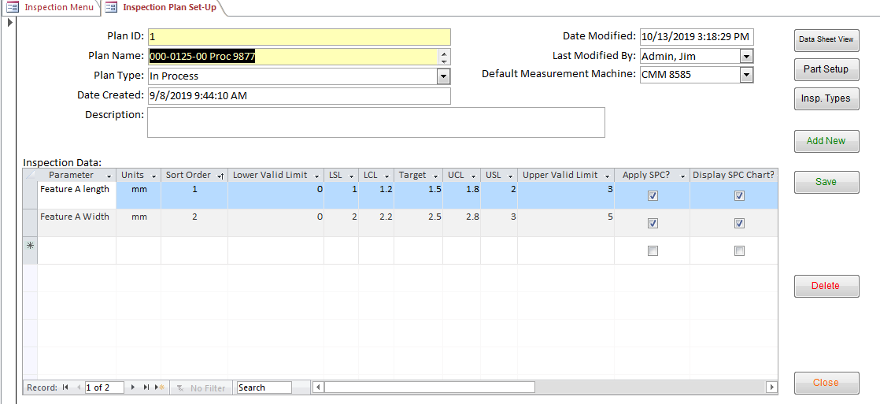
Create an Inspection Plan
Inspection Plan header information
Feature to be measured
Order in which to measure
Measurement Limits (acceptance Criteria)
Apply Limits / generate warning messages
Display control chart after data entry

Slide 11
Inspection Plan Detail
Term | Definition
Parameter | A brief description of the feature or call-out to be measured
Sort Order | The order in which the inspection parameters will be listed in the data collection form
Lower Valid Limit | A value less than the lower valid limit will not be allowed (Prevents data entry errors)
Upper Valid Limit | A value greater than the upper valid limit will not be allowed (Prevents data entry errors)
LSL | Lower specification limit
USL | Upper specification limit
LCL | Lower control limit
UCL | Upper control limit
Apply SPC? |  Will apply control and specification limits to data entry and will automatically produce reject Warnings □ (Unchecked) will not apply control and specification limits. No warnings will be generated
Display SPC chart? |  Will display a simple control chart after each entry □ (Unchecked) will not display a control chart

Slide 12
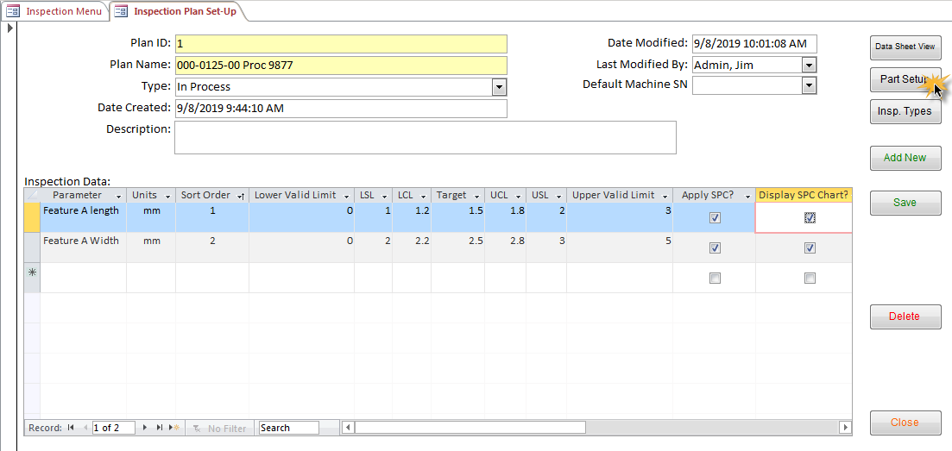
Associate an Inspection Plan to a Part Number
Each Part number may have one or more Inspection plans associated to it
Inspection plans will automatically populate the data collection subform
Parts may be edited in the Main Menu set-up form or from the Inspection Plan Set-up form

Slide 13
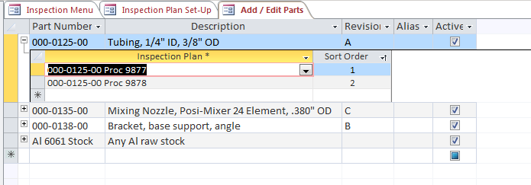
Associate an Inspection Plan to a Part Number
Select existing Inspection Plan
Click to expand

Slide 14
Request an Inspection

Slide 15

Inspection Request
Used for scheduling a measurement tool or an entire Lab
A request may be entered
  Queue may then be analyzed, prioritized, and scheduled
  Requests may be assigned to different measurement equipment or machines
Inspection may be built from
  An inspection plan associated with a part
  Any existing inspection plan
  Manually entered inspection parameters
Note that yellow fields are mandatory

Slide 16
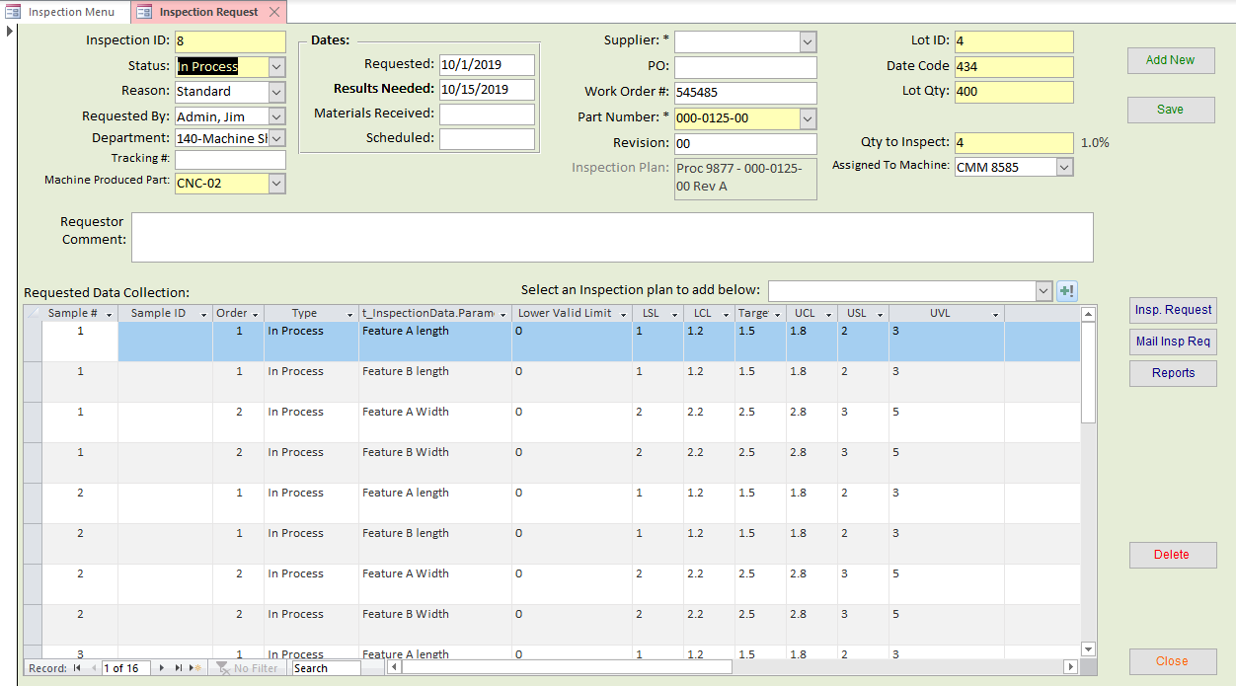
Inspection Request
Inspection Request header information
Supplier, Work Order and part Information
Lot identifiers and Qty to be inspected

Slide 17
Inspection Request
System will automatically write the data collection plan if a test plan is associated with the part #

Slide 18
Inspection Request – add additional data collection
Select an Inspection Plan
Click to add more data collection

Slide 19
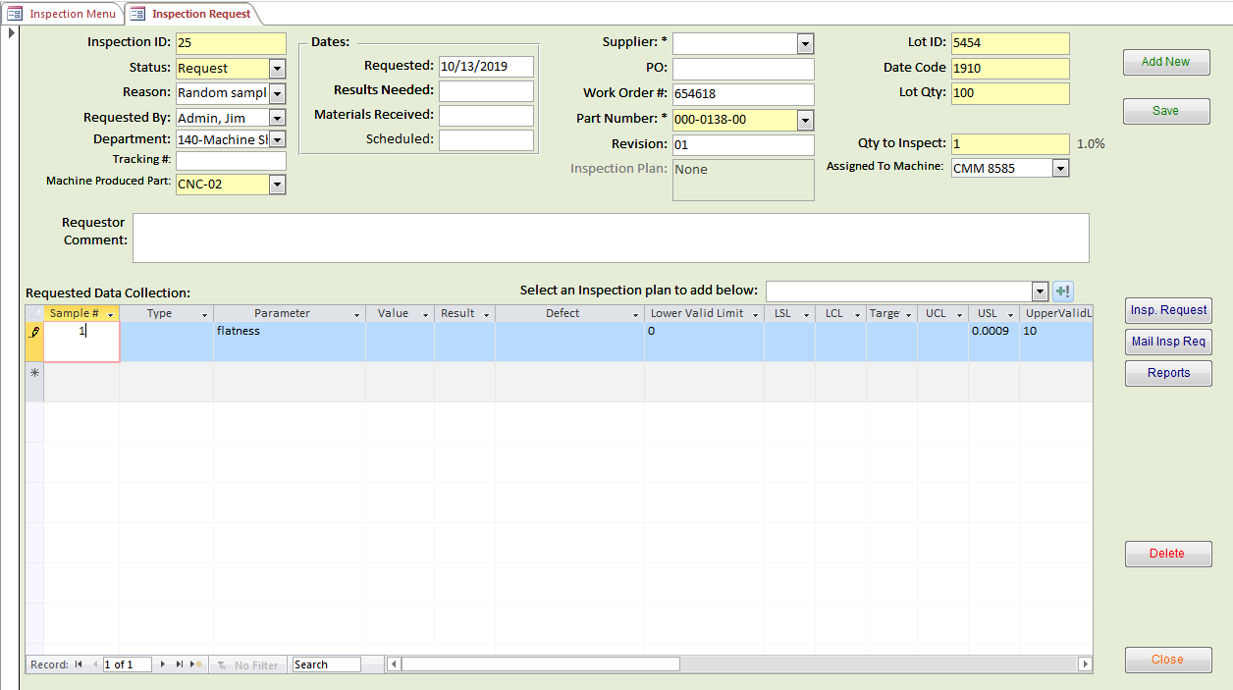
Inspection Request – manually specify data collection
Manually enter data to be collected and any spec. / control limits

Slide 20
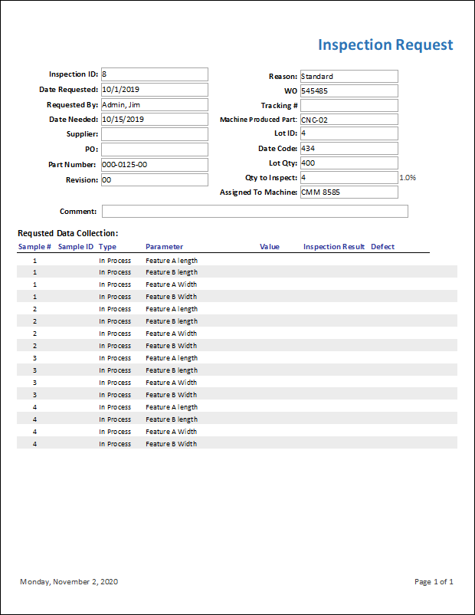
Review inspection request
View Inspection Request Report
Email Inspection Request Report

Slide 21

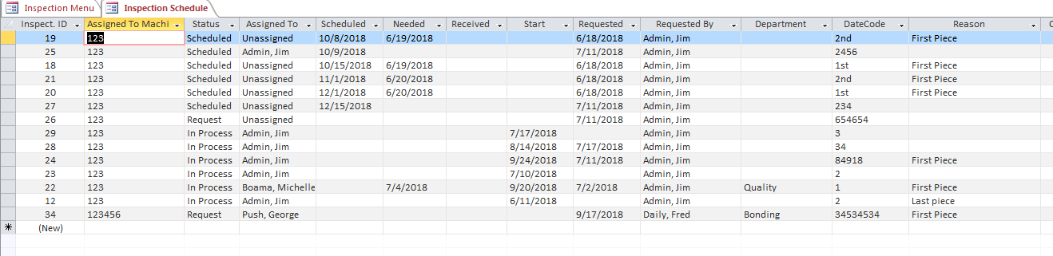
Inspection Schedule
Inspection Requests may be scheduled and reviewed

Slide 22
Inspect and Collect Data

Slide 23

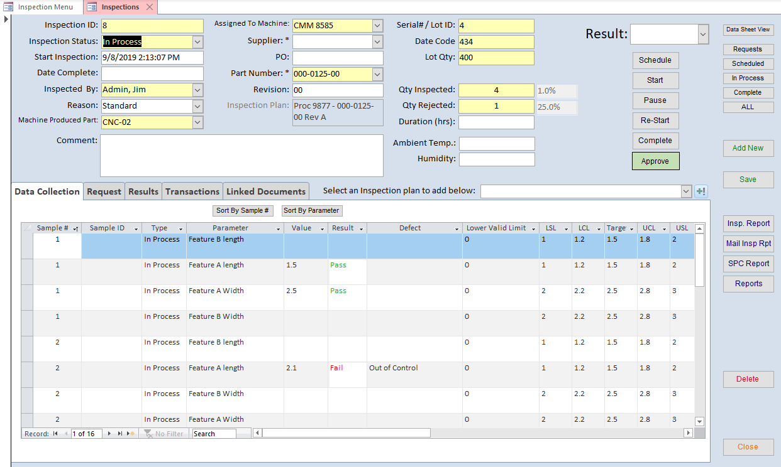
Inspect and Collect Data
Inspection details
Inspection Status buttons
Form filters

Slide 24
Inspect and Collect Data
Enter measurement values

Slide 25
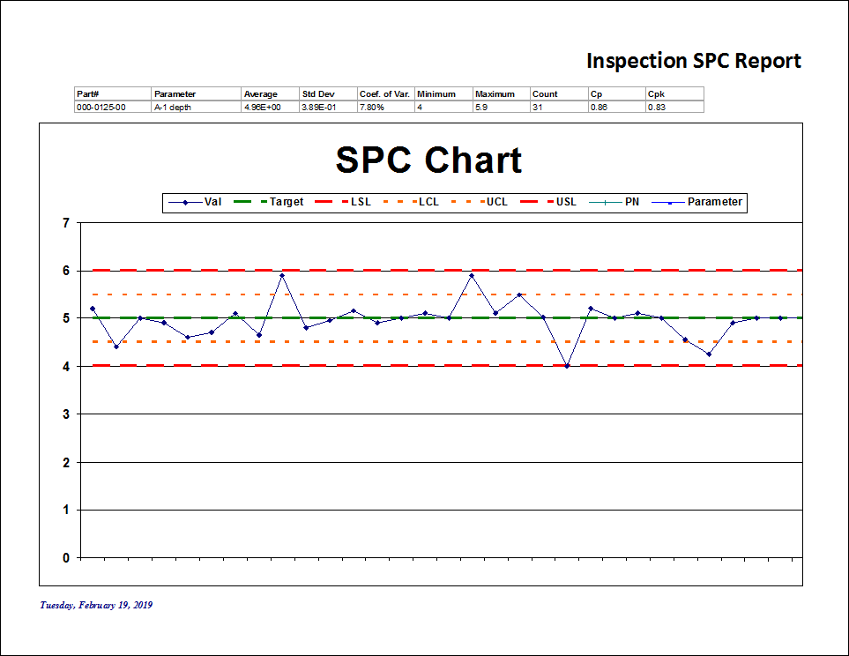
Display SPC control charts automatically (if configured)

Slide 26
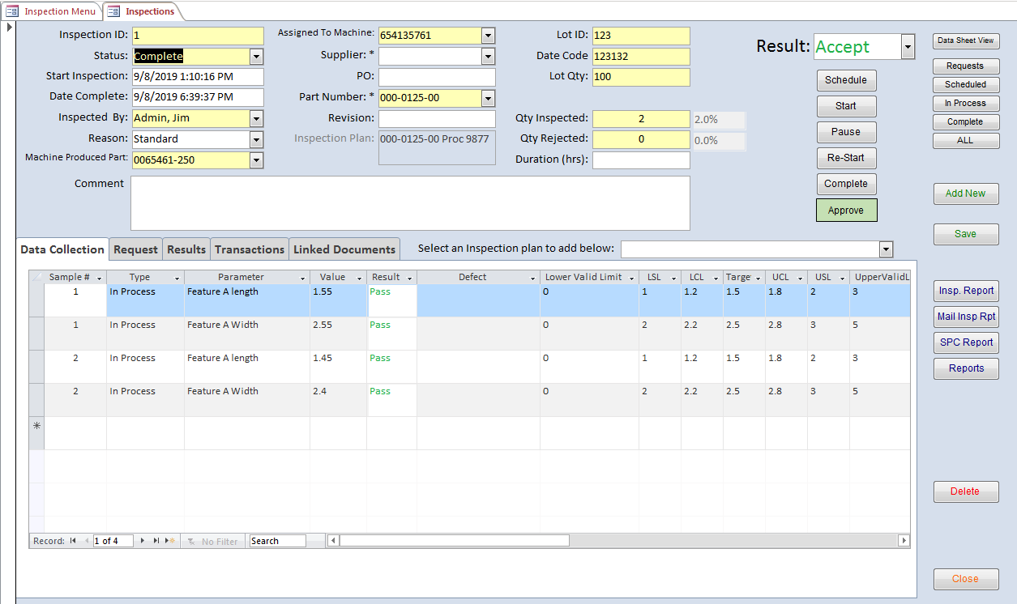
Inspect and Collect Data
Click complete for finish the inspection and Accept the results
Click Approve to enter your electronic signature to approve and lock the inspection

Slide 27
Inspect and Collect Data
View this Inspection Report
email this Inspection Report
View Detailed SPC reports
View general inspection reports

Slide 28
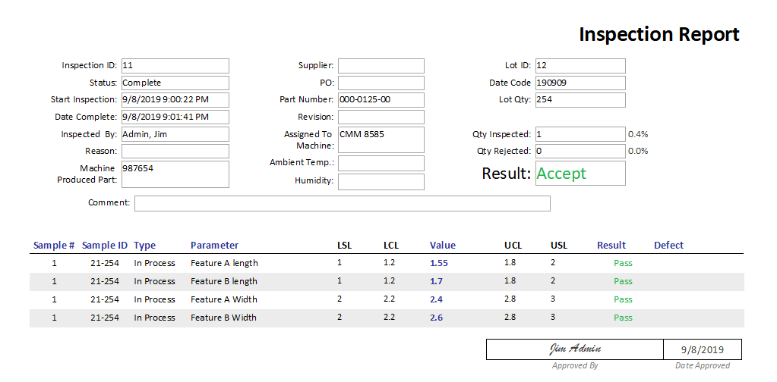
Generate Inspection Reports

Slide 29
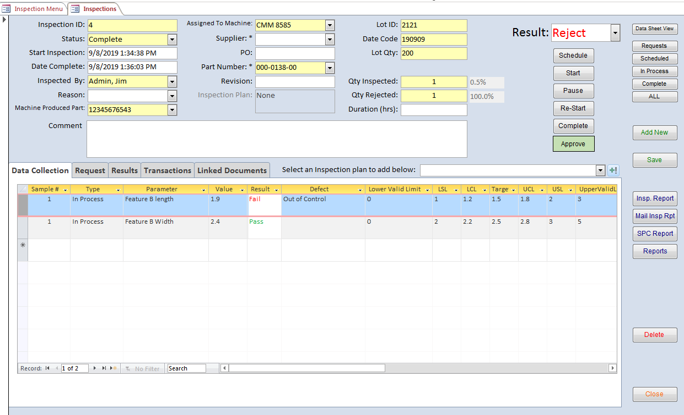
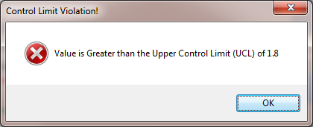
Example of failed inspection
enter a defect type

Slide 30
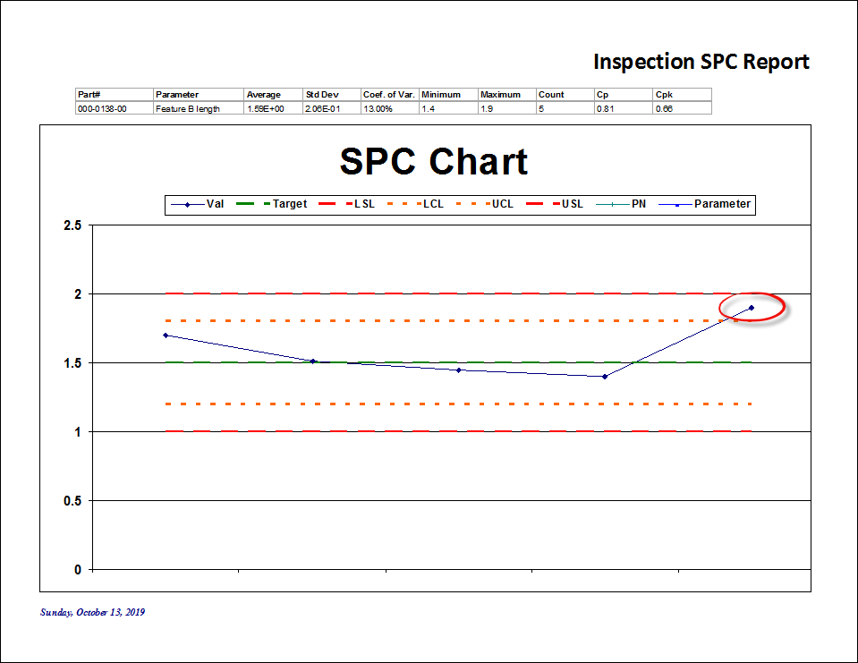
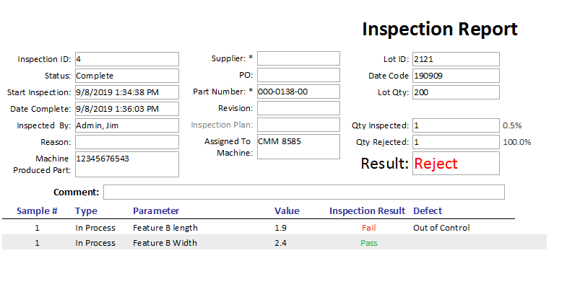
Example: Failed Inspection
Upper Control Limit violation

Slide 31
Control Plans
Build detailed Control Plans
Link plan items to Inspection Plans

Slide 32
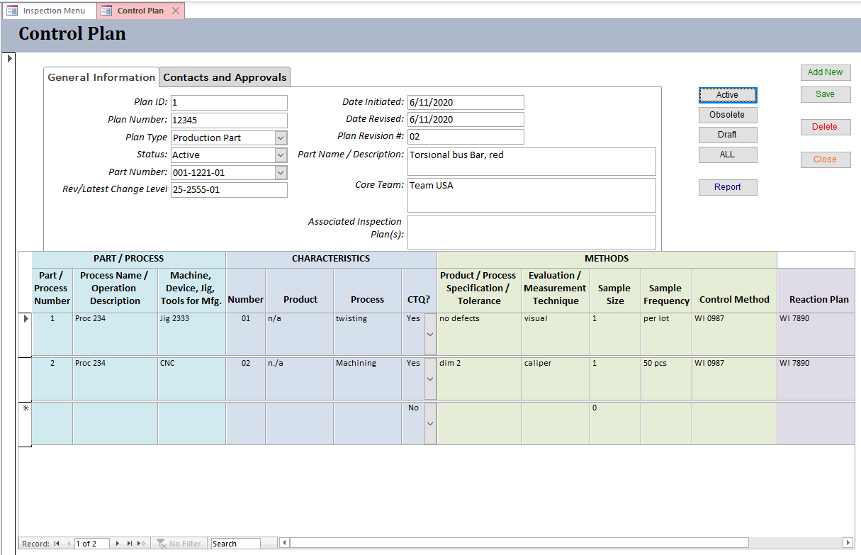
Control Plans – General Information
General information
Display Filters
Part / Process Details

Slide 33
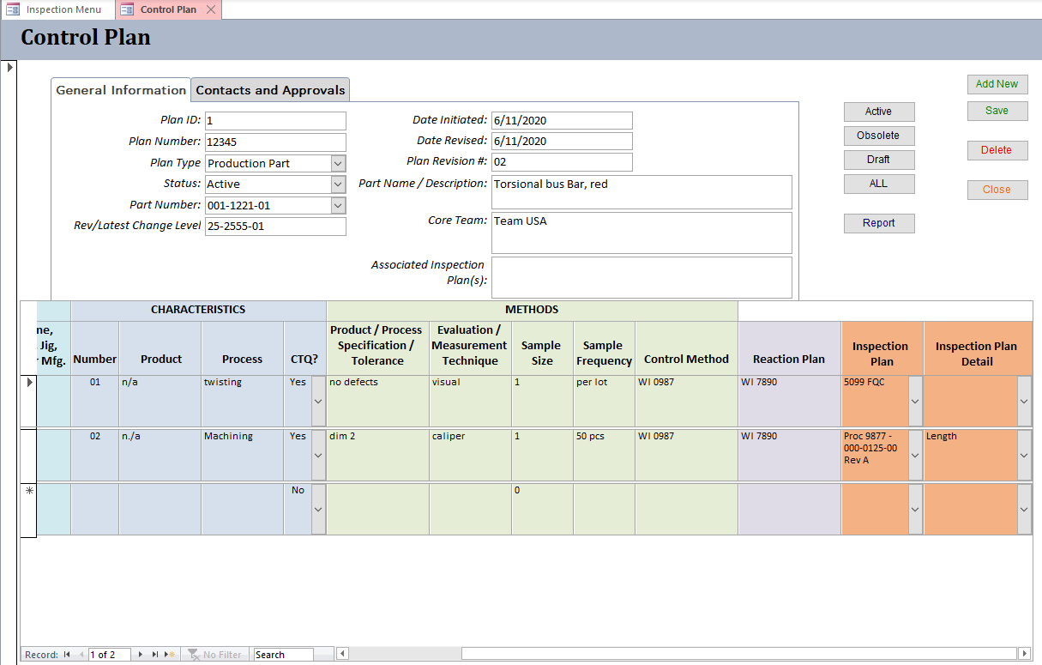
Control Plans
Link Control Plan detail to Inspection Plan
or Inspection Plan Line Items

Slide 34
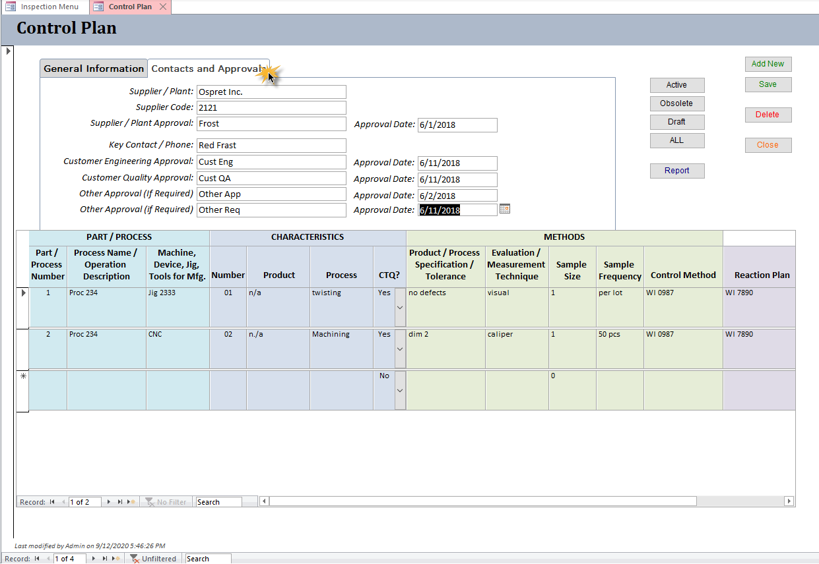
Control Plans – Contacts and Approvals

Slide 35
Reports

Slide 36

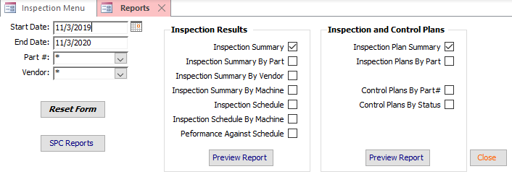
Configurable Inspection Reports

Slide 37
Set-Up and Configuration
Build drop-down lists
Set configuration parameters

Slide 38

General Set-up

Slide 39
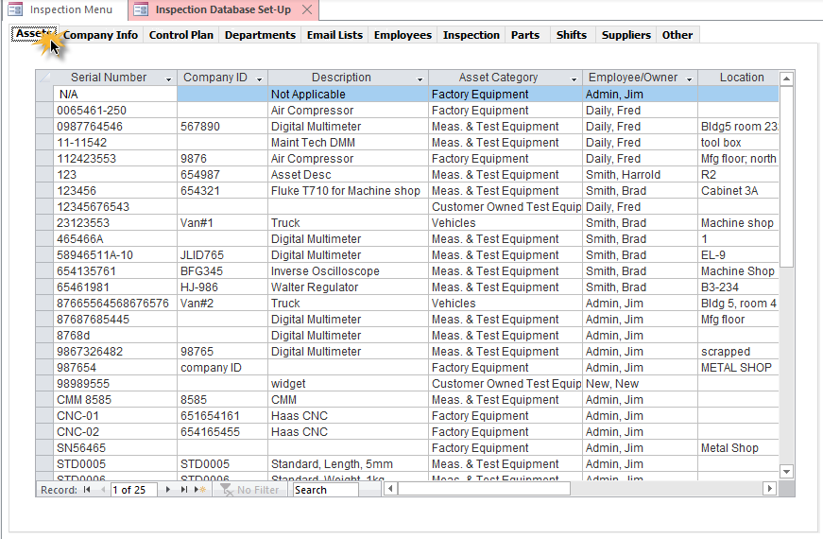
Set-up - Assets
Enter Serial# for “Machine that Produced Part”
on inspection form
Enter Serial# for “Assigned to Machine” on inspection form
Category must be “Meas. & Test Equipment”

Slide 40
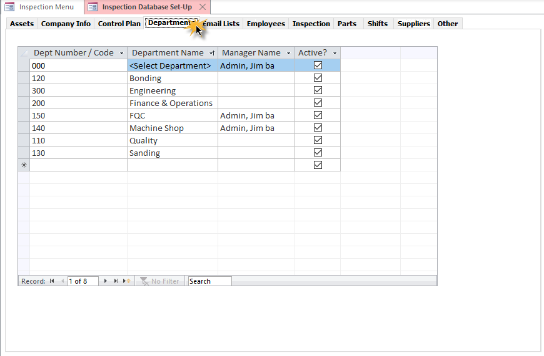
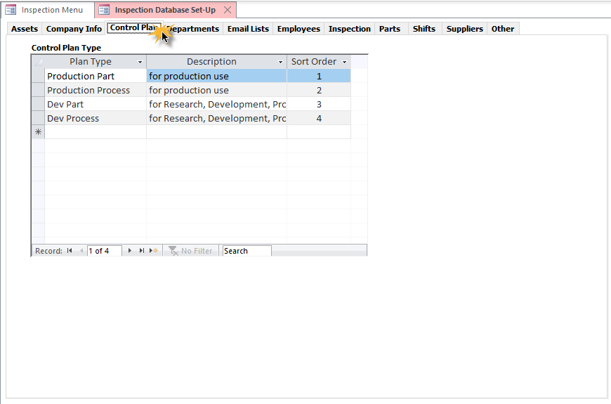
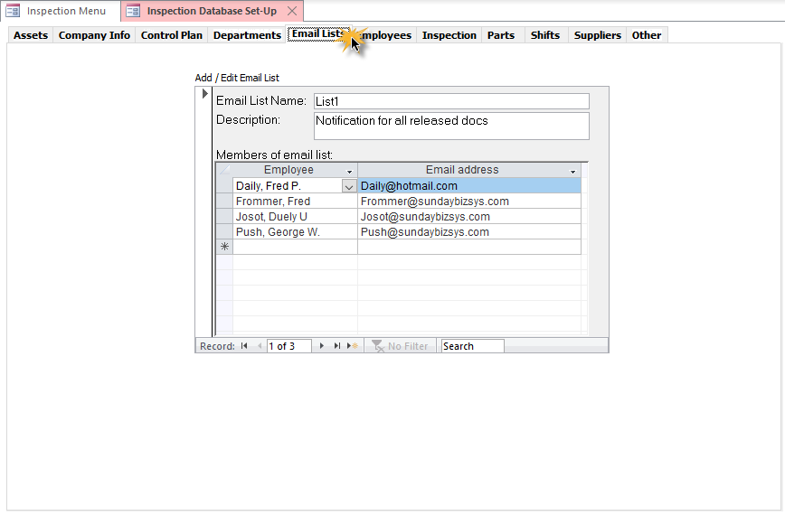
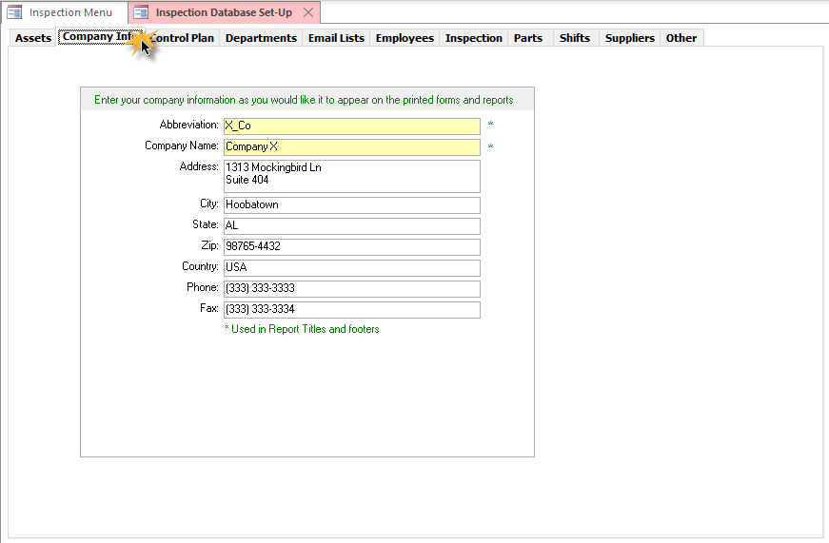
Set-up - Assets

Slide 41
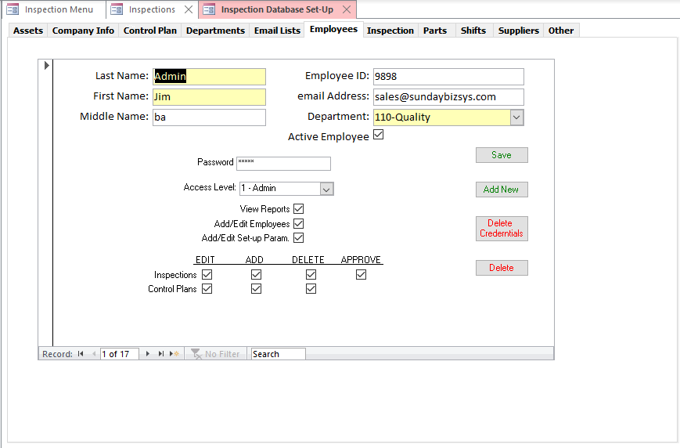
Set-up - Employees
Log in password and Privileges

Slide 42
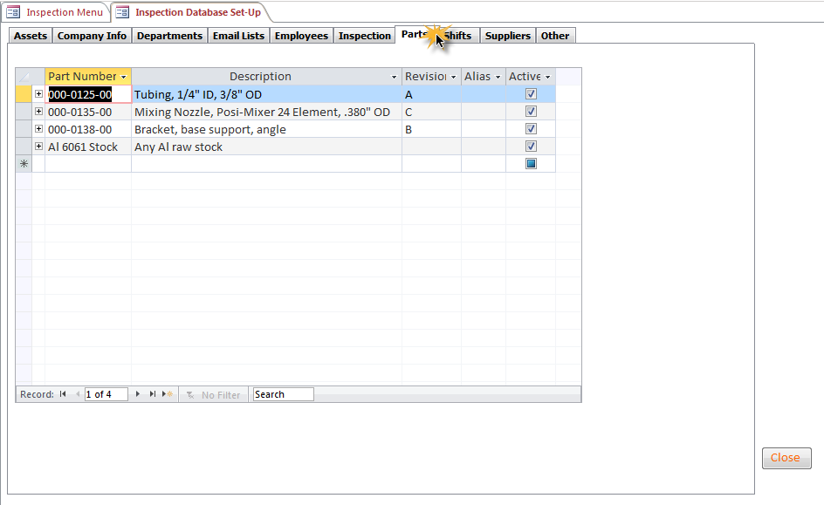
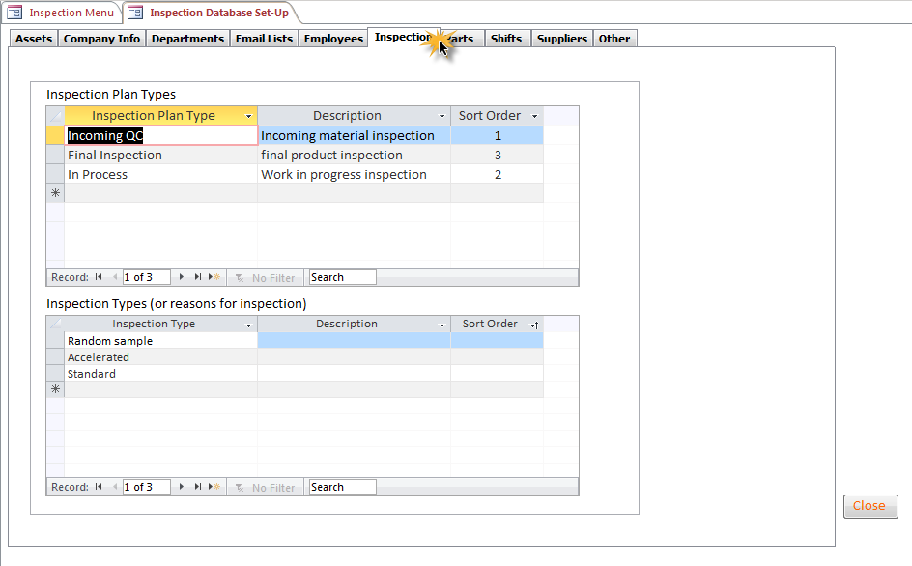
Set-up

Slide 43
Associate an Inspection Plan to a Part Number
Select existing Inspection Plan
Click to expand

Slide 44
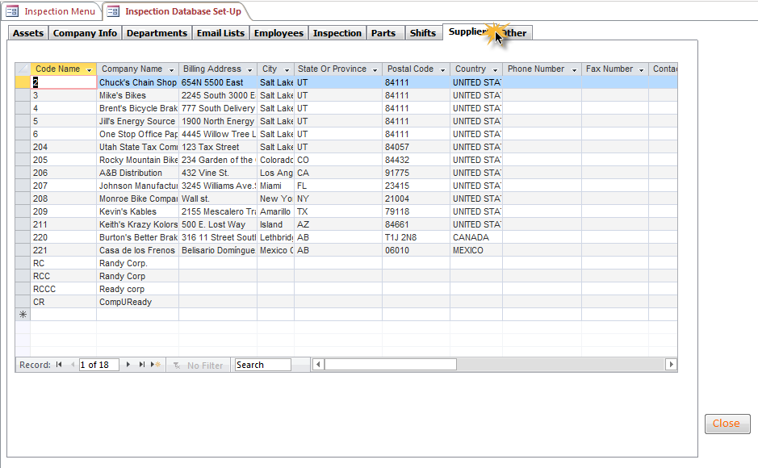
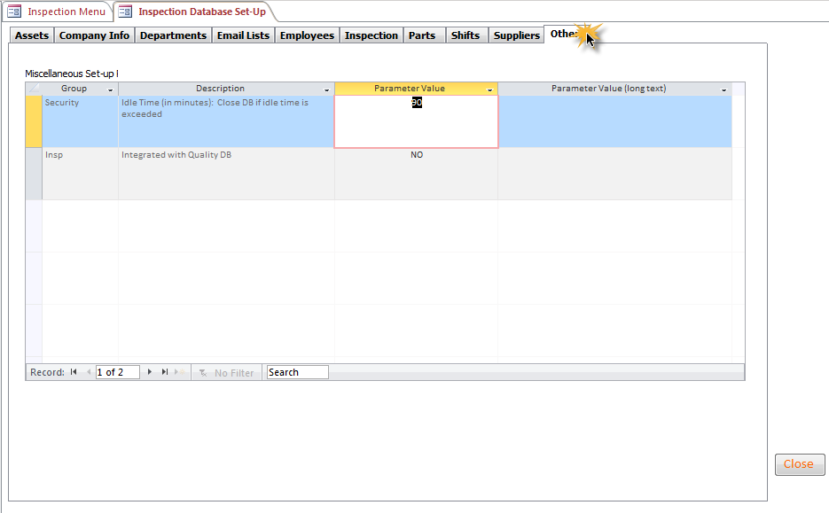
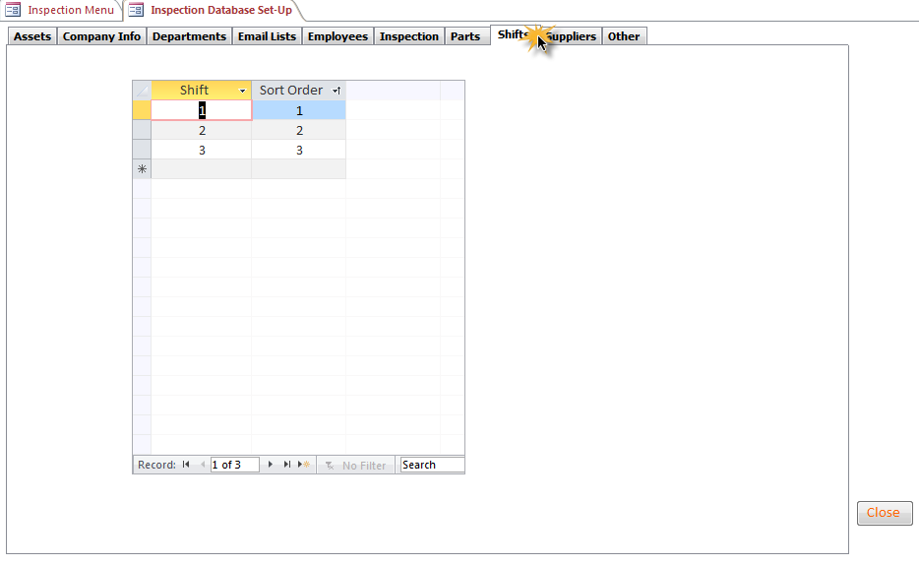
Set-up
The SQL version links Nonconformances / CARs to inspection results

Slide 45

Summary
The SBS Inspection Database is a cost effective tool to
  Collect Data on
    Incoming inspection
    In-Process inspection
    Final Inspection
  Generate real time SPC charts
  Manage your Control Plan
  Analyze performance and develop improvement strategies
  Save time and effort

Slide 46
Additional Services
Data Import Service
  Import legacy data from excel spreadsheets into your Database
Training Services
  SBS offers instructor led, WebEx based, interactive training sessions
Customization
  Talk to us about customizing the software to meet your needs!

Slide 47

About SBS
Sunday Business Systems
  Engaged in software sales and consulting services
  Since 2004
Applies Lean Manufacturing principles to Quality Management Systems
Sells affordable and efficient software solutions to help implement ISO9001:2015 QMS
  Document Control
  Corrective and Preventive Actions
  Risk Management
  Audit Management
  Employee Training
  Control of calibrated equipment
  Vendor Management
  SPC
  Communication / Continual improvement

Slide 48
Sunday Business Systems
Fueling Small Business Efficiency
Visit www.SundayBizSys.com for:
      Additional information
      Free product demos
      Pricing
      Links to purchase software
© 2019 Sunday Business Systems. All rights reserved. This presentation is for informational purposes only. Sunday Business Systems MAKES NO WARRANTIES, EXPRESS OR IMPLIED, IN THIS SUMMARY. Microsoft is a registered trademark of Microsoft Corporation in the United States and/or other countries.

