Slide 1
The SBS QMS Cloud
Cloud Based Software for an efficient Quality Management System

Slide 2
Your Quality Management System (QMS)
Traditional
  Manual Systems
    Paper records
    Ink approvals
    Multiple excel spreadsheets
  Lost or hard to find data
  Overall management is difficult
Modern
  Easy to maintain
  Cloud based software driven data collection and management
    Electronic records
    Electronic approvals
    Easy to train
    Accessible from any internet connection
SBS QMS Suite is the most efficient, affordable, and effective QMS available

Slide 3
The SBS QMS Suite
The SBS QMS Suite consists of 5 integrated modules
  Quality Database
  Ground Control
  Asset tracking Database
  Vendor Management Database
  Inspection Database
Additional applications are also available
  Change Control (custom solution)
  WizeWerk (Shop floor control)
Recognizing that each company has unique processes and terminology,
  SBS customizes our standard products
  SBS develops unique, custom solutions

Slide 4
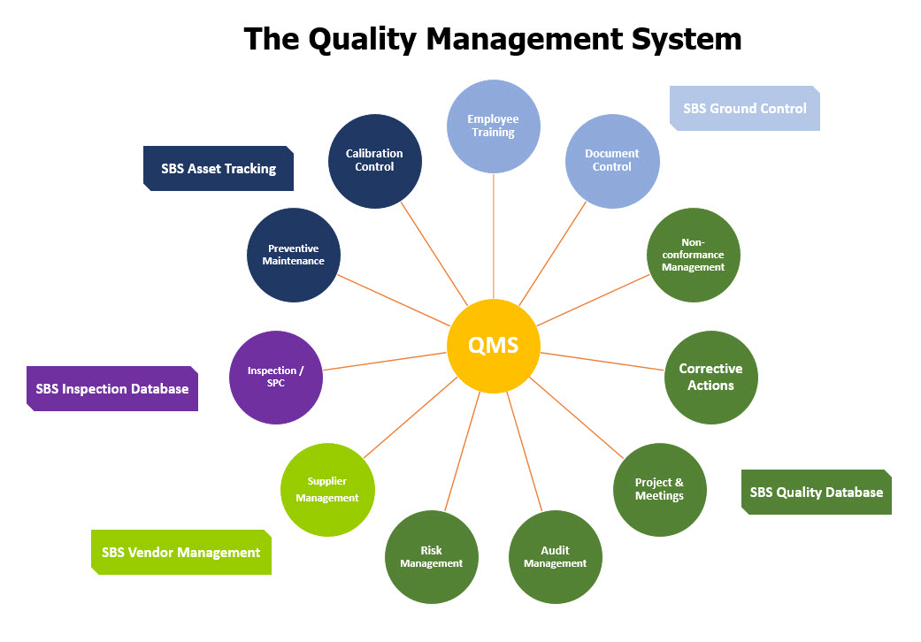

Slide 5

SBS QMS in the Cloud
Multi-user Cloud Desktop running the SBS QMS
Log in from any internet connected device (iOS or Windows)
Access to the full SBS eQMS suite up to 250 users
50GB of File Storage (expandable )
Secure data backups
Seamless product upgrades
Our Cloud Desktops are accessible with any modern Web browser (no plugin required) fully featured with full-screen desktop, built-in HTTPS encryption, bidirectional copy-paste, and printing.

Slide 6
Cloud QMS Features
Feature | Description
Access from anywhere | SBS applications are virtualized and rendered directly in the browser. No need for the end-user to install anything. Works on any web enabled device.
Ransomware Protection | Your Cloud desktop comes with pre-installed Antivirus and all snapshots are kept in an offline location to protect your business from ransomware attacks.
Daily Backup Snapshots | With our daily backup snapshots, your data is replicated to another location every day and you have access to the snapshot history.
Two-Step Authentication | You can enforce multi-factor authentication so your users will receive a one-time code via SMS or E-mail before entering their Cloud desktops.
Multi-User Desktops | Our Cloud instances are multi-user capable (up to 250). Everyone has their own desktop and private folder but are part of the same virtual machine with public shared folders.
One-Click Web Access | Our Cloud Desktops are accessible with any modern Web browser (no plugin required) fully featured with full-screen desktop, built-in HTTPS encryption, bidirectional copy-paste, and printing.
50 GB of Online document storage | 50 GB of backed-up storage (this is expandable to any level up to 1 TB at an additional cost)
Fast Internet connection | 1Gbps unmetered Internet connection
Antivirus | MalwareBytes Business
Snapshots | 7 days history (automatic) Snapshots are ransomware proof and let you roll back to a previous state for up to 7 days.
VPN connectivity | There is no VPN required to connect to the Cloud desktop but you can add VPN connectivity with your office if you desire. Software and Site-to-Site VPNs (IPsec Ikev1/2)

Slide 7
SBS QMS Software

Slide 8
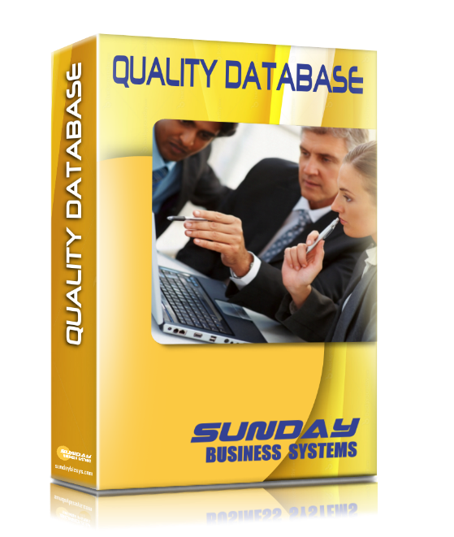
The Quality Database
Multiple Purpose QMS tool

Slide 9
Quality Database Features
SBS Quality Database
Corrective
Actions
Surveys
Risk
Management
Non-Conformances
Audit
Management
Meeting
Manager
Preventive Actions
Project Management

Slide 10

Features
Nonconformance Tracking
Corrective Actions (CA)
  Safety Corrective Actions
  Supplier Corrective Actions
  Internal Audit Corrective Actions
Preventive Actions (PA)
Risk Management (FMEA & SWOT)
Internal Audit Management
  Record and track audit findings
  Manage Audit Schedules
Document management review meetings
Manage continuous improvement projects
Customer Satisfaction Surveys

Slide 11
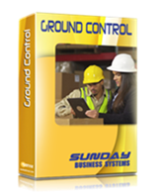
Ground Control™
Document Control and Training Manager

Slide 12
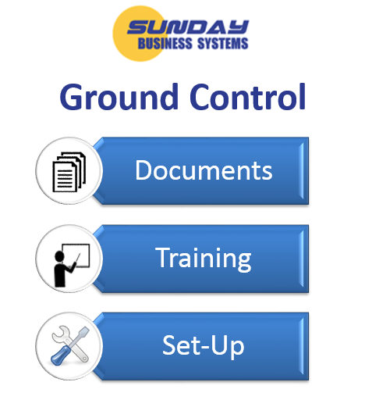
Document Control and Training
Documents and training are inter-related
  Standard operating procedures provide the basis for training
  New documents often require training in order to be effective
  Very often, document changes require additional training for effected personnel
  Documenting the training for regulatory compliance can be challenging
For this reason, SBS has bundled
  Document Control and
  Employee Training management
The Product
  Easy to use, Menu driven
  Intuitive Process flow
  Requires very little training to begin using
  Built using Microsoft Access
    Runtime version of Access is included
    No need to purchase Microsoft Access separately

Slide 13
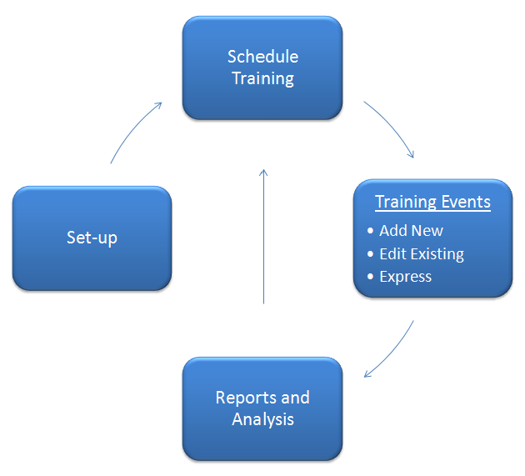
The Training Module - features and benefits
Tracks training classes and class rosters
Defines employee Positions
  Prerequisites, Previous qualifications
  Roles and Responsibilities
  Required Training for the position
Tracks training requirements
  By department
  By manager
  By individual employee
Tracks re-certification requirements
Identifies delinquent training
Rich set of reports and analysis
  Measures the effectiveness of your training management system
A full introductory presentation on the Training Module may be found from our website http://www.sundaybizsys.com/TDB_Intro.pps

Slide 14
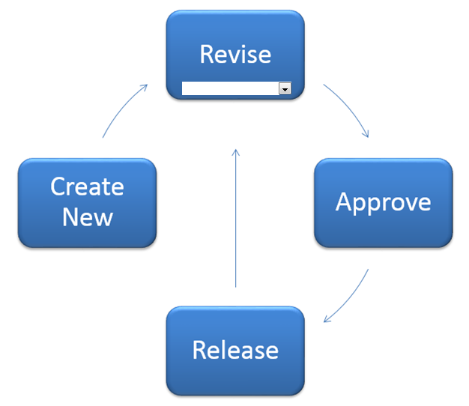
The Document Control Module
Complete document lifecycle management
  Controls any electronic document including
    Microsoft office files: Word, Excel, PowerPoint
    PDF, AutoCAD, SolidWorks
Control document releases
  New documents
  Revisions to existing documents
  Obsolete documents
Ensure approvals are documented
  Capture electronic signatures
Organize Documents
  Organize by Type, Department, and Owner
  Group related documents for quick reference
Simple, effective reports
  Measure the effectiveness of your document control system

Slide 15
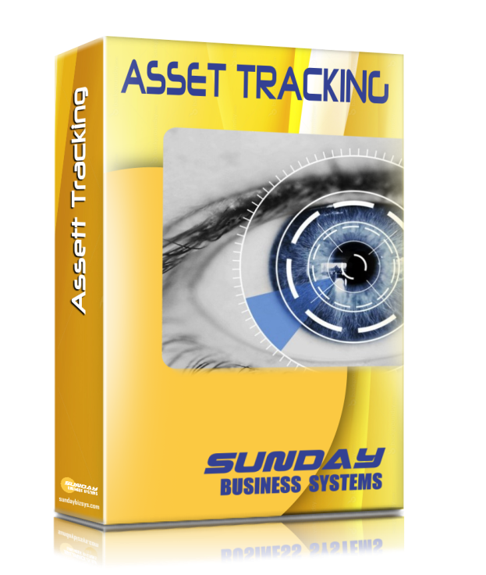
Asset Tracking Database
Control Calibrated Equipment
Manage Preventive Maintenance
General Maintenance Tracking

Slide 16
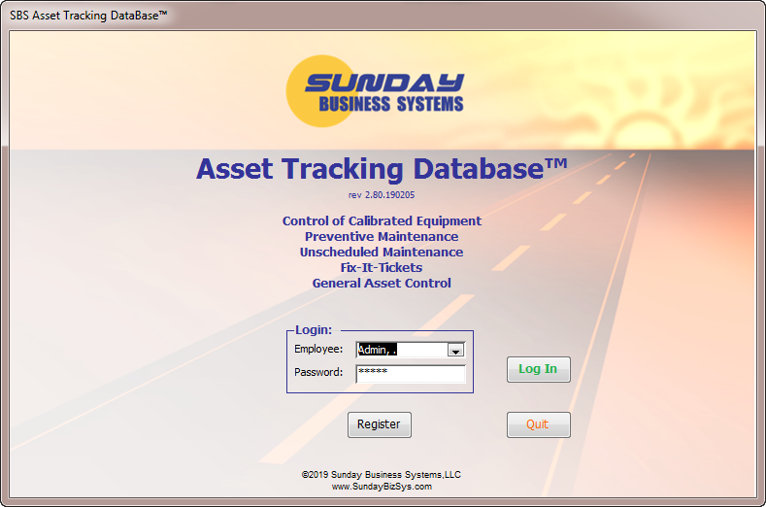
Asset Tracking Database
Control of Calibrated Equipment
Preventive Maintenance
Unscheduled Maintenance
Fix-It-Tickets
Miscellaneous Asset Control

Slide 17

Features
Tracks Equipment (or Assets) through their life cycle
  From purchase to sale or scrap
  Defines which assets require calibration
  Defines which assets require preventive maintenance
Controls Calibrated Equipment
  Recall reports
  Calibration Schedule
  Delinquent calibration report
Tracks Preventive Maintenance
  Maintenance schedule
  Delinquent Maintenance reports
Tracks Unscheduled Maintenance
Full set of reports
  To track your assets
  To manage assets through proper calibration and maintenance

Slide 18
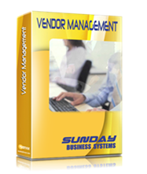
SBS Vendor Management™
Vendor Qualification
AVL

Slide 19
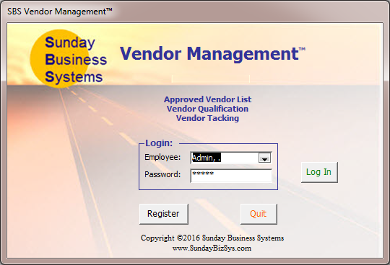
SBS Vendor Management
Easy to use, menu driven
Tracks detailed vendor information
  General contact information
  Allows multiple contacts for each vendor
  Vendor Type
  Vendor Status
Define unique Qualification plans
  Different vendors may have different plans
Record Qualification results
Track re-certification status
Full set of reports
  Email reports directly
  Export data to Excel for analysis
Built using Microsoft Access
  Runtime version of Access is included
  No need to purchase Microsoft Access separately

Slide 20
SBS Inspection Database
Define inspection plans
Collect data
Display SPC charts
Reports and analysis

Slide 21
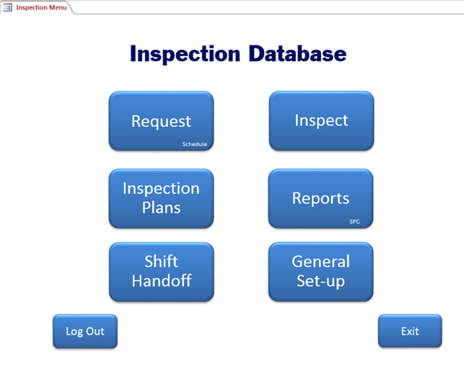
Main Menu

Slide 22
Key features
Create a detailed Inspection Plan with
  Targets, control limits, “Spec” limits
  Options to apply SPC and display control charts upon data entry
Request an inspection (as submitted to a lab)
Schedule inspections to be performed
Perform Inspections
  Measure time required for Inspection
  Collect specific data
  Automatically generate Accept / Reject messages
  Display SPC charts
  Generate detailed inspection reports

Slide 23
Inspection Work Flow
Request
Schedule
Perform
Record Results
Display SPC Charts

Slide 24
Summary
The SBS QMS suite
  Simple and effective
  Mix and match to meet your needs
  Efficient and affordable
  The greatest value on the market

Slide 25
About SBS
Sunday Business Systems has been engaged in software sales and consulting services since 2004.
Applies Lean Manufacturing principles to Quality Management Systems
Sells software solutions to small businesses which help them implement ISO 9001:2015 compliant systems for
  Document Control
  Corrective and Preventive Actions
  Risk Management (FMEA)
  Employee Training
  Control of calibrated equipment
  Preventive Maintenance
  Vendor Management
  Communication / Continual improvement
  Statistical Process Control
  Shop Floor Control
Will customize the software for a particular Customer
Offers full Training services tailored to individual needs

Slide 26
Sunday Business Systems
Fueling Small Business Efficiency
Visit www.SundayBizSys.com for:
      Additional information
      Free product demos
      Pricing
      Links to purchase software
© 2020 Sunday Business Systems. All rights reserved. This presentation is for informational purposes only. Sunday Business Systems MAKES NO WARRANTIES, EXPRESS OR IMPLIED, IN THIS SUMMARY. Microsoft is a registered trademark of Microsoft Corporation in the United States and/or other countries.

