Slide 1

The SBS T-Med Database
Features
Benefits
Set-up
Using the T-Med Database

Slide 2
Background
Managing employee training is critical to ensuring product quality and Customer satisfaction
Effective training ensures
Product quality
Employee and Product Safety
Happy customers (ultimately)
Effective Training is a key component of Quality Management Systems mandated by
ISO 13485
21 CFR part 820
AS 9100
TS 16949
ISO 9001:2015
OHSAS 18001
ISO 14001

Slide 3
ISO 13485 – Medical Devices: QMS Requirements
6.2.2 Competence, awareness, and training
The organization shall
a) determine the necessary competence for personnel performing work affecting product quality,
b) provide training or take other actions to satisfy these needs,
c) evaluate the effectiveness of the actions taken,
d) ensure that its personnel are aware of the relevance and importance of their activities and how they contribute to the achievement of the quality objectives, and
e) maintain appropriate records of education, training, skills, and experience

Slide 4
Sec. 820.25 Personnel
(a) General. Each manufacturer shall have sufficient personnel with the necessary education, background, training, and experience to assure that all activities required by this part are correctly performed.
(b) Training. Each manufacturer shall establish procedures for identifying training needs and ensure that all personnel are trained to adequately perform their assigned responsibilities. Training shall be documented.
(1) As part of their training, personnel shall be made aware of device defects which may occur from the improper performance of their specific jobs.
(2) Personnel who perform verification and validation activities shall be made aware of defects and errors that may be encountered as part of their job functions.
The T-Med Database helps
comply with these requirements

Slide 5
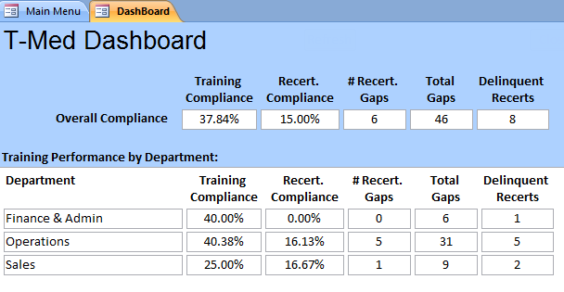
SBS T-Med Database Overview
Easy to use, menu driven
Defines employee Positions
Prerequisites, Previous qualifications
Roles and Responsibilities
Training required for the position
Tracks training requirements
By department
By individual employee
Record training classes, class rosters, and effectiveness measurements
Tracks re-certification requirements
Identifies delinquent training
Measures the effectiveness of your training management system
Utilizes electronic signatures and linked documents for a paperless system
CFR21 Part 11 compliant

Slide 6
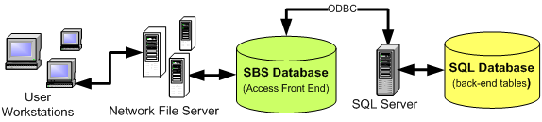
SBS T-Med Database Overview
T-med is a Microsoft SQL based program, providing excellent reliability and security.
The user interface is built on Microsoft Access
Note: The free demo version is an Microsoft Access stand-alone database.

Slide 7
Terminology
Training class
A structured set of topics for training employees on a particular subject
Training Event
An event in time where training was performed and attended by specific employees
Training for Non-Critical Tasks
For tasks that do not directly effect product quality
Employee training for non-critical tasks typically does not re-occur
Training is recorded but does not require re-certification
Training for Critical Tasks
For tasks that directly effect product quality
Requires certification and re-certification on a periodic basis
Re-certification dates are tracked and reported
Management determines critical vs. non-critical tasks / training
Skill
A group of required training classes

Slide 8
Terminology
Training Requirements
Are defined by Position
May also be defined for each Employee
Total Training Requirements are the sum of Position and Employee Requirements
Position Requirements
Required Training for Position
+
Position Skills
Employee Requirements
Unique Employee Training Requirements
+
Employee Skills
Training
Requirements
+
=

Slide 9
How the T-Med Database Works
Training Requirements are compared to historical Training Events to determine training needs or Gaps
Management must take action to schedule and execute training events to close the gaps
Training
Requirements
Historical
Training
Events
Gaps
Take Action to
eliminate Gaps

Slide 10
Dashboard
Use the Dashboard to get a quick assessment of overall compliance
Training Compliance = [# completed requirements] / [total # of requirements]
Recert. Compliance = [# completed certifications] / [total # of required Certifications]
# Recert. Gaps = # of Certification or Re-certifications that are over due
Total Gaps = Total number of requirements that are unfulfilled

Slide 11
Set Up and Configuration
Preparation
Log in and Basic Navigation
Set Up and Configuration

Slide 12
Preparation
Develop a concise Org Chart
Employee Names
Job Titles or Positions
Departments
Define who reports to who (reporting structure)
Formalize positions
Create a detailed job description for each Position
Define any prerequisites for each Position
List all required training for each position
Group training into Skills and define the skill set for each position
Note any employee specific training for each employee

Slide 13
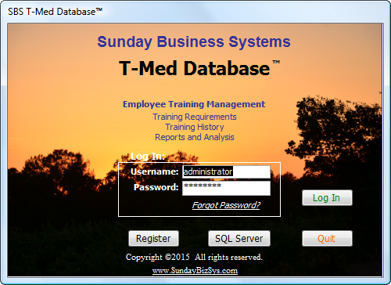
Login Screen
The login process limits access to specific database features based on the employee and password entered
The Demo version includes dummy data and fictitious employees
administrator is the default login for demo versions and has full privileges
administrator credentials:
Username: administrator
Password: Qq777777
All other employees password = Aa777777
NOTE: both username and password are case sensitive

Slide 14
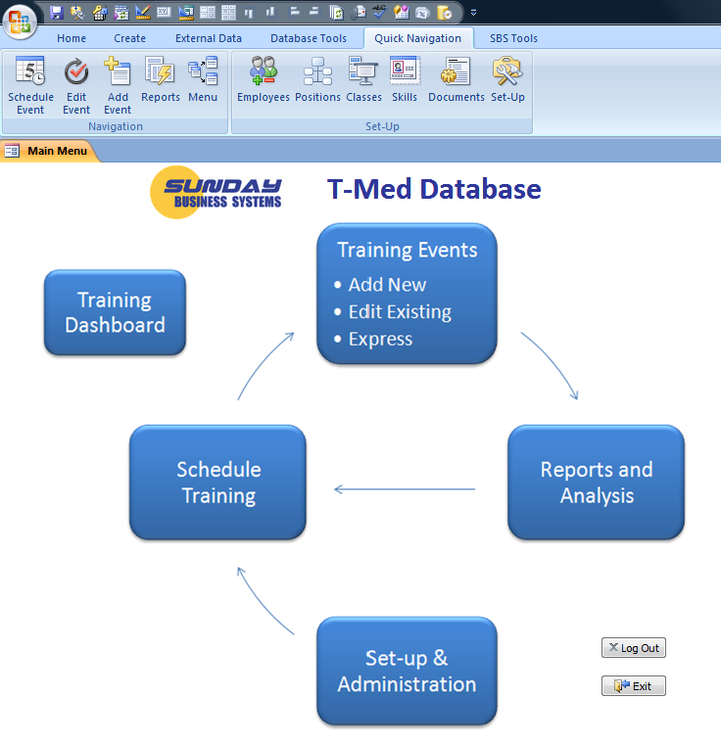
Navigation
There are 2 ways to navigate:
Using the Main Menu
Using the Quick Navigation menu
Or, use the Quick Navigation Links
Click on an item to open a form

Slide 15
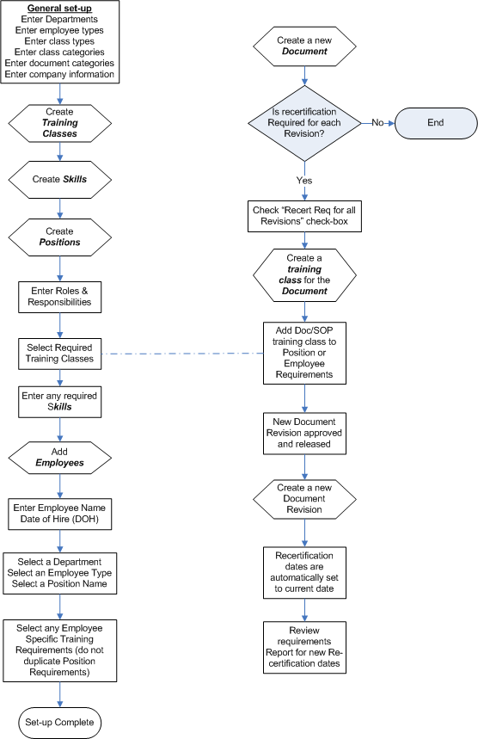
T-Med Database Set-up – Process Flow

Slide 16
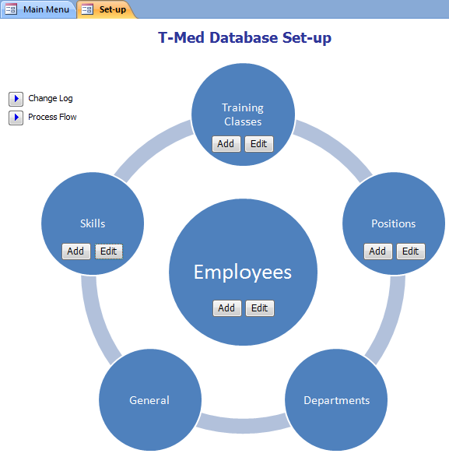
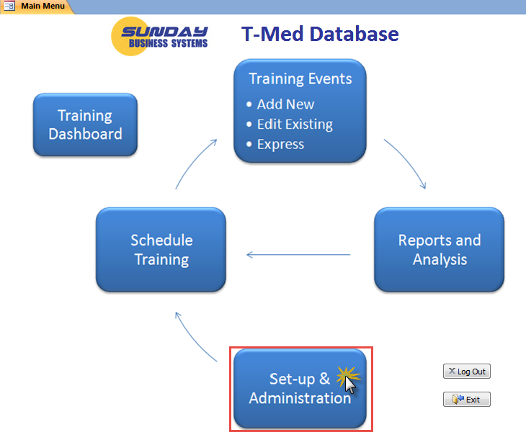
T-Med Database Set-up and Administration

Slide 17
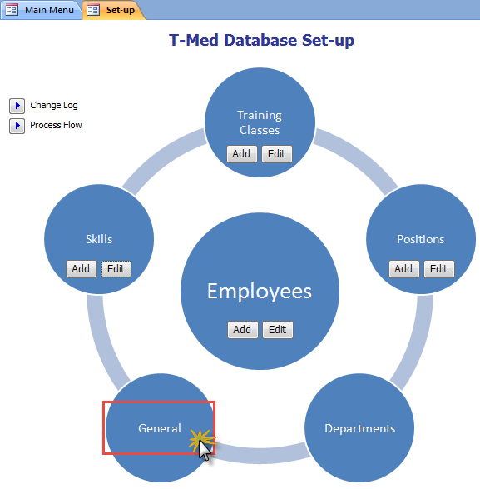
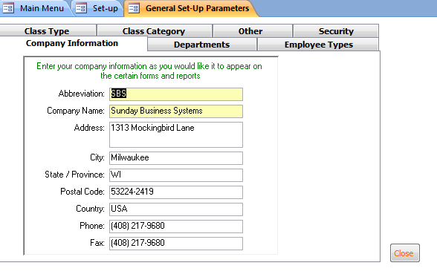
Database Set-up - General
Set-up is organized into tabs

Slide 18
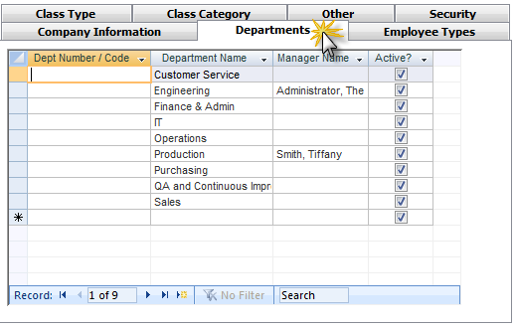
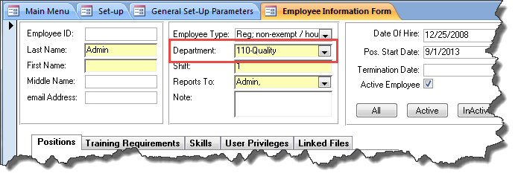
Setup - Add Departments
Add the functional departments that exist within your organization
Department numbers or codes are optional
After employees have been defined, add the department managers
Use

Slide 19
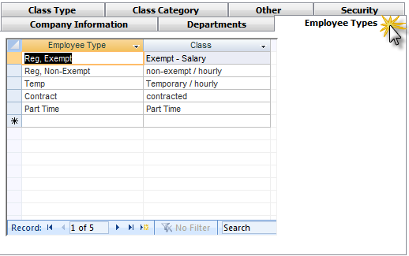
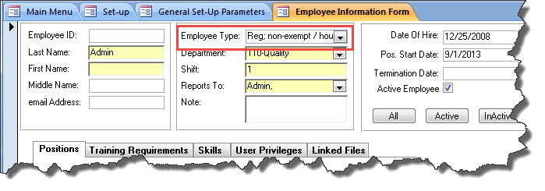
Setup - Add Employee Types
Define employee types
Such as Temporary, contractor, exempt, non-exempt
Use

Slide 20
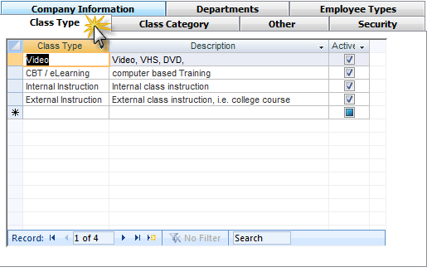
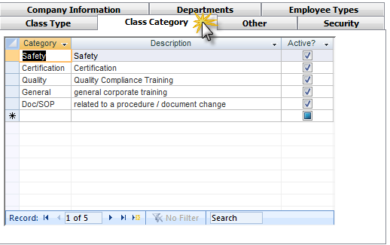
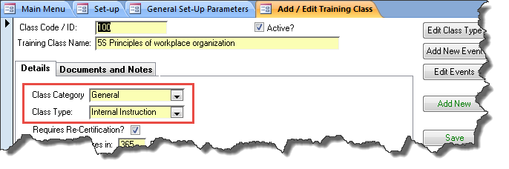
Setup - Add Class Types and Categories
Use

Slide 21
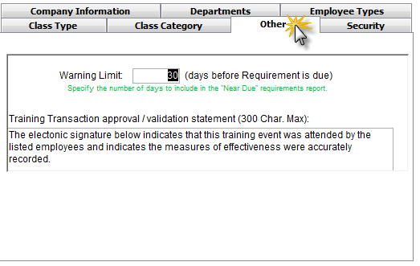
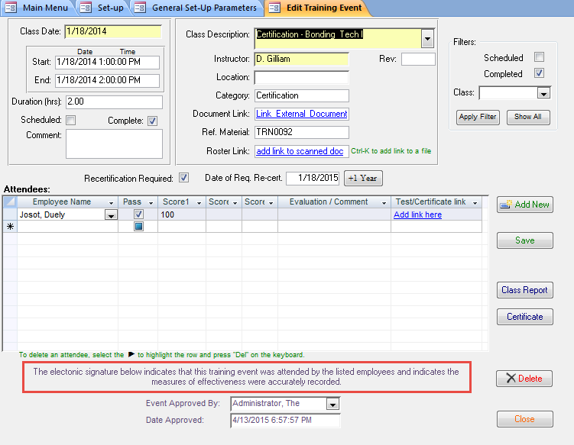
Setup - Other
Define a warning limit for reporting
Specify the number of days to look ahead in the “Near Due” reports
Define the approval validation statement
Use

Slide 22
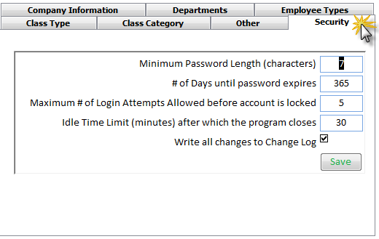
Set-Up - Security
Define password length and expiration
Password must have at least one Capital letter, one lowercase letter, and one number
Limit the number of unsuccessful login attempts
Automatically log out a user after a defined time period
Log all changes to the database (or not)

Slide 23
Database Set-up (Continued)
Create Training Classes
Non-critical tasks – no re-certification
Critical Tasks – Certification Required
Create critical Documents that require Training when new revisions are released
Create Skills
Skills are a group of related training classes assigned to one or more Positions
Create Positions
Enter roles and Responsibilities
Define Position Requirements
Define Training Requirements specifically for that position
Define Skills for the position
Enter Employees
Employees may have more than one position
Define Employee specific training requirements

Slide 24
Create Training Classes
Enter Training Class Name (Title)
What training Category is appropriate?
This field helps organize the training classes
What is the Type of training?
Is Recertification required?
If so, when does the Certification expire?
Define when the training class is scheduled to be completed
The duration
How long does the class take?
Prerequisites
What training is required before this class may be taken?
Define training materials used in the class
Set-up links to training material for easy reference
Use Ctrl-K to add a link to a file

Slide 25

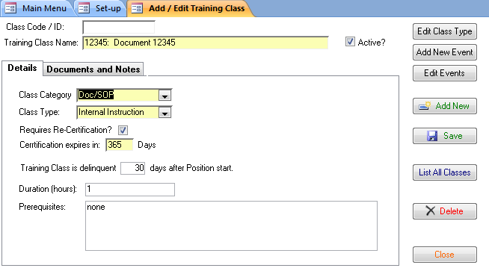
Setup - Add / Edit Training Classes
Fields with yellow background are mandatory.
Gives new employees time to train
Training Class requires re-certification
For how long is the certification valid?

Slide 26
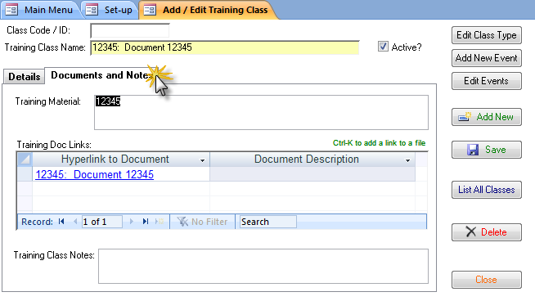
Setup - Add / Edit Training Classes (continued)
List any training material used in the class
Add hyperlinks to any appropriate electronic files

Slide 27
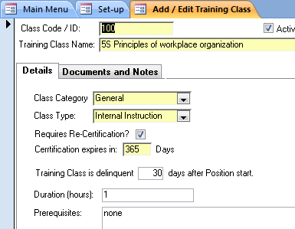
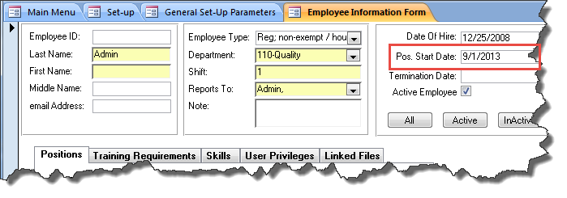
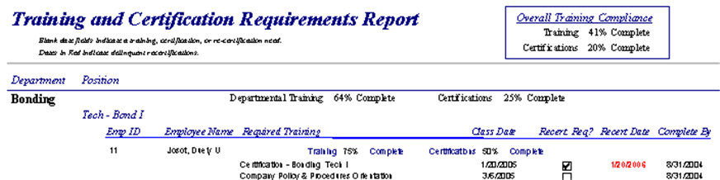
Training Class Delinquencies
Position start date is set on the Employee Information form
Reports show date on which training must be completed
# of days to complete class after position start date

Slide 28
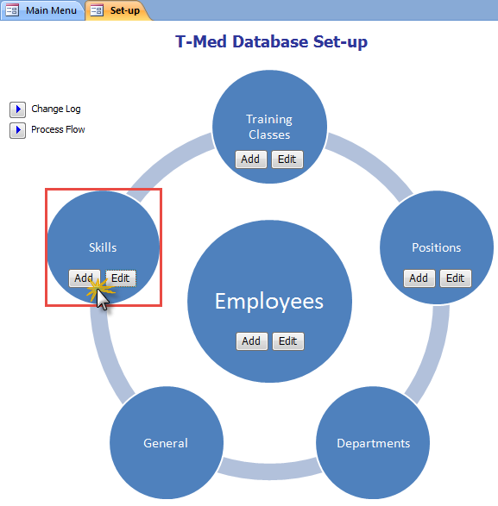
Create Skills
Skills: a group of required training classes
May be assigned to one or many positions
May be assigned to individual employees (regardless of position)

Slide 29
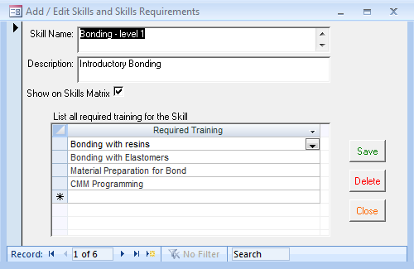
Create Skills
Name the Skill
List all training classes that are associated to the skill
Any number of classes may be attached to a skill
Enter the skill Name
Select the set of training classes that are required for each skill

Slide 30

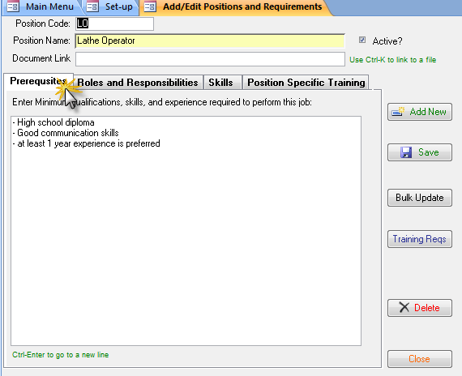
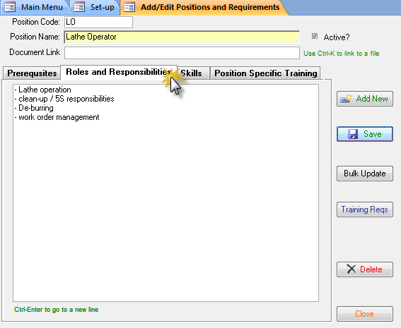
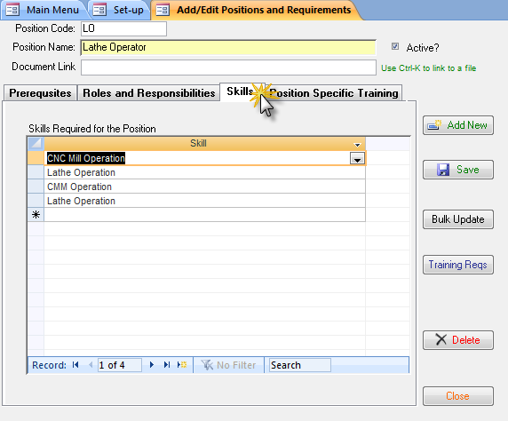
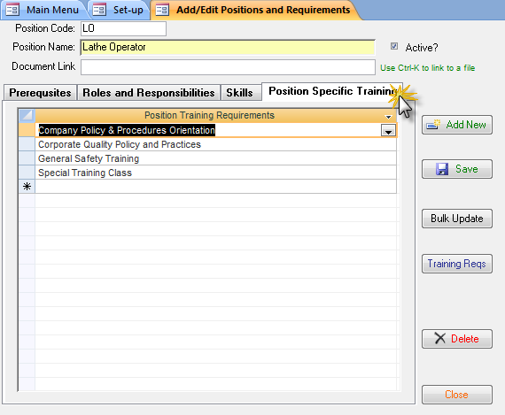
Create Positions

Slide 31
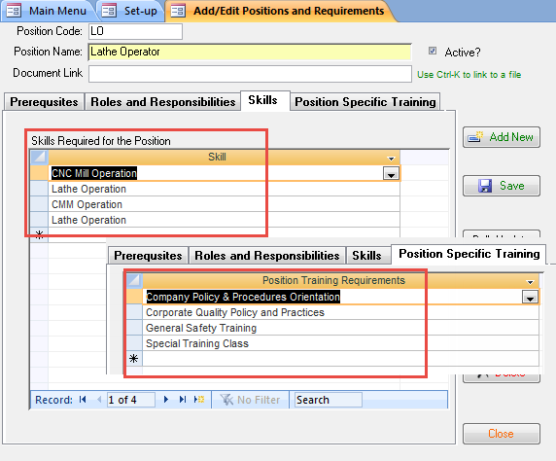
Position Training Requirements
Position Training Requirements = Skills Required + Position Specific Reqs
Position Requirements
Required Training for Position
+
Position Skills

Slide 32
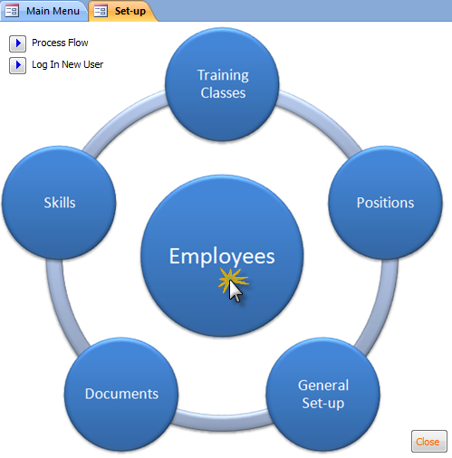
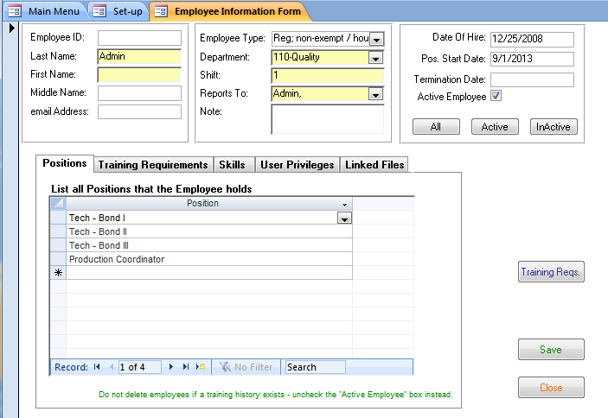
Create a New Employee
Enter Detailed information
(yellow is required)
Filters to display active/inactive employees

Slide 33
Create a New Employee – Assign Positions
Employee may hold more than one position

Slide 34
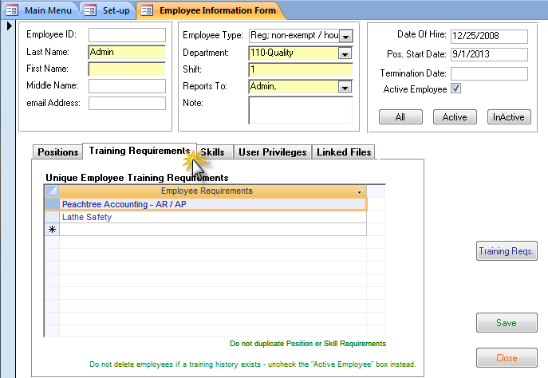
New Employee – Assign Training Requirements
Employee may have unique training requirements (beyond those defined by the position)

Slide 35
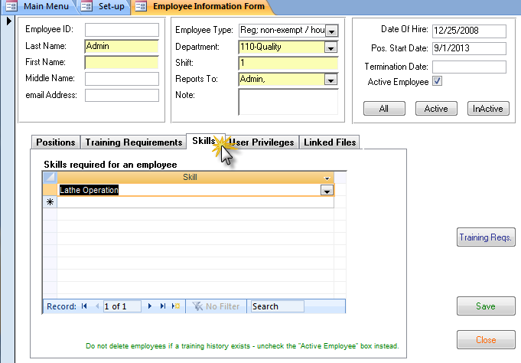
New Employee – Assign Skills
Employee may be assigned unique Skills (beyond those defined by the position)

Slide 36
New Employee – Training Requirements
Employee Training Requirements = Unique Employee Requirements + Employee Skills
Total Training Reqs = Employee Reqs + Position Reqs
Training
Requirements
Employee Requirements
Unique Employee Training Requirements
+
Employee Skills
Position Requirements
Required Training for Position
+
Position Skills
=
+

Slide 37
New Employee – Privileges and Password
If employee is to log in and use the database,
Assign a password
Password must be greater than the minimum # of characters defined in the set-up
Password may be from 1 to 50 characters
Password must include at least one Capital letter, one lowercase letter, and one number
Define which privileges apply
Only active employees may log in to the database
To prevent an active employee from logging in to the database
Click the Delete Username and Password button

Slide 38
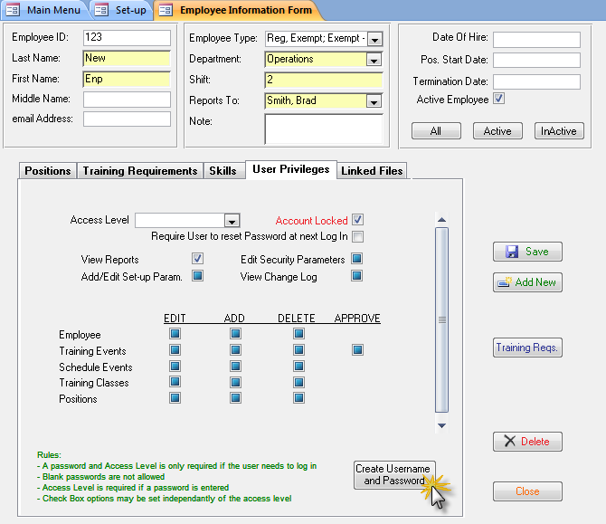
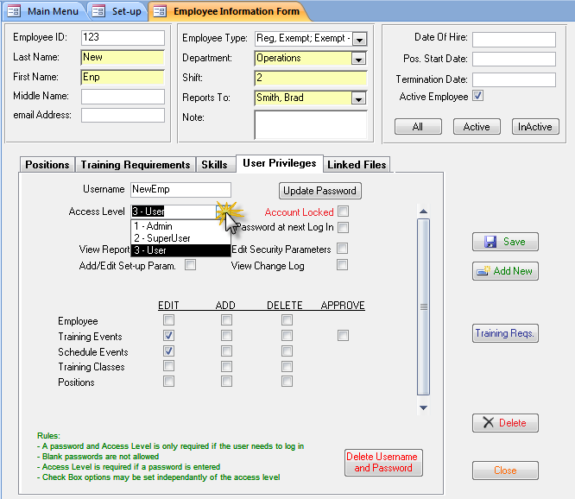
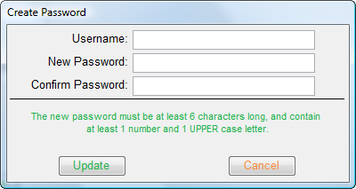
New Employee - Privileges and Password
Select an Access Level
Or set access privileges manually
Click to create login credentials

Slide 39
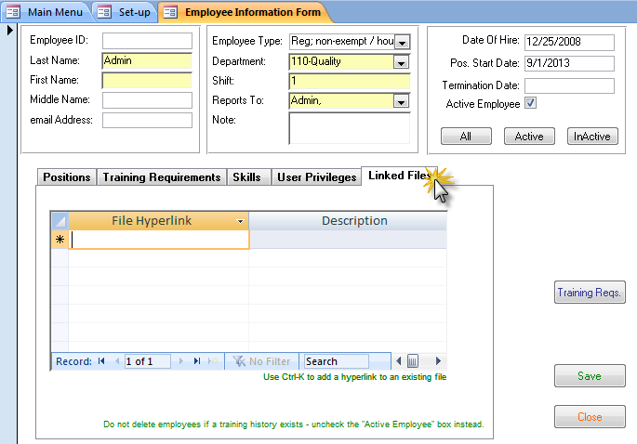
New Employee – Linked Files
Scan and link documents such as resumes / CV’s, prior certifications, licenses, etc

Slide 40
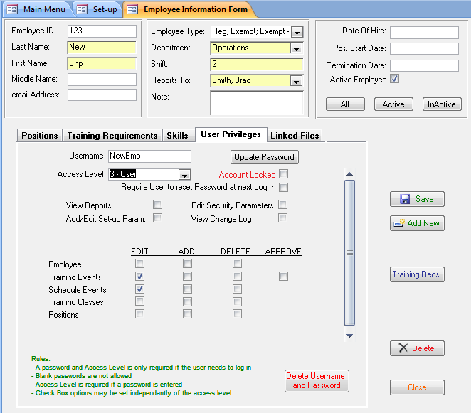
Employee form
Administrator may reset or update the employee’s password using this button
Account will be locked if there are an excessive number of failed login attempts.
Admin must uncheck box and reset password to re-activate the Employee login credentials.
Click to delete employee login credentials

Slide 41

Using the T-Med Database

Slide 42
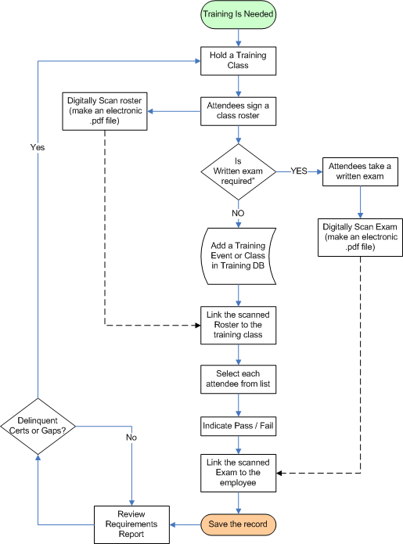
Training Process Flow

Slide 43
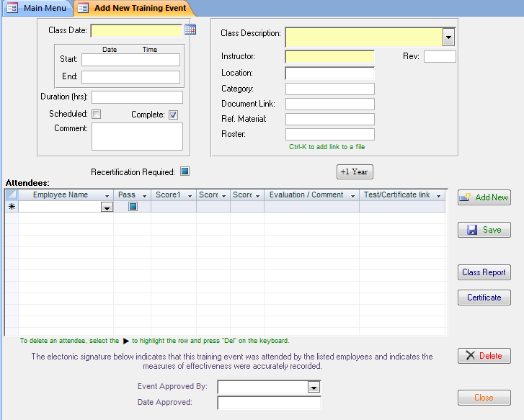
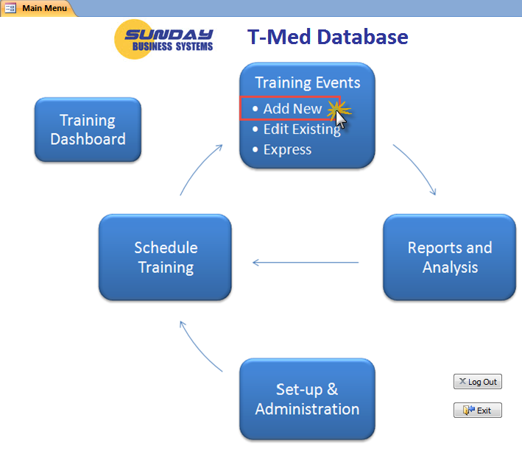
Add a New Training Event

Slide 44
Add a New Training Event
Enter a Class Date
A date range may also be entered, but the single date is required
Duration is either calculated from the date range or entered manually
Select the Class Name from the list
Enter the Instructor Name
The training roster
Have employees sign a roster proving they attended the event
Scan the document and create an electronic file (.pdf)
Link the electronic file to the training event
If recertification is required enter the Recertification Date
Then enter each attendee with Pass/fail
Pass/fail is important for the subsequent reports
If a test was taken, it may be scanned and linked to each employee name
Enter the employees that attended the class and indicate Pass / Fail

Slide 45

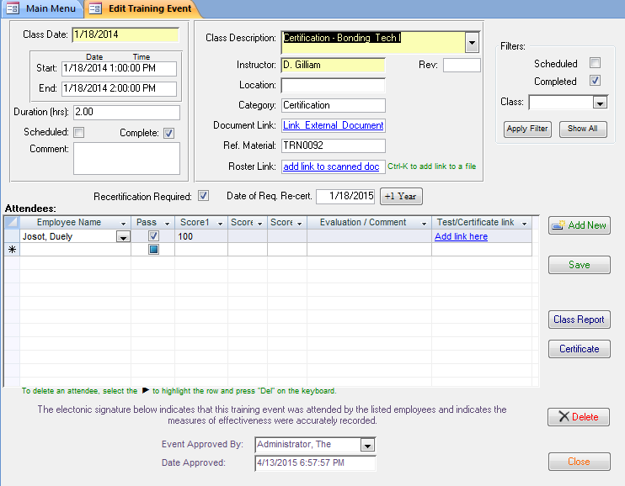
Record a Training Event
Define date when recertification is required
Scan and link electronic roster
Generate a summary report
Scan and link electronic test results
Enter measures of training effectiveness
Print a certificate
Electronic signature required for approval

Slide 46
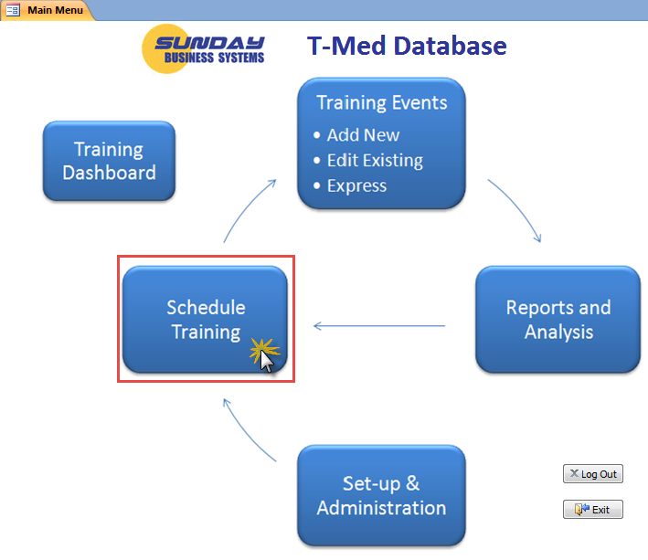
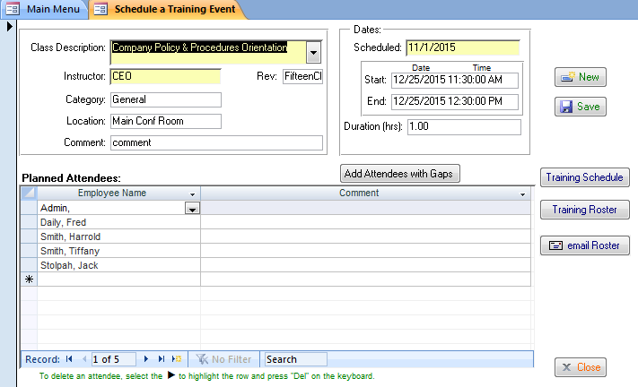
Schedule a Future Training Event
Enter event information
Or, click to add all employees with the specified training class as a gap
Enter employees scheduled to attend

Slide 47
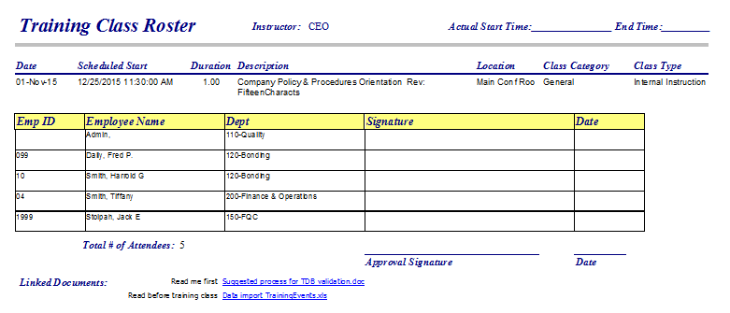
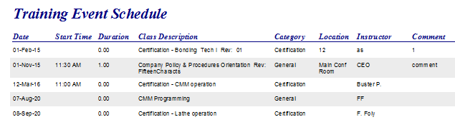
Schedule a Future Training Event
Review the entire training schedule
Click to print a Class Roster (may be used as a “sign-in sheet”, scan and link to event)

Slide 48
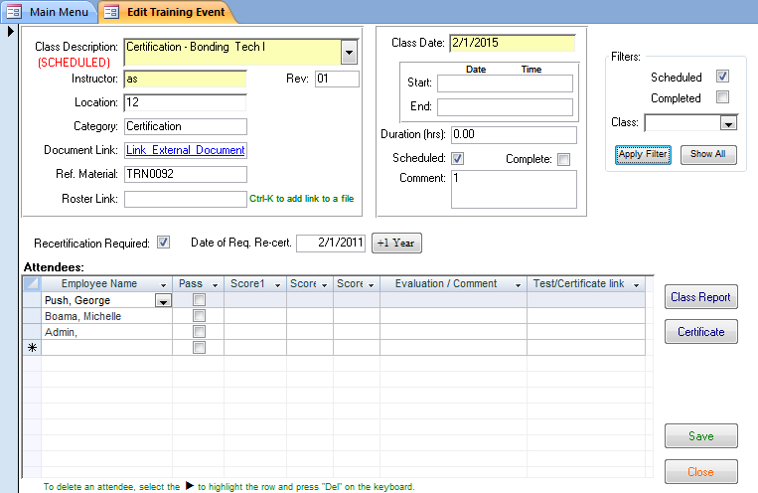
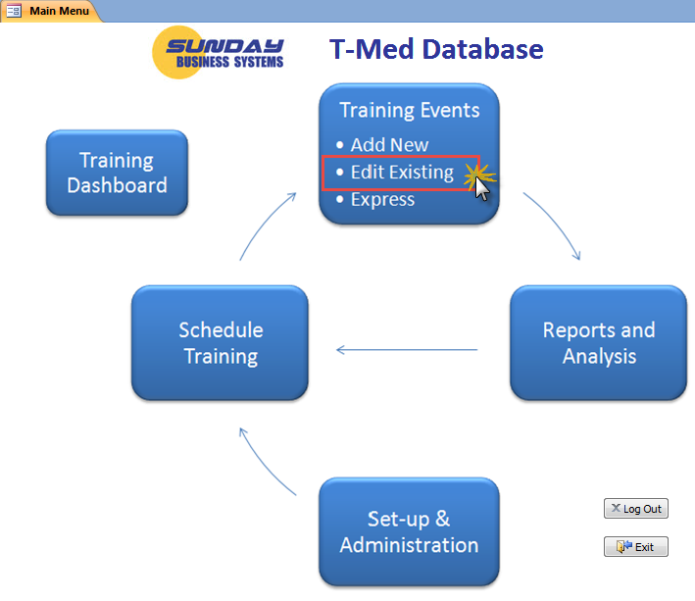
Hold a Scheduled Training Event
Use the Edit Existing Event button to convert a Scheduled event to a Completed event
Filter the form for Scheduled Events
Mark the event as Complete
Scan and link the training roster
Enter Pass/Fail and evaluation details

Slide 49
Reports and Analysis
Historical Reports
Training Requirements
Gaps

Slide 50
Different Report Types
Historical reports
Complete training history
Shows all employees (active or inactive)
Requirements reports
Training Requirements for active employees
Shows all required training
Needed training (training that has not yet been performed)
Needed and Scheduled training
Delinquent re-certifications
Completed training
Gaps reports
Required training for active employees including
Needed training
Needed and Scheduled
Delinquent re-certifications

Slide 51


Configurable Reports
Report Filters
(different filters apply to different reports)

Slide 52

Key Reports – Training History

Slide 53

Key Reports – Gaps By Department
Date In Red indicates recertification is delinquent
Need indicates class has not been taken
Scheduled indicates class has not been taken, but is scheduled

Slide 54

Key Reports – Requirements By Department
Key performance indicators
Date In Red indicates recertification is delinquent
Need indicates class has not been taken
Date In Red indicates training is past due
Scheduled indicates class has not been taken, but is scheduled

Slide 55


Click & Email reports to all delinquent employees
Email addresses are automatically populated

Slide 56


Analyze Employee Turn Over
Analyze employee turn over
Head Count reports
Ratio of Employees hired to Terminated
Turn Over Rate = (# Employees Terminated) / (Total head Count)

Slide 57
Deleting Demo Data
The demo is a full featured demonstration Database
Customers will purchase an activation code and activate the demo

Slide 58

Deleting Demo Data
The demo data may be deleted once you purchase a License key
You may activate the actual file you downloaded and evaluated
To delete a single employee

Slide 59
Summary
The SBS T-Med Database is a cost effective tool to
Ensure effective training compliance with
ISO 13485
21 CFR part 820
AS 9100
TS 16949
ISO 9001:2015
Develop and execute training plans
Maintain paperless quality records
Analyze performance and develop improvement strategies
Save time and effort

Slide 60
Additional Services
Data Import Service
Import legacy data from excel spreadsheets into your Database
Training Services
SBS offers instructor led, Webex based, interactive training sessions
We cover the following subjects:
Vendor Management Database features and benefits
General set-up and configuration
Creating Qual plans / requirements
Creating Qualifying Vendors
Using reports to manage the qualification process
Microsoft Access tips and tricks
Customization
Talk to us about customizing the software to meet your needs!
Contact Sales@SundayBizSys.com for additional details

Slide 61
About SBS
Sunday Business Systems is engaged in software sales and consulting services.
Applies Lean Manufacturing principles to Quality Management Systems
Sells software solutions to small businesses which help them implement ISO 13485 compliant systems for
Employee Training
Document Control
Corrective and Preventive Actions
Risk Management (FMEA)
Control of calibrated equipment
Preventive Maintenance
Vendor Management
Customer Satisfaction Surveys
Statistical Process Control
Shop Floor Control
SBS will customize the software for a particular Customer
Offers full Training services customized to individual needs

Slide 62
Sunday Business Systems
Fueling Small Business Efficiency
Visit www.SundayBizSys.com for:
Additional information
Free product demos
Pricing
Links to purchase software
© 2016 Sunday Business Systems. All rights reserved. This presentation is for informational purposes only. Sunday Business Systems MAKES NO WARRANTIES, EXPRESS OR IMPLIED, IN THIS SUMMARY. Microsoft is a registered trademark of Microsoft Corporation in the United States and/or other countries.

