Slide 1
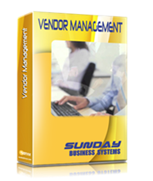
SBS Vendor Management Database™
The Best Value in QMS Software
Features
Benefits
Set-up
Use

Slide 2
ISO 9001:2015 Purchasing Requirements
The SBS Vendor Management Database makes it easy to comply with the ISO 9001 requirements:
8.4 Control of externally provided processes, products and services
The organization shall
determine and apply criteria for the evaluation, selection, monitoring of performance, and re-evaluation of external providers
retain documented information of these activities and any necessary actions arising from the evaluations
5.1.2 Top management shall ensure that:
the risks and opportunities that can affect conformity of products and services are determined and addressed

Slide 3
ISO 9001:2015 Compliance
The SBS Vendor Management DB is used to
Establish Vendor Qualification plans
Complies with “determine and apply criteria for…external providers”
Qualify Vendors
Complies with “…the evaluation and selection…of external providers”
Re-Qualify Vendors
Complies with “…apply criteria for the…re-evaluation of external providers”
Maintain a paperless record of all qualifications and re-qualifications
Complies with “retain documented information of these activities”
Quickly generate reports showing when qualification and requalification is required

Slide 4

Traditional Methods
Excel Spreadsheets
Paper files filled with
Vendor Surveys,
performance data
On-time delivery reports
Non-conformance reports
Return to vendor
Problems
Time consuming
Requires large storage area
Difficult to manage
Difficult to audit

Slide 5
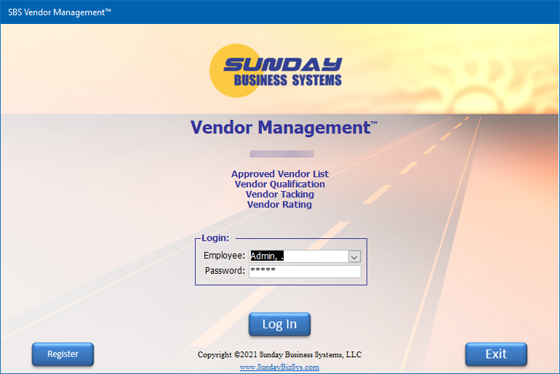
SBS Vendor Management
Easy to use, menu driven
Tracks detailed vendor information
General contact information
Allows multiple contacts for each vendor
Vendor Type
Vendor Status
Define unique Qualification plans
Different vendors may have different plans
Record Qualification results
Track re-certification status
Full set of reports
Email reports directly
Export data to Excel for analysis
Built using Microsoft Access
Runtime version of Access is included
No need to purchase Microsoft Access separately

Slide 6

Database Set-up and Configuration

Slide 7
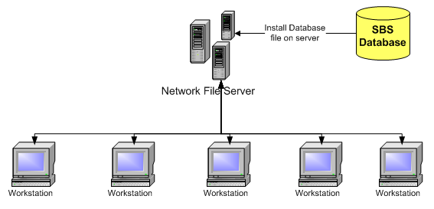
Easy Installation
Download the demo database
Save or copy the VendorMgmt.accde or VendorMgmt.mde file to a designated folder on your Network File Server
Once purchased, register the demo database (enter the Product Key)
Ensure all Workstations have
Microsoft Access or the free Runtime version of Microsoft Access
Read and write privileges to the designated folder on the Network File Server
Note: The above graphic is for stand alone Access databases - SQL configurations are different

Slide 8
Login Screen
The login process limits access to the database features
The Demo version includes dummy data and employees
Admin is the default login for demo versions (unregistered)
Admin has full Database privileges
Employee: Admin
Password: admin
All other employees password = pw

Slide 9
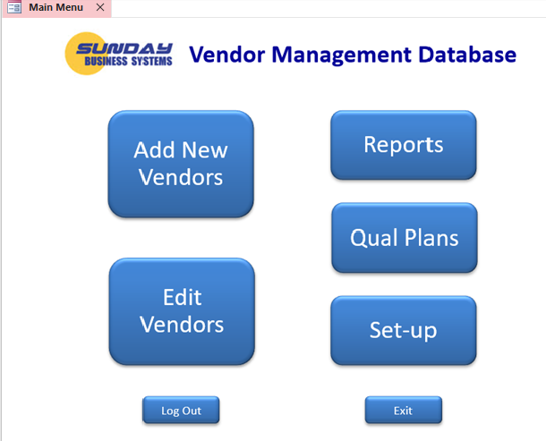
The Main Menu
Large buttons to make navigation easy

Slide 10
Preparation
Vendors
Develop a list of vendors
Classify each as critical or non-critical
(you may also create a new vendor type)
Define the list of tasks required to qualify each vendor
For example
Must maintain a valid ISO 9001 registration
Must maintain on time delivery of >90% each quarter
Must maintain fewer than 1% nonconformance rate
Must complete the vendor survey

Slide 11

Overview: Database Set-up
Enter Company information
Preferred freight carriers
The vendor types
Vendor status
Vendor qualification plans
Create qualification tasks
Build a qualification plan from the list of tasks
Enter Employees
Define Employee specific training requirements
Enter vendor details

Slide 12
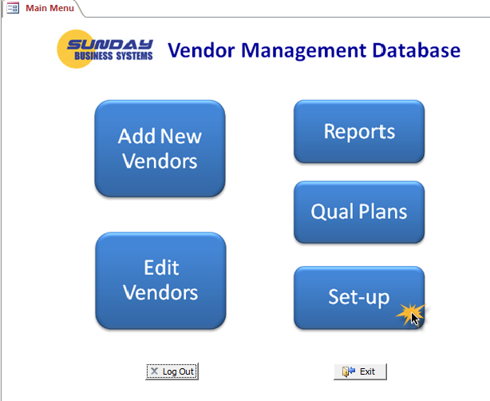
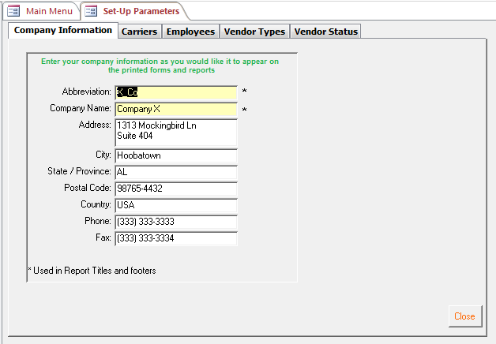
General Set-up Parameters
Set-up parameters are organized into multiple tabs

Slide 13
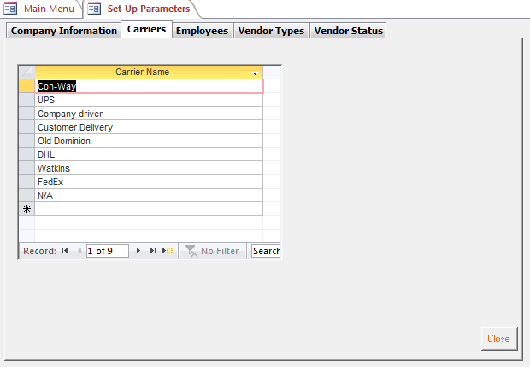
Set-up Parameters – Shipping Carriers
List all preferred carriers

Slide 14
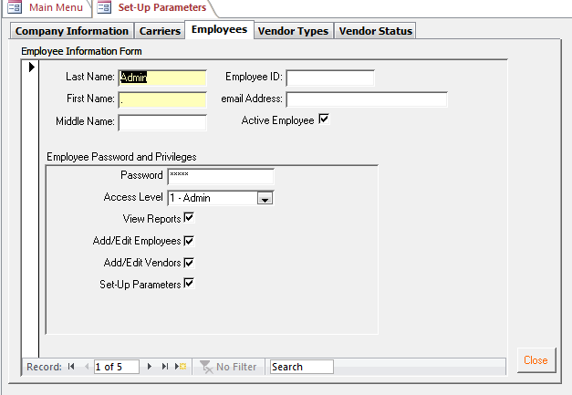
Set-up Parameters – Employees
Add Employee Information
Add Password and assign privileges

Slide 15
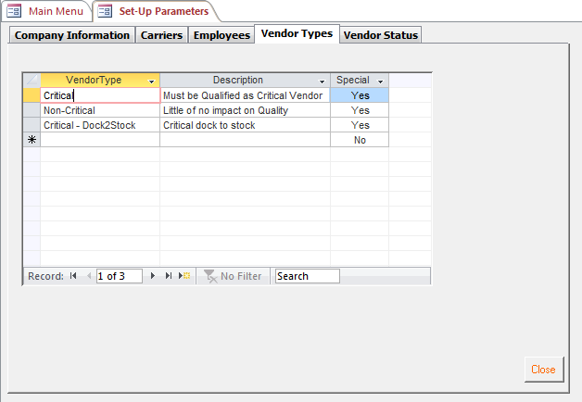
Set-up Parameters – Vendor Types
Add Vendor Types (Risk based classification)
Special vendor Types cannot be changed

Slide 16
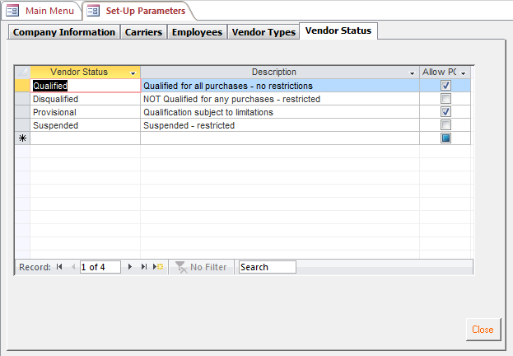
Set-up Parameters – Vendor Status
Add Vendor Status (based on Qualification criteria)
Note: Special vendor Status’s cannot be changed

Slide 17
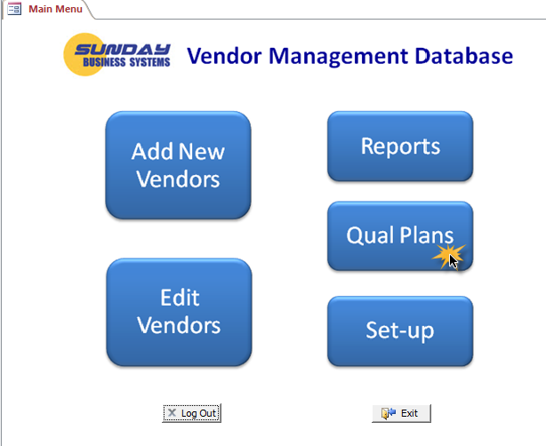
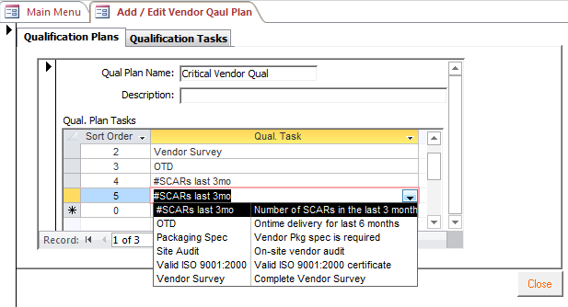
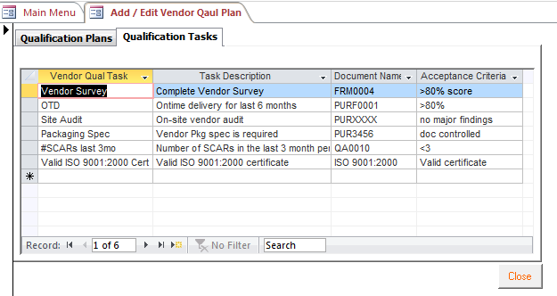
Qualification Plans
The Qualification Plan is a list of tasks that will be scheduled, scored, and marked as Pass / Fail
Create a list of Qual. Tasks
Build the qualification plan by selecting each task from the drop down list

Slide 18
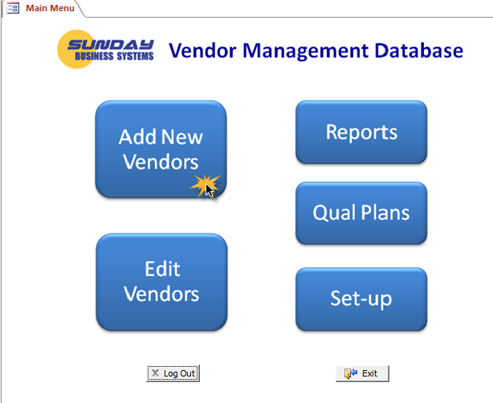
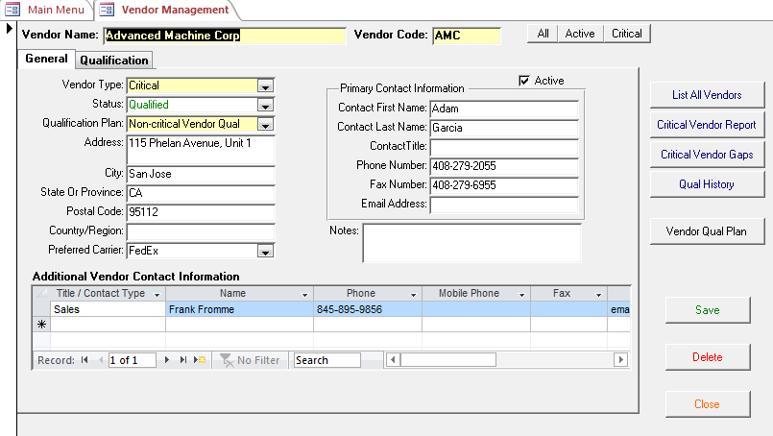
Using the Database – Add or Edit Vendors
Yellow background indicates a required field
Form filters to display a sub-set of Vendors
Enter General Vendor details
Key Vendor management parameters
Enter multiple contacts for a single vendor

Slide 19
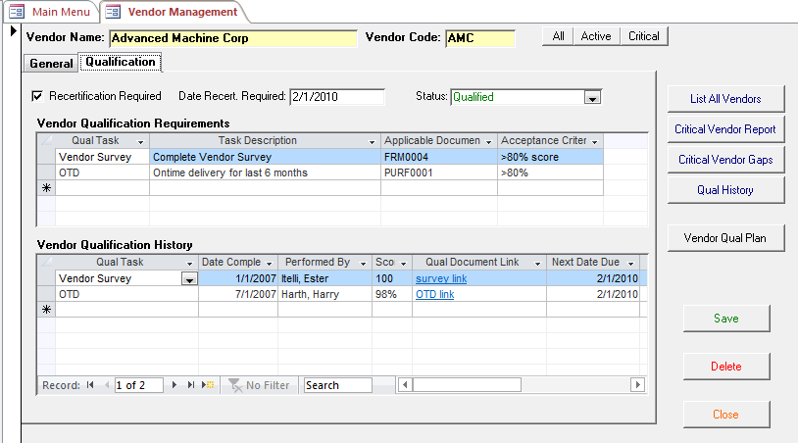
Using the Database
Define recertification dates
Manage the qualification process
Record complete Qualification history
Define recertification dates
Define due dates for individual tasks
Scan and link supporting documents
Record complete Qualification history
Scan and link supporting documents
Define due dates for individual tasks

Slide 20
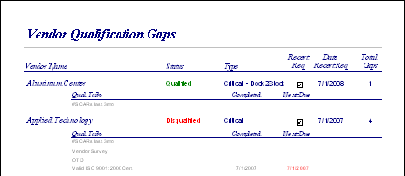
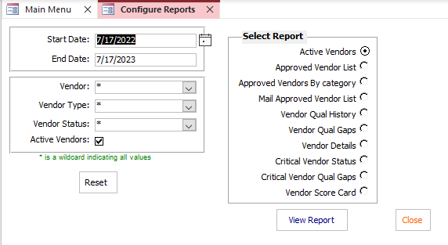
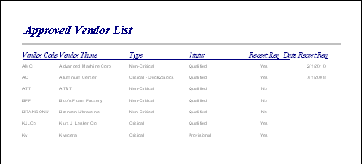
Configurable Reports
Rich set of configurable reports

Slide 21
Summary
The SBS Vendor Management is a cost-effective tool to
Ensure effective compliance with
ISO 9001:2015
AS 9100
TS 16949
OHSAS 18001
ISO 14001
API Q1
Develop and execute vendor qualification plans
Maintain paperless quality records
Analyze performance and develop improvement strategies
Save time and effort

Slide 22
Additional Services
Data Import Service
Import legacy data from excel spreadsheets into your Database
Training Services
SBS offers instructor led, Webex based, interactive training sessions
We cover the following subjects:
Vendor Management Database features and benefits
General set-up and configuration
Creating Qual plans / requirements
Creating Qualifying Vendors
Using reports to manage the qualification process
Microsoft Access tips and tricks
Customization
Talk to us about customizing the software to meet your needs!

Slide 23
About Sunday Business Systems
Founded in 2004, Sunday Business Systems provides cost effective software and training services to achieve compliance to quality standards such as ISO 9001, AS9100, TS16949, ISO 13485 and API Specification Q1.
SBS provides eQMS (Electronic Quality Management System) software solutions for:
Document control
Corrective and preventive action management
Risk management (FMEA / SWOT)
Non-conformance tracking
Audit Management
Control of calibrated equipment
Employee training management
Supplier management
Preventive Maintenance
Control of Calibrated Equipment

Slide 24
About Sunday Business Systems
In addition to our standard products, we use our extensive manufacturing operations experience to provide consulting services and to develop custom solutions for small businesses.
We specialize in consulting for ISO 9001:2015 registration and for operations systems such as ERP / MRP implementations.
In addition to customizing our standard products, we have developed custom software solutions for MES (Manufacturing Execution Systems), clinical data collection, QA / inspection, accounting reports, SOX compliance, and more.
Contact SBS for additional details
Sales@SundayBizSys.com

Slide 25
Sunday Business Systems
The Best Value in QMS Software
Visit www.SundayBizSys.com for:
Additional information
Free product demos
Pricing
Links to purchase software
© 2023 Sunday Business Systems. All rights reserved. This presentation is for informational purposes only. Sunday Business Systems MAKES NO WARRANTIES, EXPRESS OR IMPLIED, IN THIS SUMMARY. Microsoft is a registered trademark of Microsoft Corporation in the United States and/or other countries.
Notes:
<number>

