Slide 1
Tips and Tricks
Improve your user experience
Use SBS products more efficiently

Slide 2
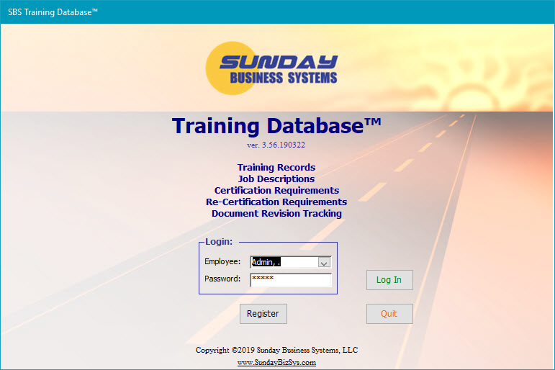
The Basics
SBS has built its QMS products on Microsoft Access Database
Microsoft Access consists of
  Tables
    Where data is stored
  Queries
    Questions asked of the database
  Forms
    Displays data (or records)
    Controls the entry & editing of data
    Records are made up of fields
    Forms may have subforms
  Reports
    Based on queries
    Formats and organizes information
Our software user interface
  Consists of forms and reports
  Tables, queries and code are hidden for simplicity
The SBS Training Database will be used to demonstrate Tips and Tricks

Slide 3
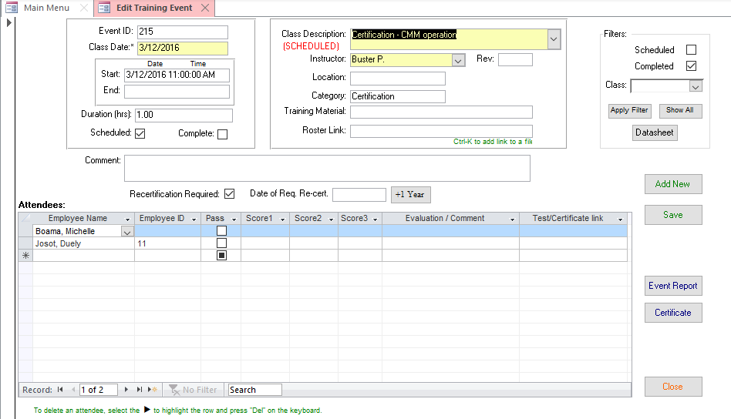
Form Basics
►
Is the Record Selector
Navigation controls
Global search

Slide 4
Form Navigation
Move to FIRST Record
Move to LAST Record
Filter Indicator
…currently indicating the filter is OFF and all records are displayed
Move to PREVIOUS Record
Move to NEXT Record
ADD NEW Record
Global Search function

Slide 5
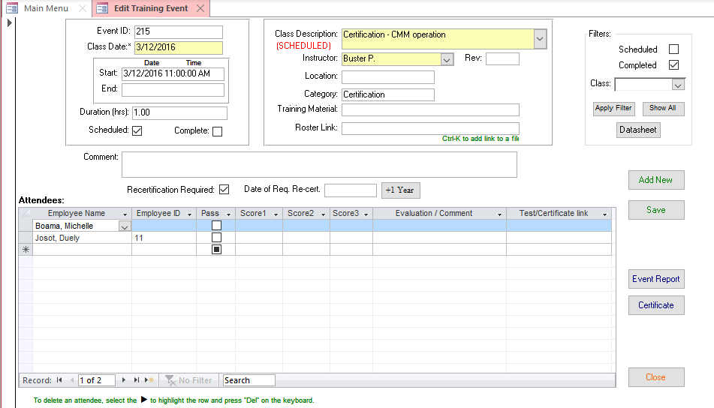
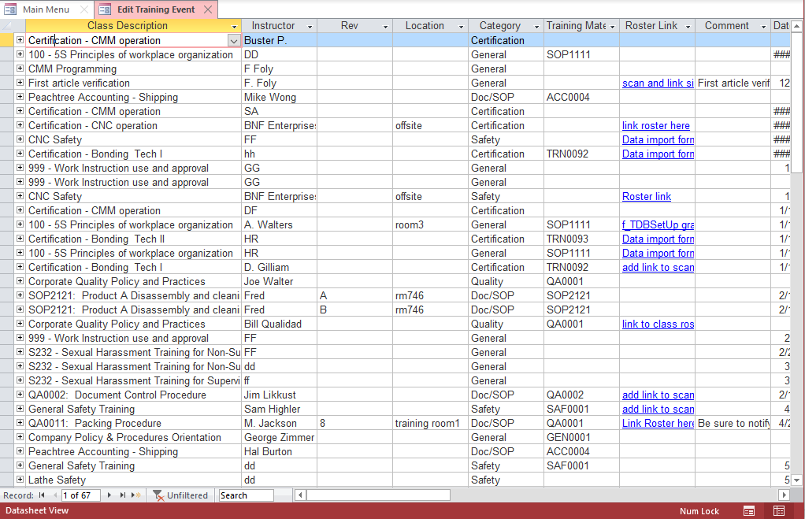
Two ways to view data in forms
Data may be viewed in
  Form View
    one record at a time
  Datasheet View
    multiple records displayed like in a spreadsheet
    Subforms may be displayed by clicking the + on the left-hand side of the record
    Not all forms are designed for Datasheet view
Form View
Datasheet View

Slide 6
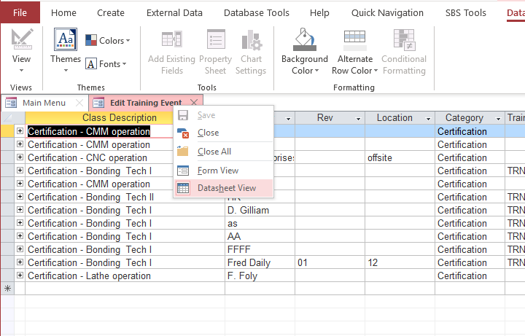
Forms in Datasheet View
1) Right Click
2) Select Datasheet View

Slide 7
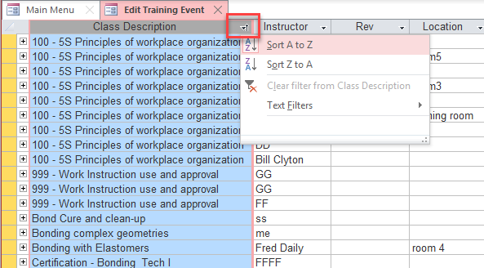
Datasheet View
Drag column to re-arrange column order
Drag column separator to change width (double-click to auto re-size)
Sort and filter with a click on the right button

Slide 8
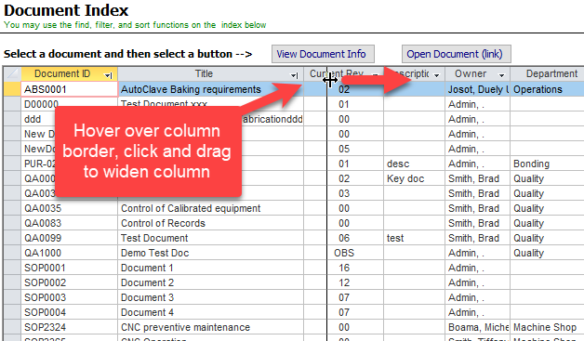
Datasheet View
Drag column separator to change width (double-click to auto re-size)

Slide 9
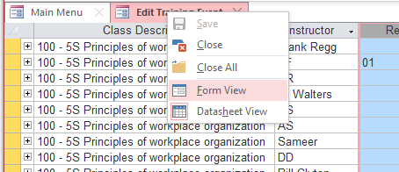
Return to Form View
Right click tab - select Form View to return to form view
OR
Select the desired row and double click

Slide 10
ADDING, EDITING, AND DELETING RECORDS

Slide 11
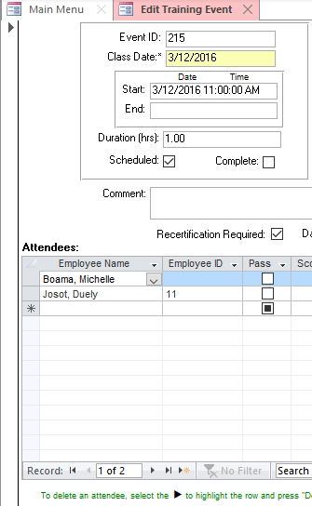
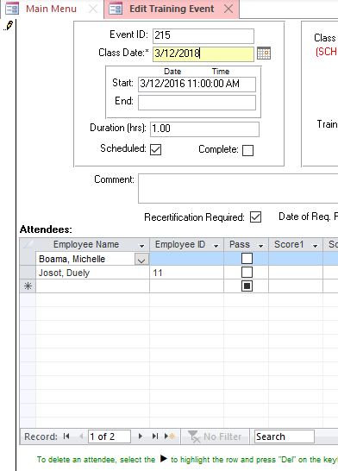
Editing a record
Record Selector changes to a Pencil when record is being edited
…At this point, a change may be cancelled by pressing the Esc key on the keyboard
To save a record:
Click on the record selector,
change records,
click a save button, or
close the form
…Once a record is saved or deleted, there is no way to cancel or Undo the change.

Slide 12
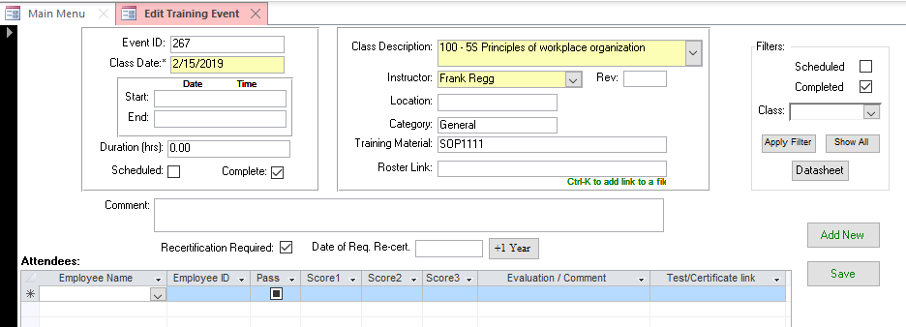
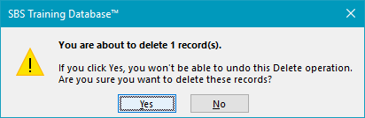
Delete a Single Record
1) Click Record Selector to highlight the record
2) Press DELETE on the keyboard
3) Confirm Record Deletion
Note: Once the DELETE action is confirmed, the records are permanently deleted

Slide 13
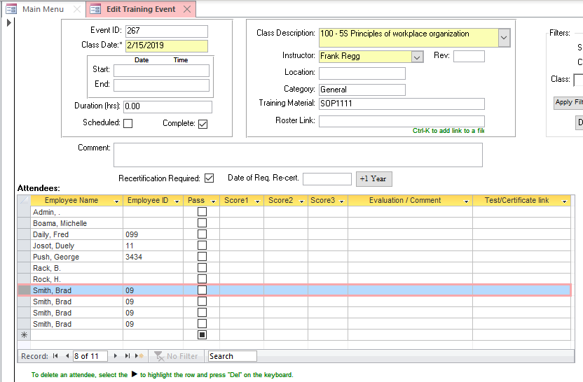
Delete Multiple Records
1) Click Record Selector to highlight the 1st record

Slide 14
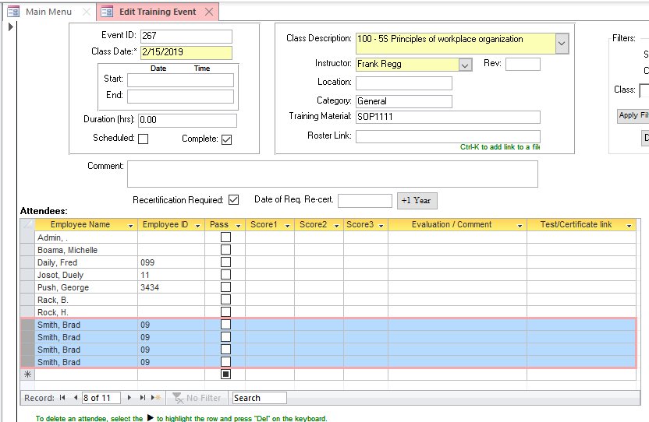
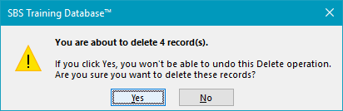
Delete Multiple Records
4) Confirm Record Deletion
2) Hold SHIFT key down and select last record selector
3) Press DELETE on the keyboard

Slide 15
FINDING AND FILTERING RECORDS

Slide 16
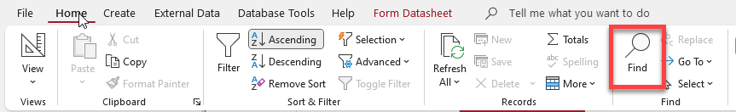
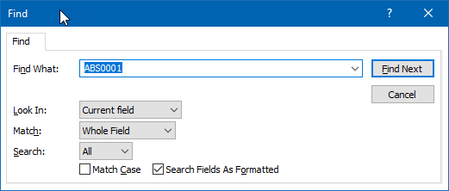
Finding records
Global Search function
There are 3 methods for searching records in forms
  Use the global search from the navigation panel at the bottom
  Click the Find button in the Home ribbon (near the top)
  Use a keyboard short-cut: Ctrl-F

Slide 17
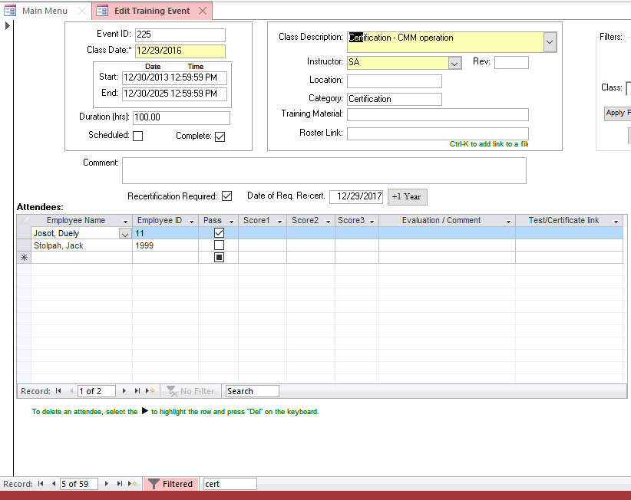
Finding records using global search
The 1st instance of the search string is displayed
…Press ENTER on the keyboard to find the next occurrence
1) Enter a text string into the search field

Slide 18
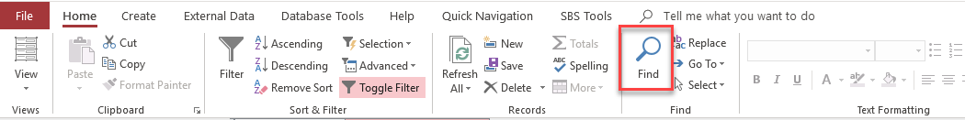
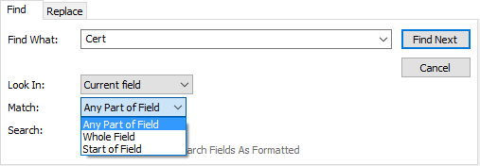
Finding records with search
Click on the form field that you want to search
Click on the Home menu and then on the Magnifying Glass in the Ribbon
Enter search criteria
  Find What: (enter your search string)
  Look In
    Current field or
    Current document (form) – same as global search
  Match criteria
    Any Part of Field
    Whole Field (exact match)
    Start of field

Slide 19
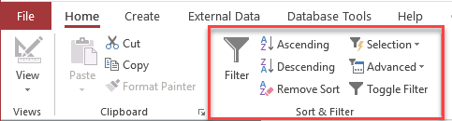
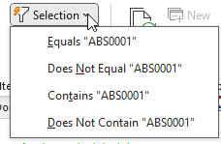

Using Filters to display limited data
Find one instance of the string you want in the filter's results.
1) Select/highlight the string
2) In the “Sort & Filter” ribbon section, Click “Selection”
  3) Choose filter type:
    String “Begins with”
    String “Does NOT begin with”
    String “Contains”
    String “Does NOT contain”
Filtered forms will display a limited set of records
  The total number of records will change
  The filter indicator in the navigation panel will change to “Filtered”

Slide 20
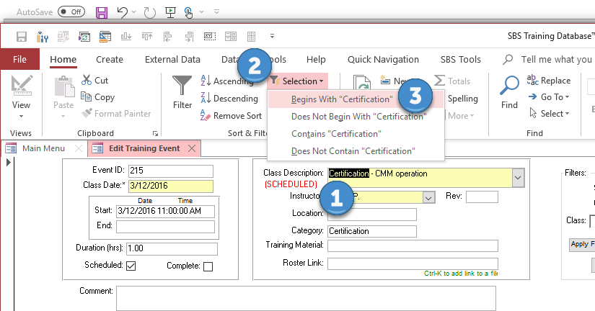
Using Filters

Slide 21
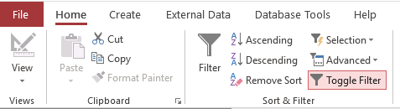
Using Form Filters
To reset the filter,
  Click the “Toggle Filter” on the “Sort & Filter” ribbon
  Or Click the “Filtered” button at the bottom of the form
  Note that the button changes to and the record count will change

Slide 22
SORTING RECORDS

Slide 23
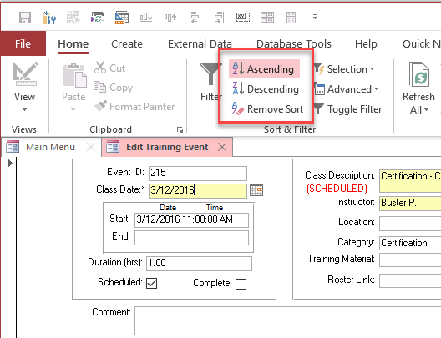
Sort Records
Click on the field you want to sort
Click on the sort Ascending or Descending button in the ribbon

Slide 24
Finding data in Datasheet View
Sort and filter with a click on the right button

Slide 25
TIME SAVING TRICKS

Slide 26
Time saving tricks
Action | Keyboard combination
Enter the current date | Ctrl + ;
Enters the current time | Ctrl + Shift + :
Enters the previous value in the field | Ctrl + ‘
Search for records (find) | Ctrl + F
Move to the next field | Tab key
Move to the previous field | Shift+Tab
Open the Print dialog box for reports | Ctrl+P
Open the Find and Replace dialog box | Ctrl+H
Add a new record | Ctrl+Plus Sign (+)
Exit Access | Alt+F4

Slide 27
CUSTOMIZE ACCESS

Slide 28
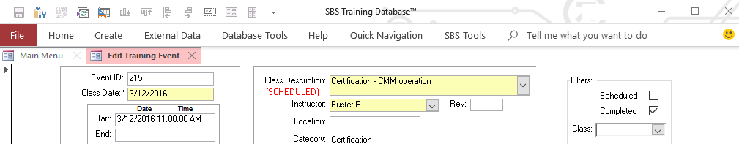
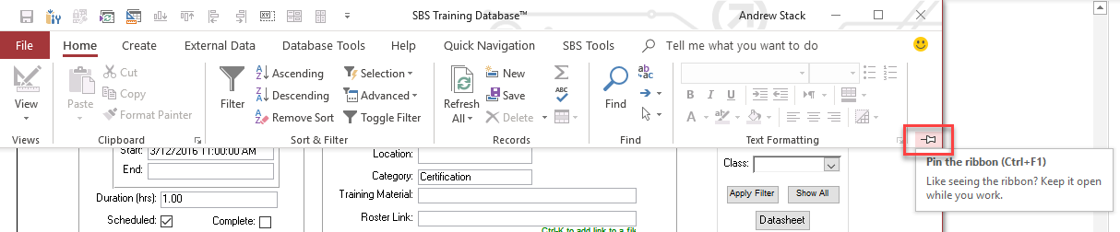
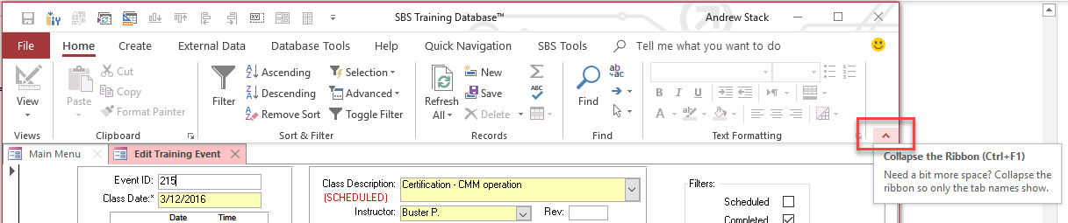
Hide or Display the Access Ribbon
Ribbon may be hidden
Pin the ribbon
Collapse the ribbon
Ribbon is hidden

Slide 29
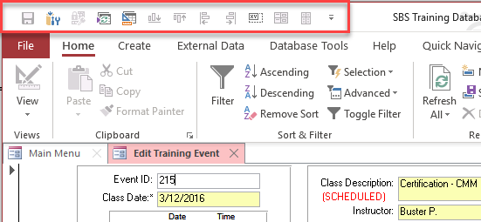
Quick Access Toolbar
Quick Access Toolbar is great for commonly used functions
Quick Access Toolbar

Slide 30
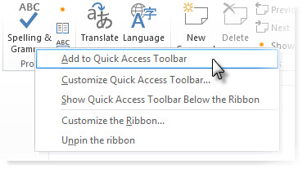
Quick Access Toolbar
Add a command to the Quick Access Toolbar (from the ribbon)
  On the ribbon, click the appropriate tab or group to display the command that you want to add to the Quick Access Toolbar
  Right-click the command,
  then click Add to Quick Access Toolbar on the shortcut menu

Slide 31
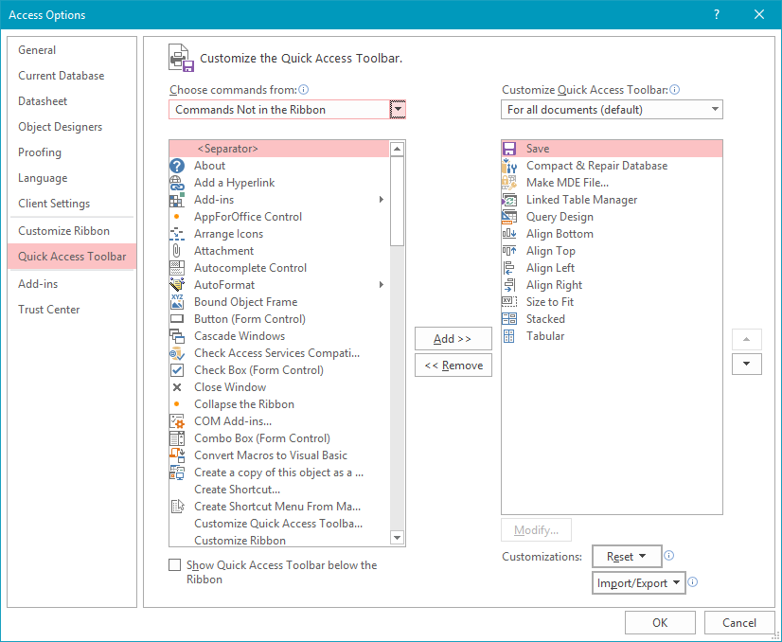
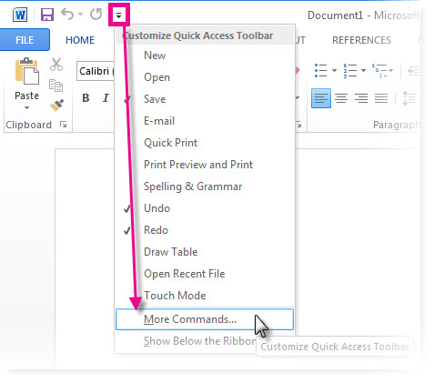
Quick Access Toolbar
Click Customize the Quick Access Toolbar > More Commands
In the Choose commands from list, click Commands Not in the Ribbon
Find the command in the list, and then click Add

Slide 32
AVOID THE START-UP SECURITY NOTICE

Slide 33
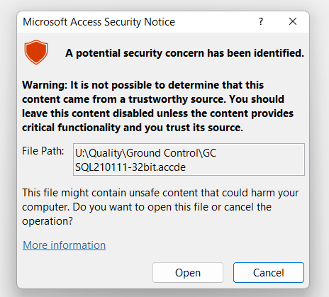
Microsoft Access Security Notice
When you first open a database in Microsoft Access, you will receive a “Security Notice”
“A Potential security concern has been identified."
This is normal, but annoying since SBS products are safe and trustworthy
This notice may be disabled by using the Trust Center settings

Slide 34
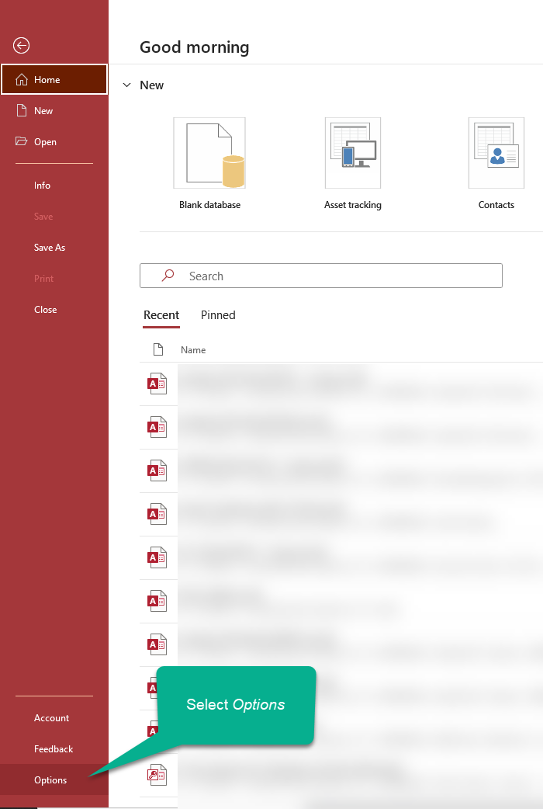
Define a Trusted Location
Define a Trusted Location
  Open Microsoft access
  click File from the menu
  click options near the bottom of the page

Slide 35
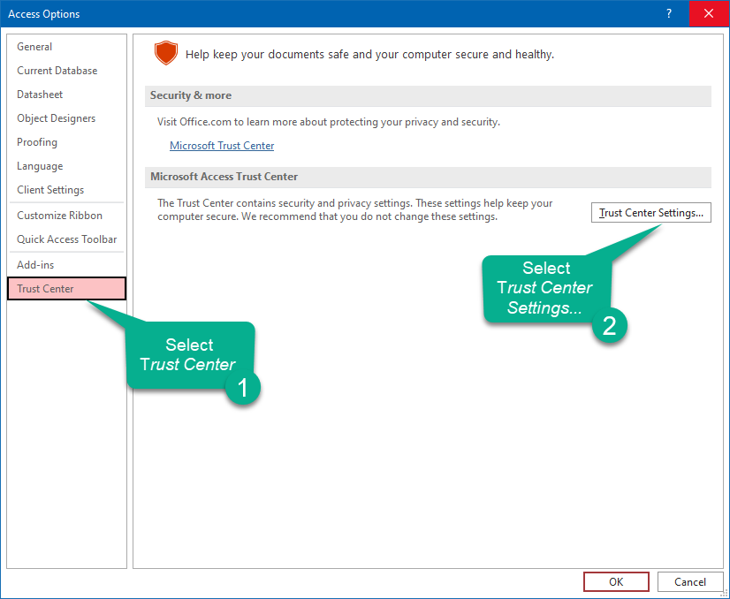
Define a Trusted Location
Select “Trust Center”
Select “Trust Center Settings”

Slide 36
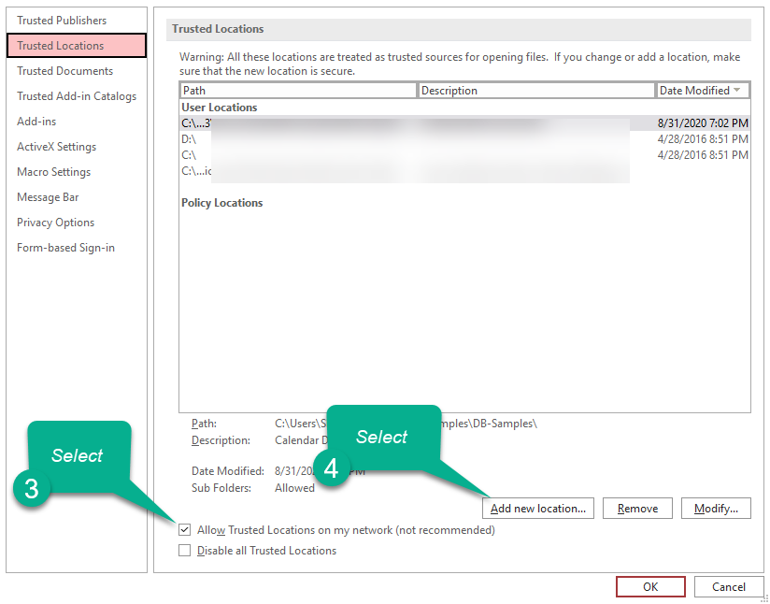
Define a Trusted Location
Select “Allow Trusted locations on my network”
Select “Add new Location...”

Slide 37
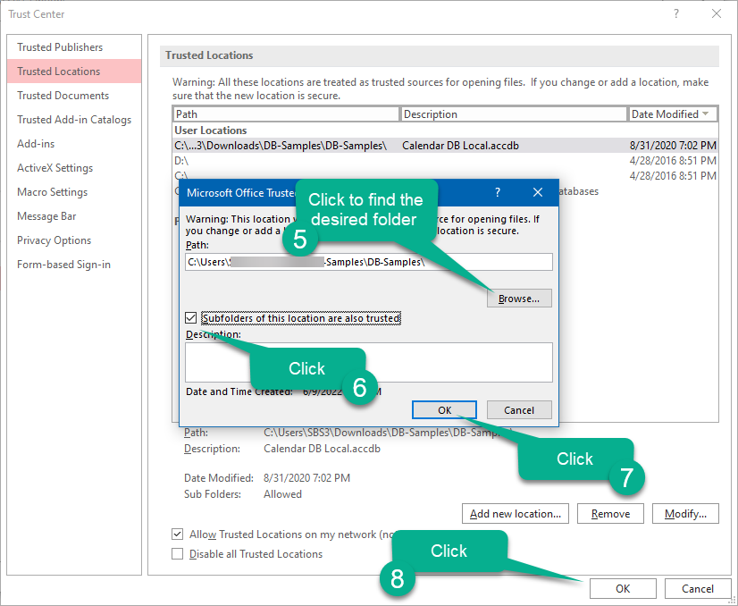
Define a Trusted Location
Select “Browse”
Check “Subfolders...” (if applicable)
Select “OK”
Exit and re-start your database
You will no longer see the annoying security notice

Slide 38

QMS Software solutions for
Document control
Corrective and preventive action management
Non-conformance tracking
Audit Management
Control of calibrated equipment
Employee training management
Supplier management
FMEA / Risk management
Preventive Maintenance
Visit www.SundayBizSys.com for:
      Additional information
      Free product demos
      Pricing
      Links to purchase software
© 2024 Sunday Business Systems. All rights reserved. This presentation is for informational purposes only. Sunday Business Systems MAKES NO WARRANTIES, EXPRESS OR IMPLIED, IN THIS SUMMARY. Microsoft is a registered trademark of Microsoft Corporation in the United States and/or other countries.
Notes:
<number>

