Slide 1
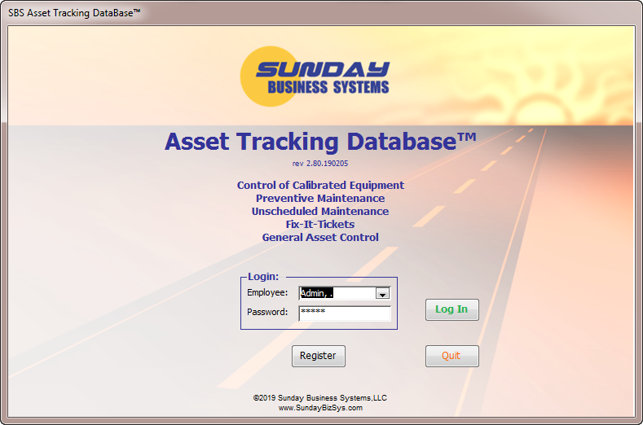
SBS Asset Tracking Database
Features, Benefits, & Use
Manage Company Assets (Equipment)
Track Calibrated Equipment
Manage Preventive Maintenance
Perform General Maintenance Activity

Slide 2
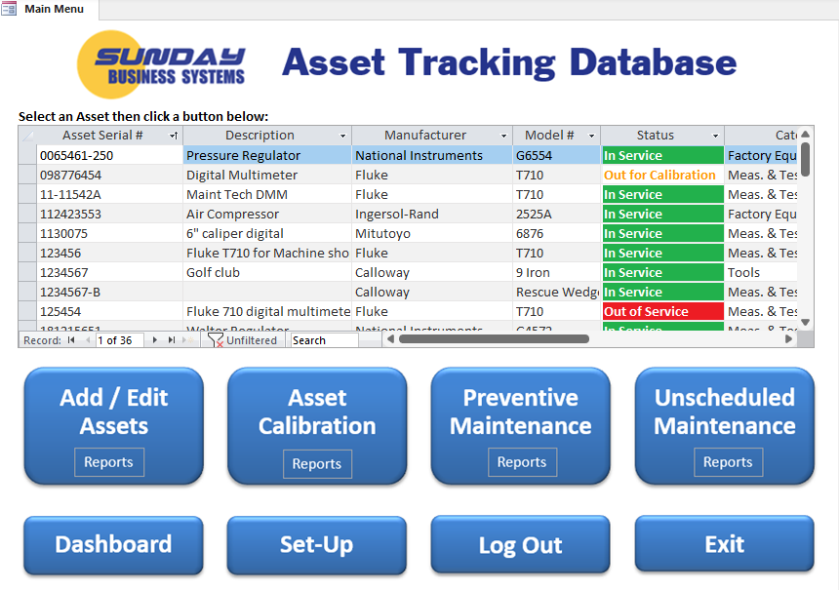
Asset Tracking Database – 4 Main Functions
Asset Management and Control
Control of Calibrated Equipment
Manage Preventive Maintenance
Track Unscheduled Maintenance
  Fix-It-Tickets

Slide 3

Features
Tracks Equipment (or Assets) through their life cycle
  From purchase to sale or scrap
  Define which assets require calibration
  Define which assets require Preventive Maintenance (PM)
Manage Calibrated Equipment
  Document in-house calibration or verification
  Document externally calibrated assets using electronic certificates
  Generate recall reports or delinquent calibration reports
  Manage Calibration Schedules
Tracks Preventive Maintenance (PM)
  Schedule preventative maintenance
  Create electronic PM Checklists
  Record preventive maintenance events / checklists
  Generate Delinquent Maintenance reports
Tracks Unscheduled Maintenance events
Real-time Dashboard and a rich set of reports
  To track your assets
  To manage assets through effective calibration and maintenance schedules

Slide 4

Key Benefits
A vital tool to ensure QMS compliance (ISO 9001, AS 9100, etc.)
Control your calibrated equipment
  Display your recall list
  Manage calibration / verification history
Prevent damage to equipment from “forgotten” maintenance
Simple Dashboard to view calibration and PM compliance
An efficient and cost-effective software solution
  Simple, low-cost solution
  Saves time and improves efficiency
  Shows the status of your equipment with a click of a button
Paperless system
  Scan and link
    digital photographs,
    calibration certificates,
    or other electronic documents

Slide 5

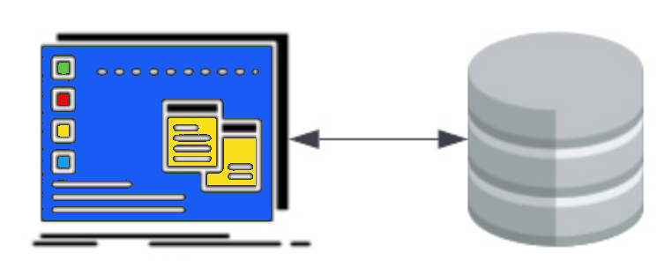
Flexible Deployment Options
SBS Cloud QMS
  SBS offers the full QMS suite in the cloud, including the Asset Tracking Database
  Accessible from any web enabled device
  Reduce IT costs
  Improve security and reliability
Locally installed versions
  Access-stand-alone version
    Single Access Database
  SQL based version
    User interface in Access / SQL back-end data storage
    Better data security and reliability
    Better access control

Slide 6

Demo Database Setup

Slide 7
Demo Software
SBS offers full-featured demo versions for customer testing and evaluation
Cloud Demo
  Contact us for access to SBS products in the cloud
  Email sales@SundayBizSys.com
Demo Download
  This demo is designed to be installed on a single computer or on your network file server for multiple user access
  Once purchased, you may register the demo database and save your activity
  Ensure all Workstations have
    Microsoft Access or the free Runtime version of Microsoft Access
    Read and write privileges to the designated folder on the Network File Server
  Note that the SQL version is identical to the demo version, but requires some advanced installation
Note: The above graphic is for stand alone Access databases - SQL configurations are different

Slide 8
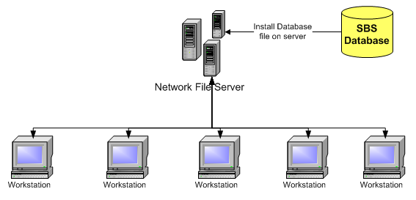
Demo Installation
Download the demo database
Extract the files and save them locally
Copy the Asset Tracking.accde file to a designated folder on your local computer or Network File Server
Open the Asset Tracking.accde file
Log in using Employee: Admin and Password: admin
Note: The above graphic is for stand alone Access databases - SQL configurations are different

Slide 9
Using the SBS Asset Tracking Database

Slide 10
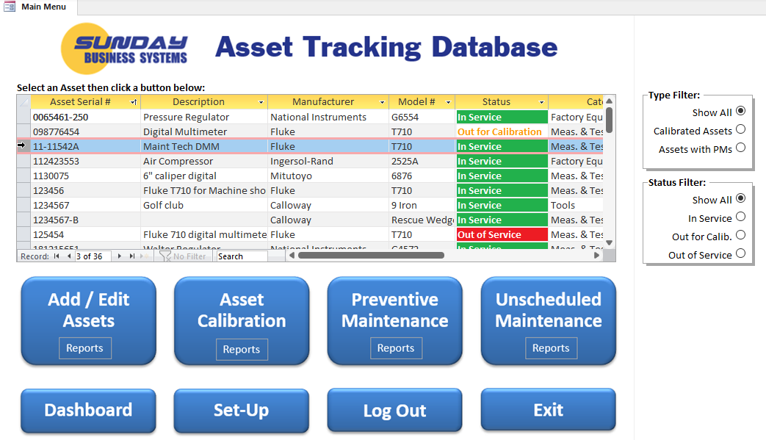
The Main Menu
Simple, intuitive main menu
Add a new Asset or
Find / filter and select an asset from the list
Then click the blue button of your choice

Slide 11
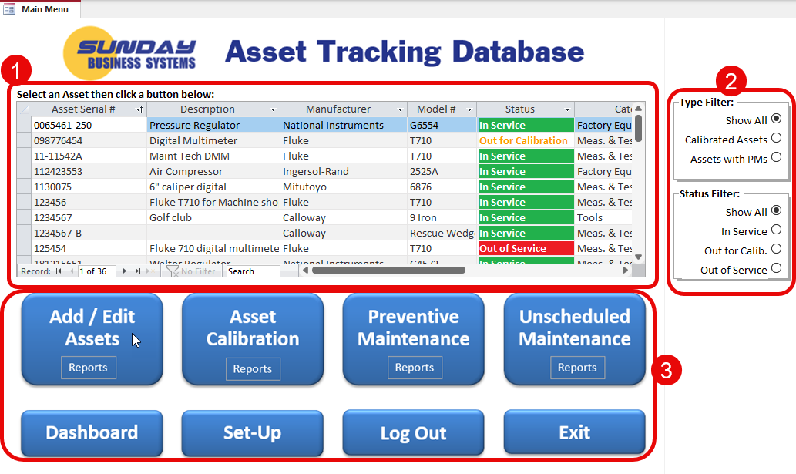
Using The Main Menu
List of Assets
Filters
Function Buttons

Slide 12
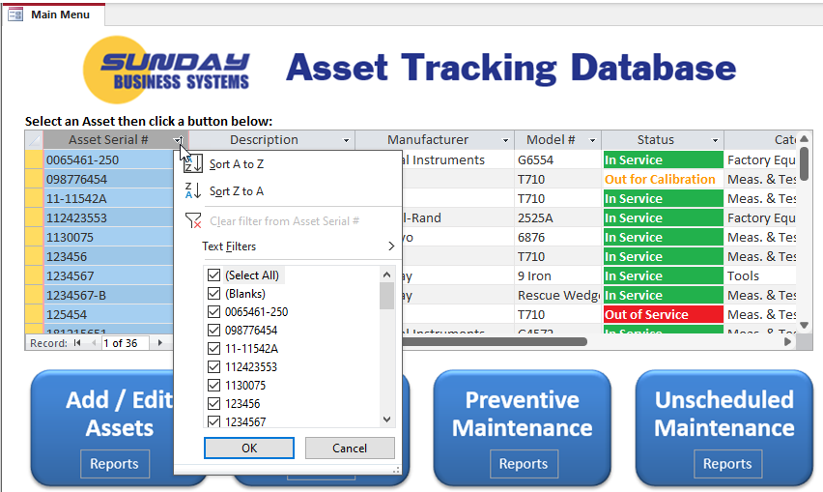
Using the Main Menu
Sort assets by any displayed column
Click to sort or filter

Slide 13
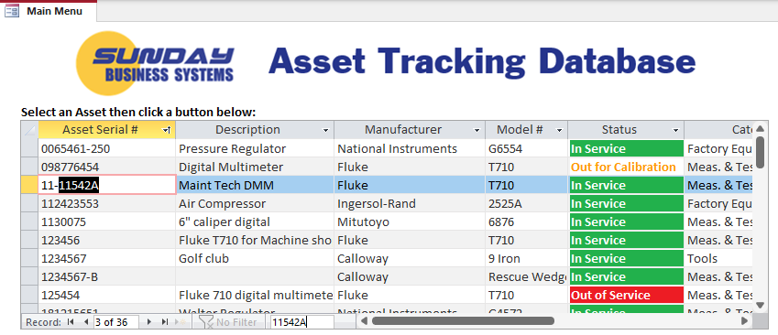
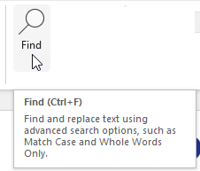
Using the Main Menu
Search / find an asset
Enter search string
Navigation buttons
NOTE: The Find function is also in the top ribbon or Ctrl-f

Slide 14
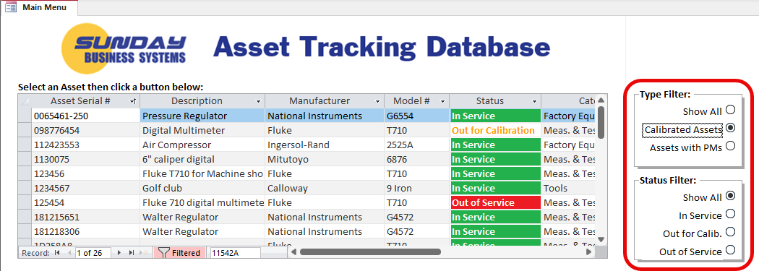
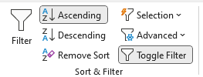
Using the Main Menu
Filter by type and status
Filter by Type of asset
Filter by asset Status
Indicates that the form is filtered (only particular assets are displayed)
Click to remove filter
NOTE: The Sort & Filter functions are also in the top ribbon

Slide 15
Conventions used in all SBS products
Form / Button Color | Meaning
Yellow background | Required field
Blue button font | Report or configurable reports
Orange button font | Close/exit
Green button font | Save / add new record
Red button font | Delete record
Black button font | Special function (e.g. open new form, filter, change view)
Feature | Meaning
* | Double-click the field nearest the “*” to open a linked form or auto-populate a date
Form View | Shows the form as designed with all features and subforms
Datasheet | The datasheet view makes the form look like a spreadsheet – double click on the rows’ record selector to return to form view

Slide 16

Asset Dashboard
Calibration and Maintenance Dashboard

Slide 17
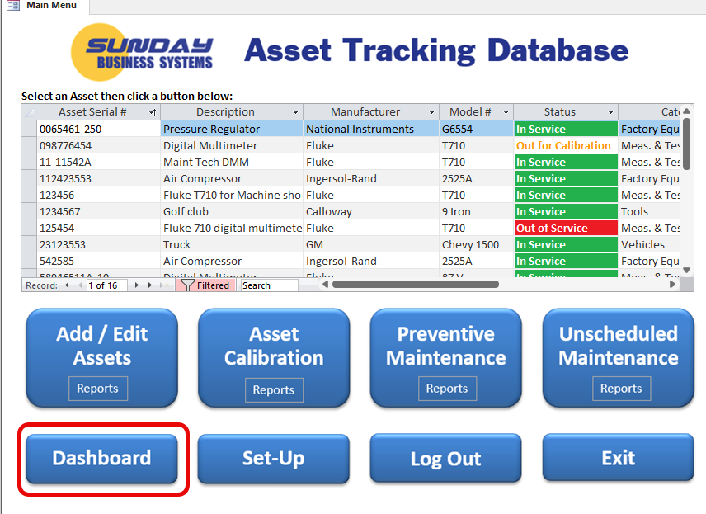
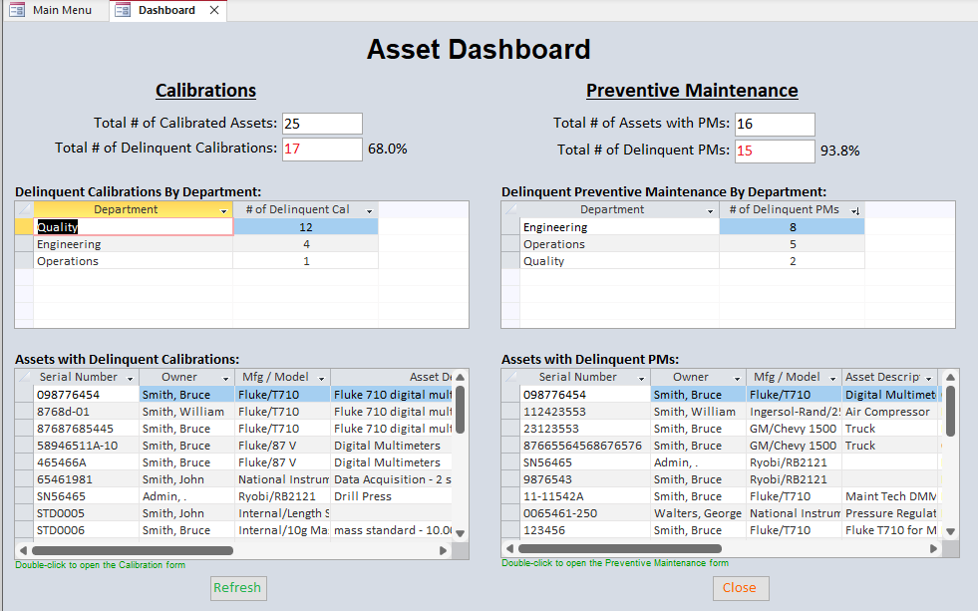
Dashboard
Get a quick and detailed view of your assets and delinquencies

Slide 18

Create a New Asset
Create new assets
Set-up the asset for calibration
Set-up the asset for preventive maintenance

Slide 19
Assets
Assets can be any material owned by the company
  Computers
  Furniture
  Vehicles
  Factory equipment
  Measurement and test equipment (special case for calibration)
Each asset has
  A unique serial number for tracking
    Two additional tracking numbers are available if needed
  A manufacturer and model
  An owner, department, and location for organizing and tracking
  An asset category such as “Measurement and Test Equipment”
Each asset may be further classified as
  Calibration required
  For Reference Only
  Preventive maintenance required

Slide 20
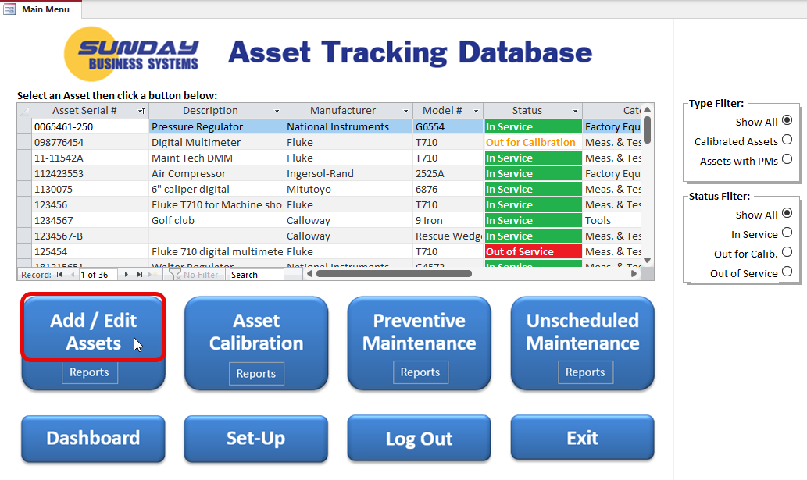
Add a New Asset
To Add a New Asset: Click the Add/Edit Assets button on main menu, then click the Add New button
To Edit an existing Asset: select the asset from the list then click the Add/Edit Assets button or double click the asset row record selector

Slide 21
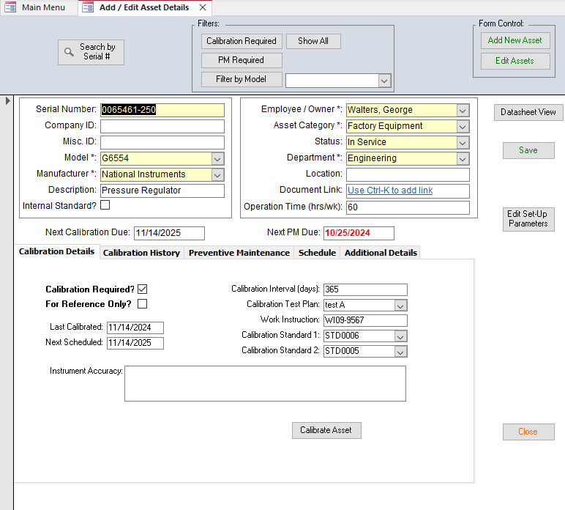
Create a New Asset
Click to add a new Asset
Click to unlock the form to edit an Asset
Enter Asset information
Fields in YELLOW are required

Slide 22
Create a New Asset
Serial Number is the key tracking parameter
Calibration and Maintenance info organized into 4 tabs

Slide 23
Create a New Asset Requiring Calibration
Check to define the asset to be used as an internal standard (i.e. gauge blocks)
Interval (in days) used to calculate next calibration due date
Option: Define calibration data to be collected (test plan)
Check to require Calibration
Specify a work instruction which details how to calibrate the Asset
Check to indicate the measurement device does not require calibration
Specify internal standards used to calibrate the asset

Slide 24
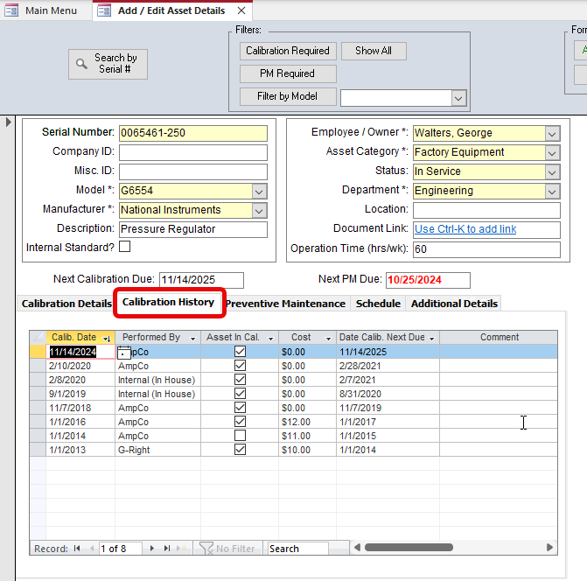
Create a New Asset – Calibration History
Shows the past Calibration Events

Slide 25
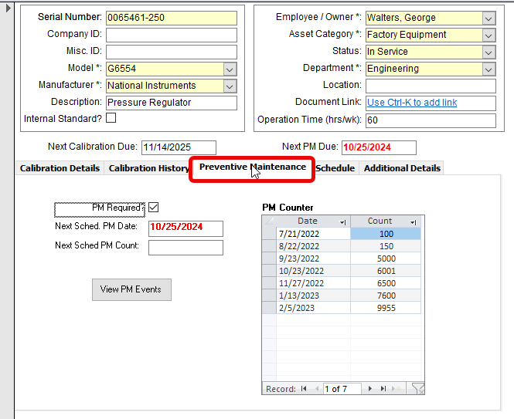
Create a New Asset Requiring Preventive Maintenance
Indicates that a PM is required
PM counter may be miles, KW-hrs, Machine hours, units produced, etc.
PMs may be time based…
…or based on a count
Click to view Maintenance History

Slide 26
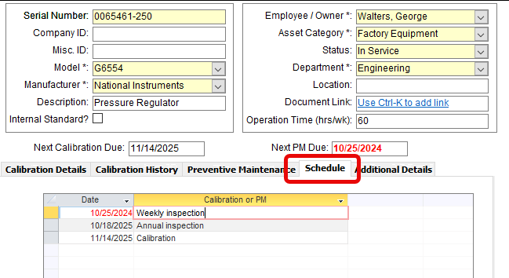
Create a New Asset – Schedule
The schedule shows all PMs and calibrations by date

Slide 27
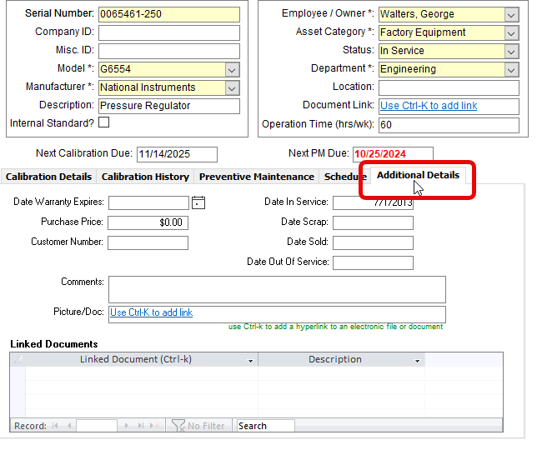
Create a New Asset – Additional Details
Add any relevant details for each asset
Use Ctrl-K keyboard short-cut to add any links to pictures, documents or manuals for future reference

Slide 28
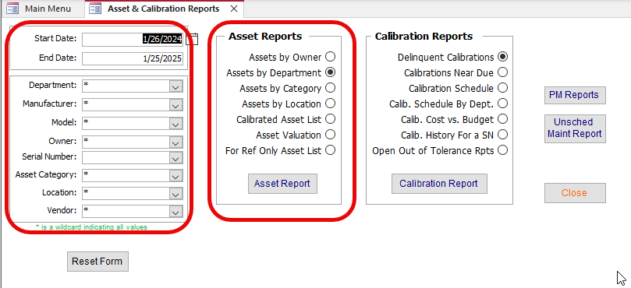
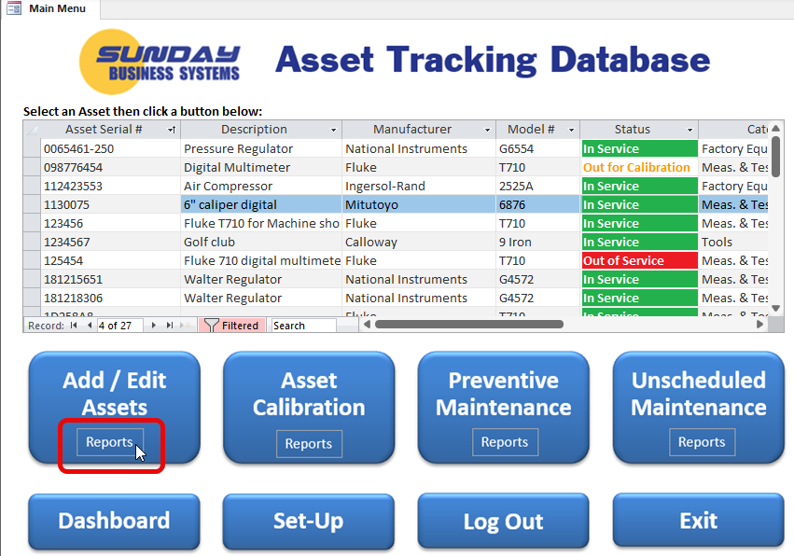
Asset Reports
View reports
Apply filters

Slide 29

Calibration
Record calibration events
Record data collection
Review calibration reports

Slide 30
Asset Calibration
Record calibration events
  When was it calibrated?
  Who performed calibration?
    Internally calibrated / verified
    Calibrated / verified by external laboratory (electronic certificate provided)
  In-house validation: What specific measurements were recorded?
  Did it pass?
    If not, generate an Out of Tolerance Report
  How much did it cost?
  When is the expiry date?
  Electronic Certificate may be linked to the event
Manage Calibration recall
  Generate reports to establish a recall schedule
  Prevent delinquent calibrations
  Monitor using the dashboard

Slide 32
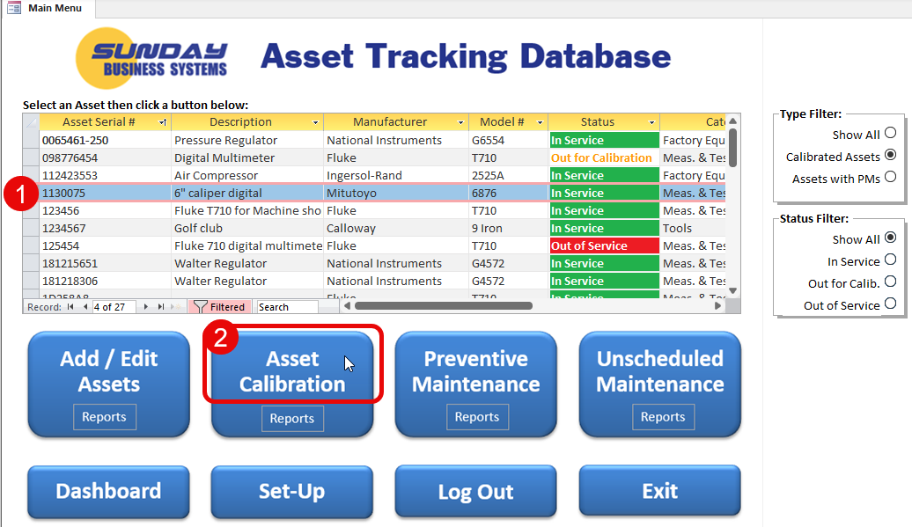
Record a Calibration Transaction
Select an asset for calibration from the Main Menu
  Use the filters / find to select the asset by serial number
  Click the Asset Calibration button

Slide 33
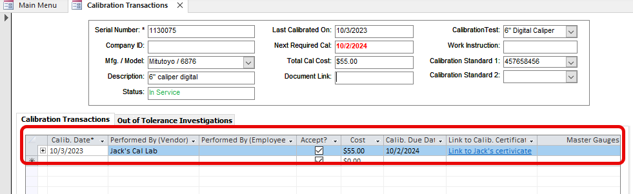
Record a Calibration Transaction – external calibration
Save the external service providers certificate on your file server (.pdf)
Record a new calibration transaction
Calib. Due Date drives the recall reports
Enter
Calibration record
Use Ctrl-K to create hyperlink to electronic document (PDF certificate)

Slide 34
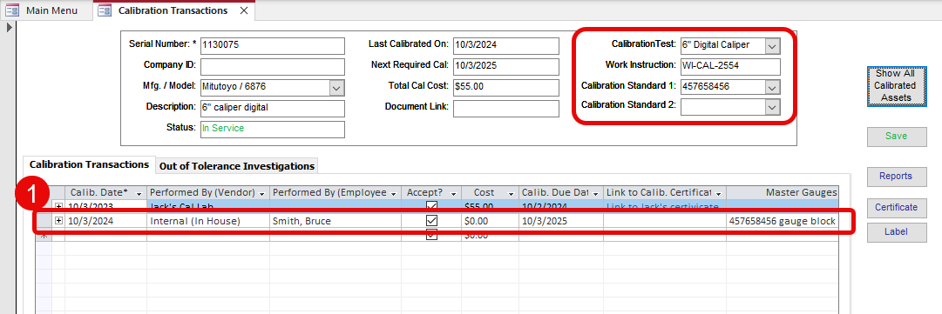
Record a Calibration Transaction – in-house verification
Trained & certified employee follows work instruction and uses defined calibration standards to perform verification
Record data as per the Calibration Test Plan
Pre-defined test plan, Work Instruction, and Calib. Standard
Enter Calibration Transaction details for In-House verification

Slide 35
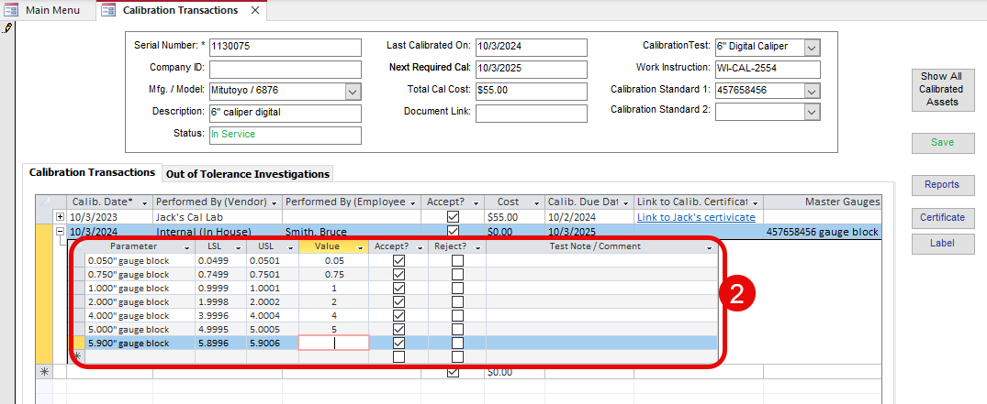
Record a Calibration Transaction – in-house verification
Select the “+” to open the data collection subform
Record detailed measurements as required by pre-defined Calibration plan
Click “+” to expand
Enter measurement results as required by the calibration test plan and work instruction
Results compared to spec limits and Accept/Reject automatically generated
Generate an official In-house Certificate and Label

Slide 36
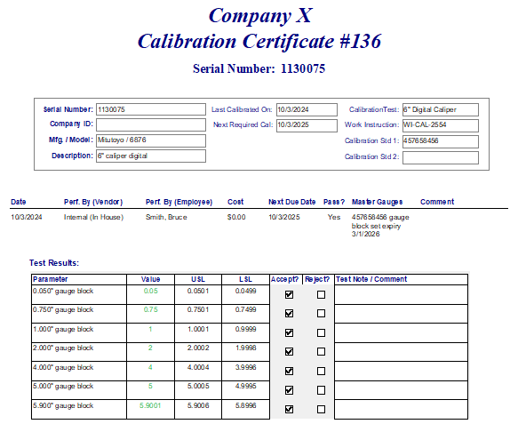
Record a Calibration Transaction – in-house certificate

Slide 37
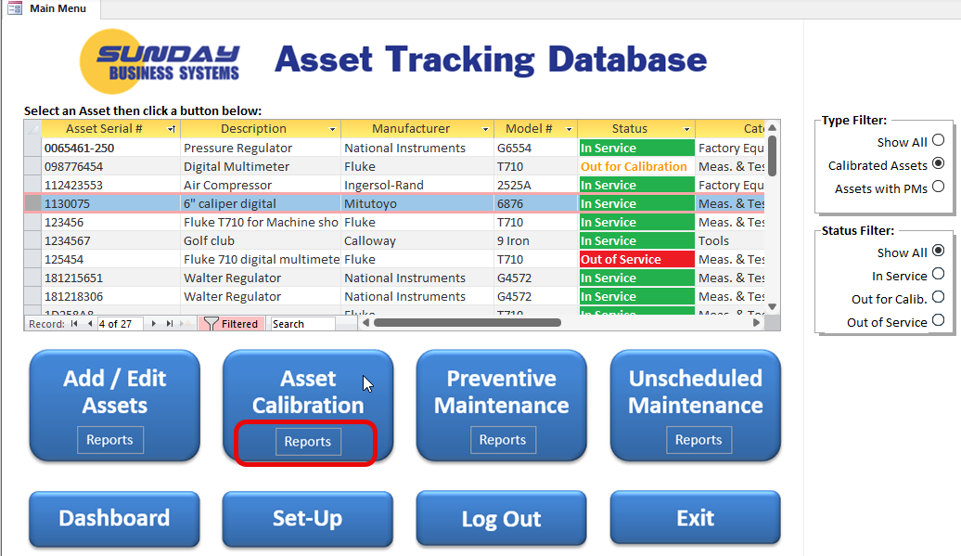
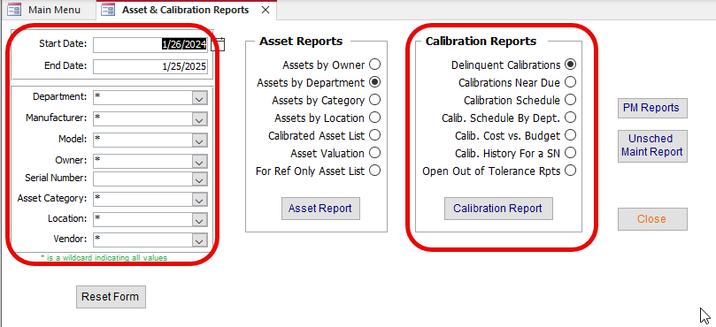
Calibration Reports
View reports
Apply filters

Slide 38
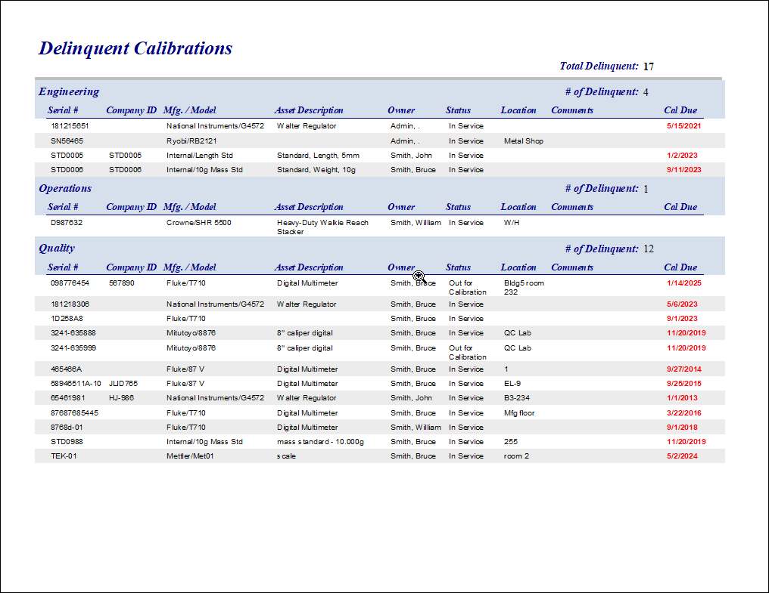
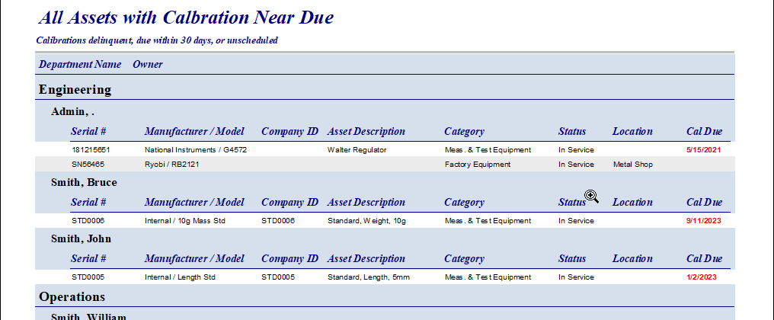
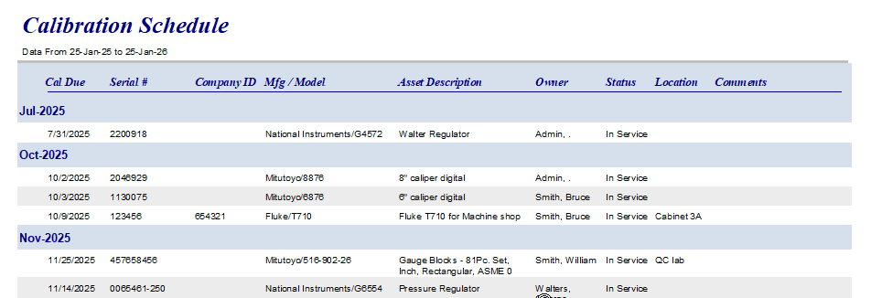
Review Reports
A rich set of flexible, configurable reports
Review Reports to manage calibration schedule
  Review all delinquent assets
  See all assets due within the next 30 days

Slide 39
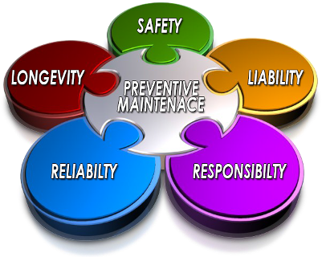
Preventive Maintenance
Add a PM
Create a PM Checklist
Add a PM transaction
Review PMs Near Due Report

Slide 40
Preventive Maintenance
PMs may be based on a count such as
  Operating hours
  Miles
  Parts produced
PMs may be based on a time interval
  Weekly (52 times per year)
  Monthly (12 times per year)
  Quarterly (4 times per year)
Use the set-up form to create a
  PM Frequency
  PM Checklist
  and then a PM Type

Slide 41
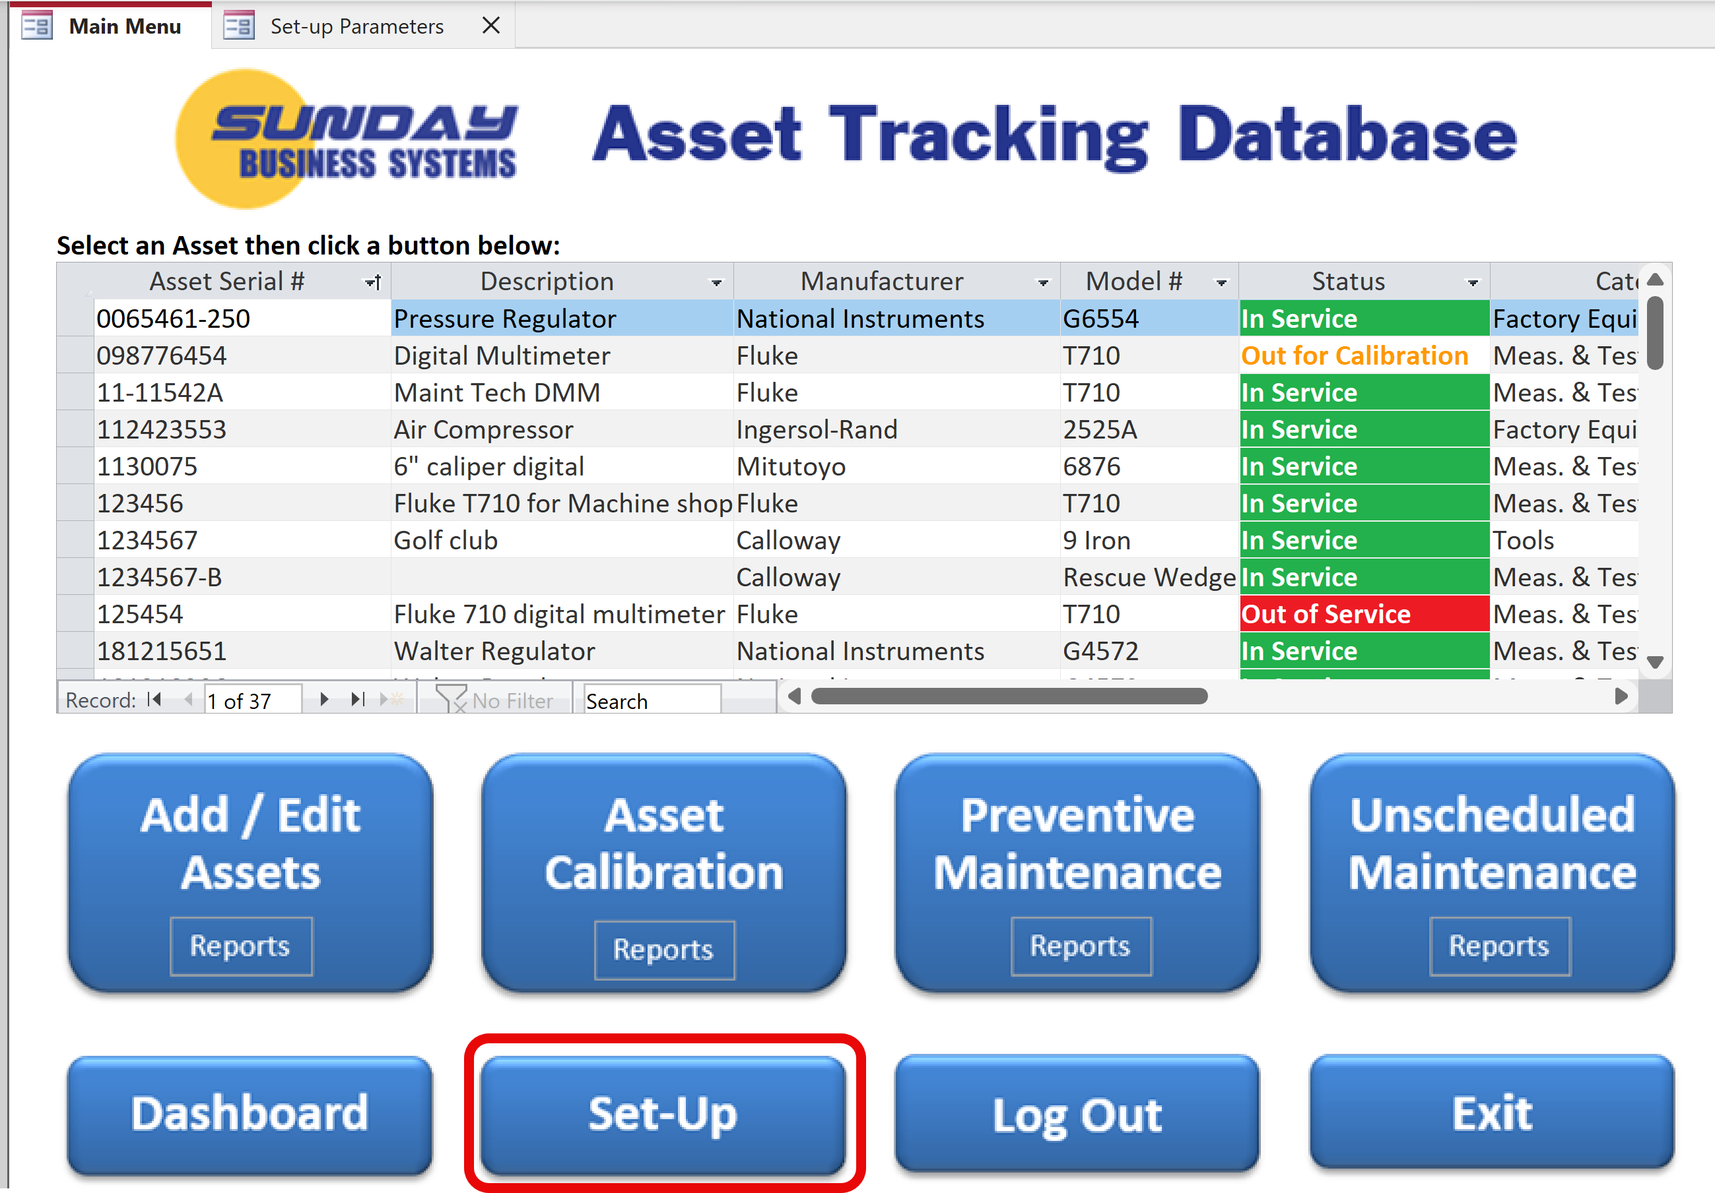
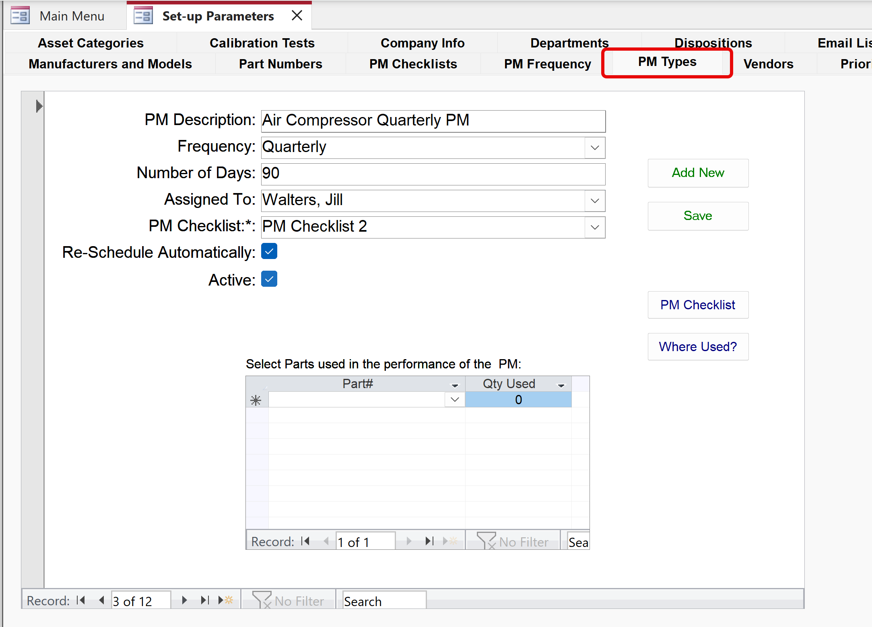
Create a PM (time based)
Enter PM Description or Name
Choose PM time-based Frequency
Assign the PM to an employee
Used to schedule the next PM
Optionally select an electronic PM Checklist
Once Complete, PM will be automatically re-scheduled X# of days in the future
Optionally create a list of parts that are required for this PM

Slide 42
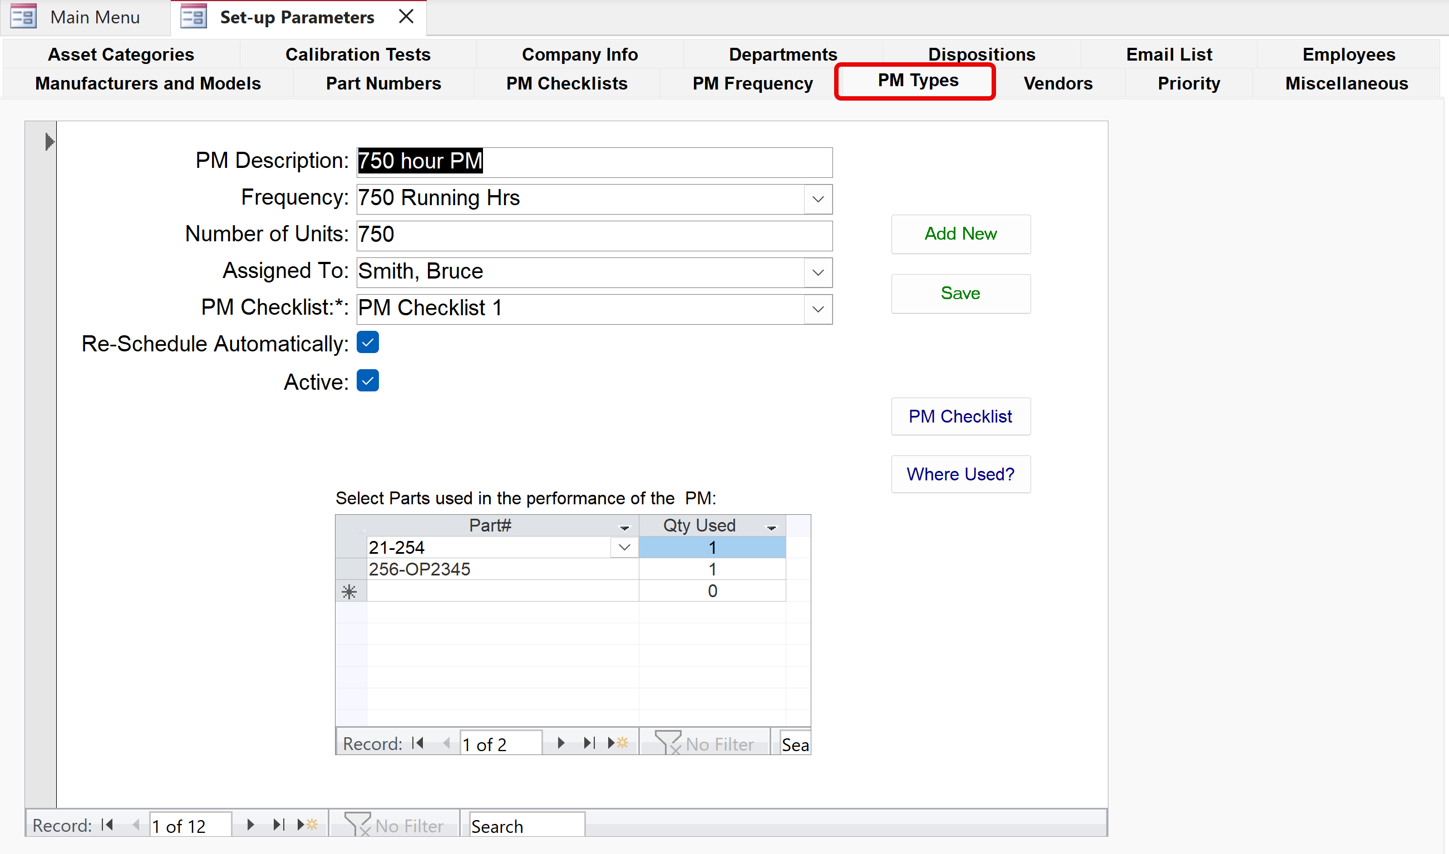
Create a PM (count based)
Enter PM Description or Name
Choose PM Frequency: time based or count based
PM will be automatically re-scheduled once it is marked complete

Slide 43
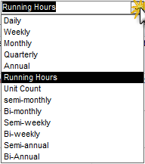
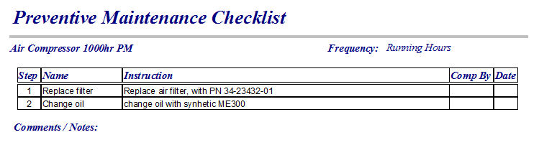
Create a PM
Enter PM Description
Choose PM Frequency: time based or count based
PM will be automatically re-scheduled once it is marked complete
PM will be due every 750 running hours
Print a simple PM Checklist

Slide 44
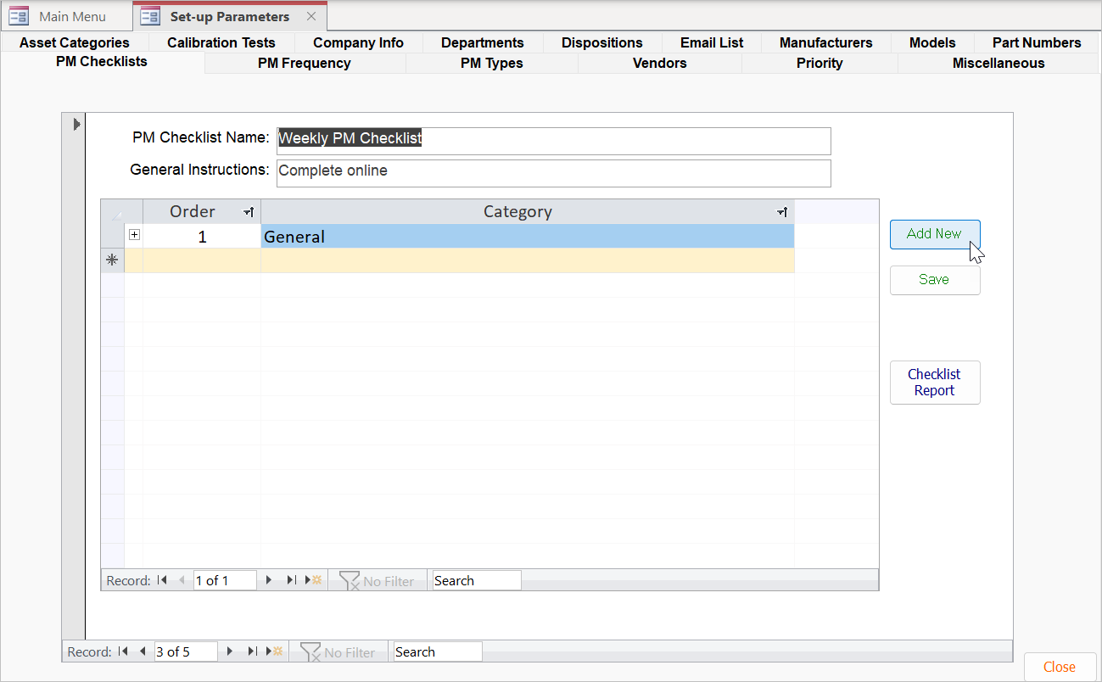
Set-Up – Create a PM Checklist
Add definition or delete
  Add detail or delete
Name and describe new PM Checklist
Click button to add new PM Checklist
Define at least one category of instructions, General category first.
Click record selector to save, or click Save button

Slide 45
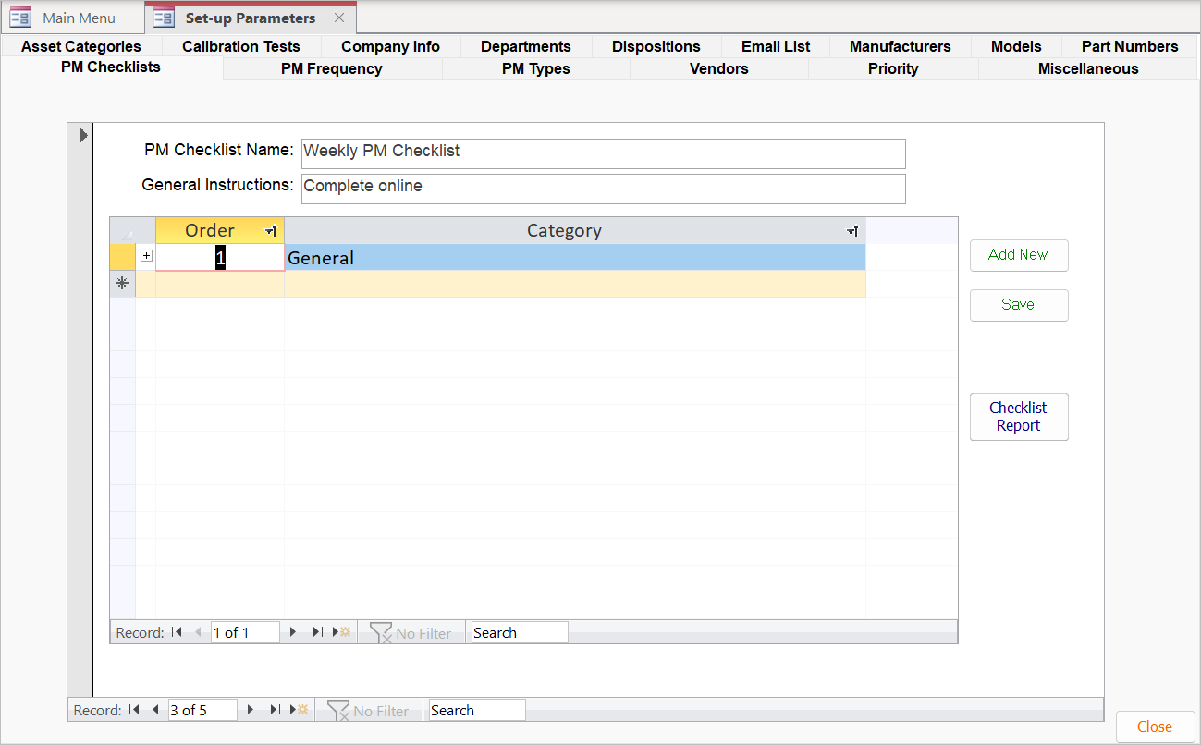
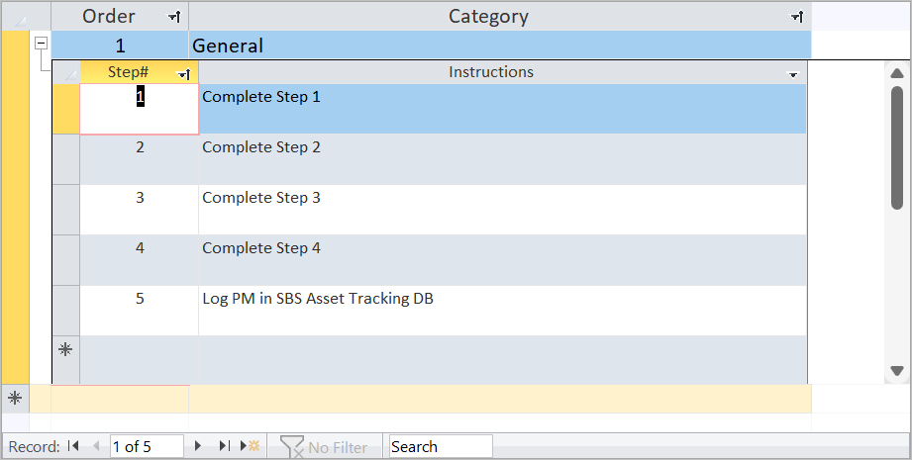
Set-Up – Add PM Checklist Instructions
Click the (+) button to add/edit/delete instructions
Enter Step Number and step Instructions
View Checklist Report

Slide 46
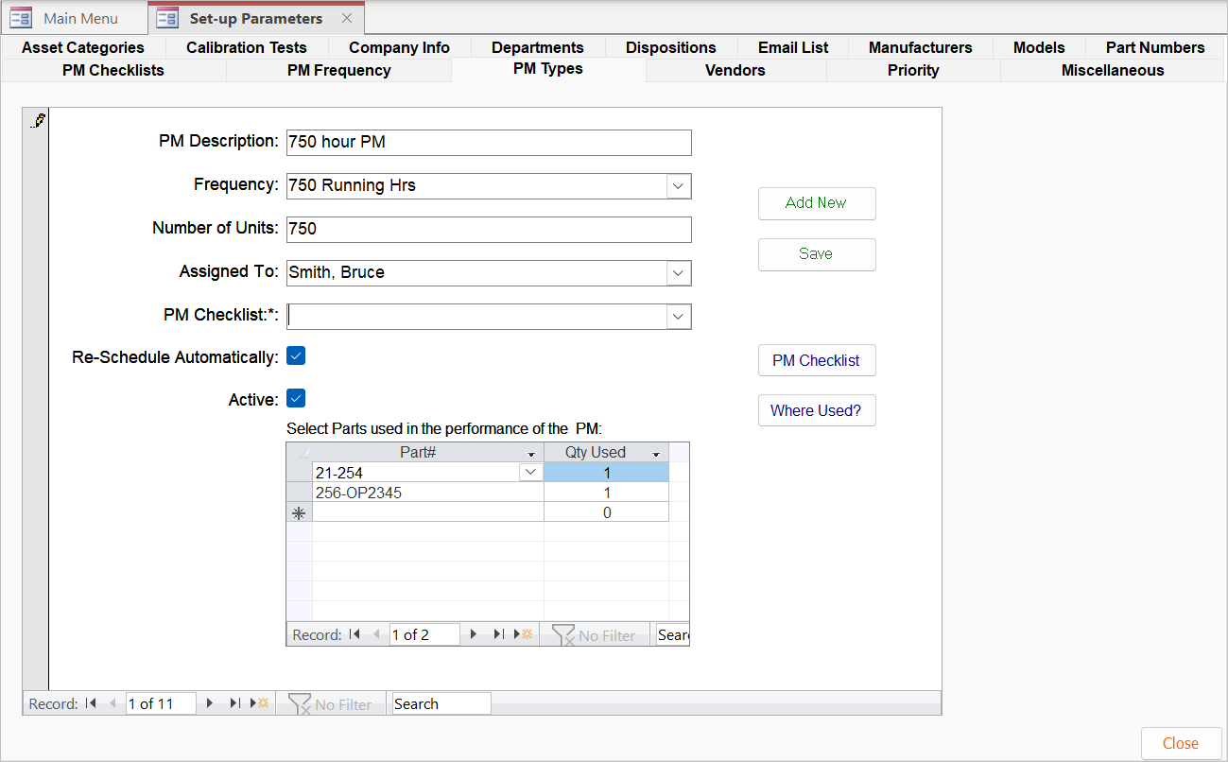
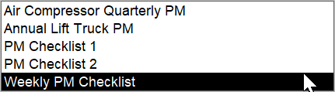
Set-Up – Assign PM Checklist to PM Type
View PM Types
View dropdown list
Select PM Checklist
Print PM Checklist

Slide 47
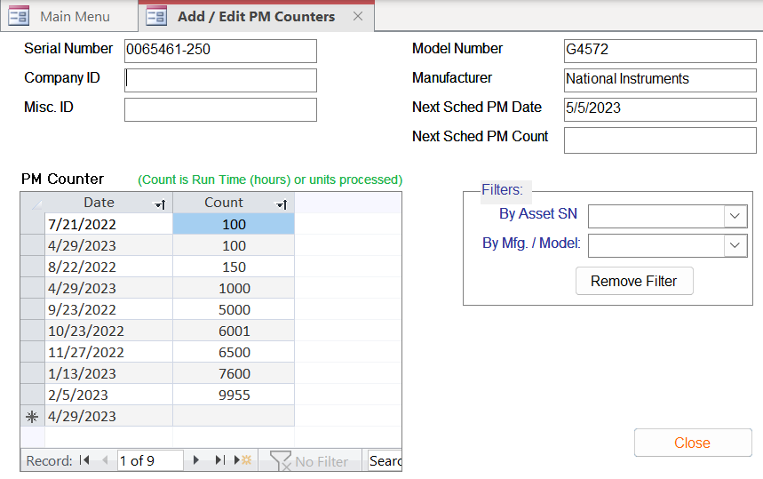
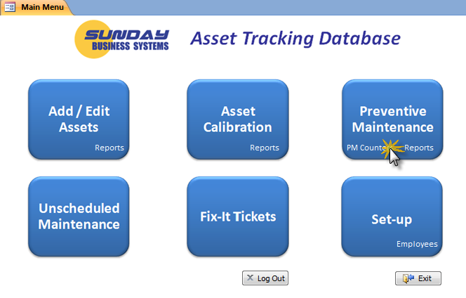
Update Asset Counters
Asset counters may be
  Running hours – the number or running or processing hours an asset or equipment has accrued from an arbitrary starting point.
  Unit Count – the number of pieces an asset has produced or completed
Enter the current Count (running hours or unit count)

Slide 48
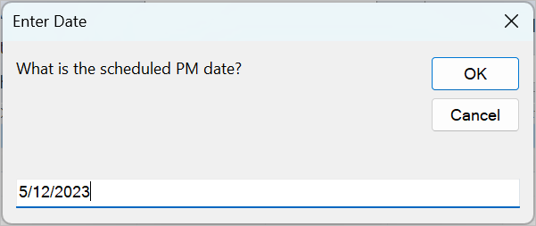
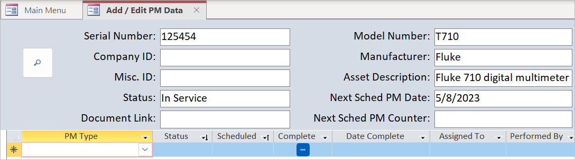
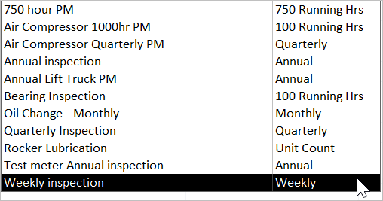
Assign PM Checklist to Asset
Enter PM date
For Status, choose Scheduled
Check when PM Checklist is completed
Double click to check off PM Checklist steps…
Choose the PM Type to be scheduled
View asset. Choose PM checklist

Slide 49
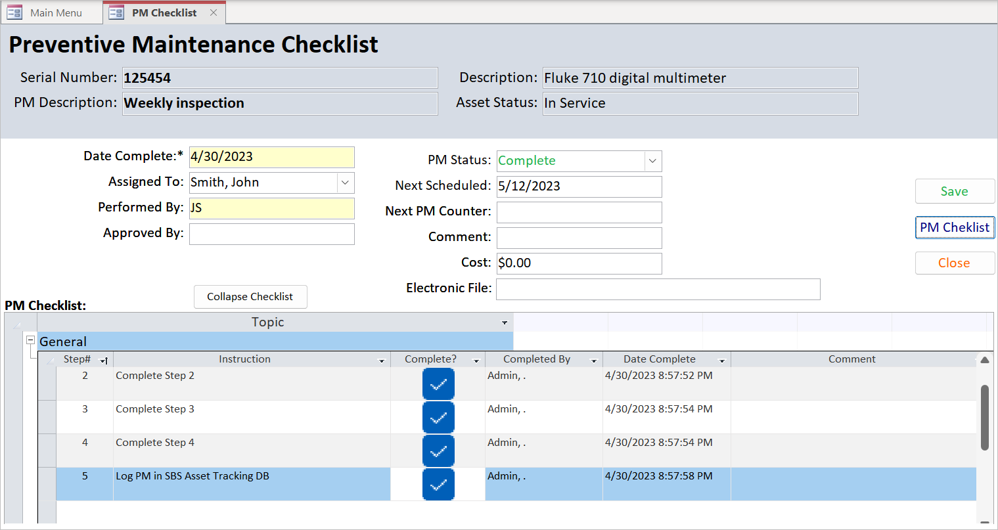
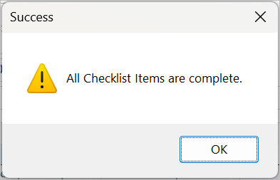
Assign PM Checklist to Asset — Slide 2
Click OK
Print PM checklist
Enter details
Optional: Add comments, edit details
Check off steps

Slide 50
Record a PM Transaction
PMs have a status that describes their state
First, PMs are scheduled for a future date (Date Next PM) or Count (Next PM Counter)
  Status = Scheduled
Then they are marked as Complete
  Status =
    Completed
    Waived
    Or Not Done
  If the PM Type is configured appropriately, the PM will be automatically re-scheduled for a future Date or Count (Next PM Counter)

Slide 51
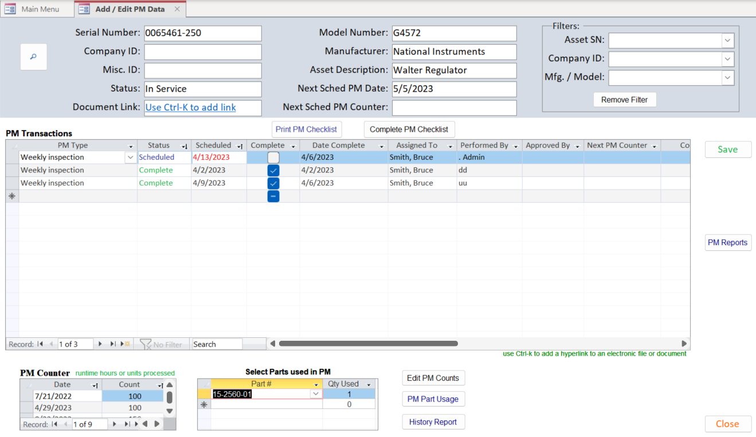


Record a PM Transaction
Double click record selector to open PM Checklist
Click to indicate a PM is complete
Enter the requested information to complete the PM

Slide 52




Review PM Reports
Review Reports to manage PM schedule
  Review all delinquent PMs
  See all PMs due within the next 30 days
  Review the PM Schedule

Slide 53

Unscheduled Maintenance
Create a Fix-It-Ticket
Record unscheduled maintenance
Review reports

Slide 54


Create a Fix-It-Ticket
Check to Add a Fix-It-Ticket and change the status to “Out of Service”
Print a Fix-it-ticket; affix it to the asset
Email a notice
Record a detailed description of the problem to be addressed
Reports

Slide 55
Create a Fix-It-Ticket
List of Open Fix-It Tickets for this asset
Open tickets must be completed or closed using the Unscheduled Maintenance form

Slide 56


Resolve the Fix-It-Ticket
Use the filter to find an Asset
Enter a Date to “close” the ticket
Document any parts used
Document what was done to resolve the issue

Slide 57
Summary

Slide 58

Summary
The SBS Asset Tracking Database is an efficient tool to
  Document and manage calibrated assets
  Track and document Preventive Maintenance activities
  Document Unscheduled Maintenance
Analyze results with a rich set of reports
Create paperless quality records
Maintain QMS compliance

Slide 59
Additional Services
Data Import Service
  Import legacy data from excel spreadsheets into your Database
Training Services
  SBS offers instructor led, Webex based, interactive training sessions
  We cover the following subjects:
    Database features and benefits
    General set-up and configuration
    Creating Preventive Maintenance schedules
    Documenting Calibration history
    Using reports to manage the PMs and Calibration process
    Microsoft Access tips and tricks
Customization
  Talk to us about customizing the software to meet your needs!

Slide 60
About SBS
Sunday Business Systems is engaged in software sales and consulting services to help customers maintain Quality Management System compliance.
Sells software solutions which help businesses implement ISO 9001, AS 9100, ISO 13485, etc. compliant systems for
  Document Control
  Corrective and Preventive Actions
  Risk Management (FMEA)
  Employee Training
  Control of calibrated equipment
  Preventive Maintenance
  Vendor Management
  Communication / Continual improvement
  Statistical Process Control
  Shop Floor Control
Will customize the software for a particular Customer
Offers full Training services customized to individual needs

Slide 61
Sunday Business Systems
Fueling Small Business Efficiency
Visit www.SundayBizSys.com for:
      Additional information
      Free product demos
      Pricing
      Links to purchase software
© 2019 Sunday Business Systems. All rights reserved. This presentation is for informational purposes only. Sunday Business Systems MAKES NO WARRANTIES, EXPRESS OR IMPLIED, IN THIS SUMMARY. Microsoft is a registered trademark of Microsoft Corporation in the United States and/or other countries.

